Slide 1
Denton County Correctional Health
A division of

Slide 2
Organization
Dr. Matt Richardson-Health Director
Juan Rodriguez-Assistant Health Director
Dr. Marty Buchanan-Health Authority/Medical Director
John Kissinger-Jail Health Administrator
Shannon Sprabary-Manager Kris Queen-Manager Renee Siegel-Manager-MH

Slide 3
Providing for the medical and mental health necessities of the inmate population in the county jail
Assimilate with jail operations
Certified Jailers
NCCHC certifications

Slide 4
Estelle v. Gamble, 429 U.S. 97 (1976)
Origin of prisoner’s rights to adequate healthcare.
The Supreme Court held that deliberate indifference to the serious medical needs of incarcerated people violates the Eighth Amendment’s prohibition against cruel and unusual punishment, constituting the unnecessary and wanton infliction of pain.
In an 8-1 decision written by Justice Thurgood Marshall, the court acknowledged that the Eighth and Fourteenth Amendments required the Texas government to provide medical care for prisoners

Slide 5
The Texas commission on jail standards
The Texas Commission on Jail Standards is the regulatory agency for all county jails and privately operated municipal jails in the state.
Assist local governments in providing safe, secure and suitable local jail facilities
Jail standards directly reflect the Texas Administrative Code Title 37 (public safety and corrections) Part 9
Chapter 273 addresses Health Services

Slide 6
37 Tex. Admin. Code § 273.1 - Health Services
The owner/operator of each facility shall provide medical, mental, and dental services in accordance with the approved health services plan. These services may include, but shall not be limited to, the services of a licensed physician, professional and allied health personnel, hospital, or similar services.
RULE §273.2 specifies 15 requirements of this plan

Slide 7
37 Tex. Admin. Code § 273.3 - Health Instructions
All medical instructions of designated physicians shall be followed
Dr. Buchanan is the Denton County Health Authority and the Medical Director of Denton County Correctional Health

Slide 8
Credentialing
Multidisciplinary
Administrative Support
Medical assistants
EMTs
Pharmacy technicians
LVNs
Paramedics
RNs
QMHPs

Slide 9
Services and evolutions
Jail-Health is staffed by four 12 hour shifts providing 24 hour coverage
Intake Assessments
Medical history and triage
Deferred for stabilization
Emergency Response
On-site stabilization/treatment
Opioid OD, CVA, MI, SZ…
EMS transfers if indicated
Acute therapeutic intervention
Florid psychosis/severe agitation

Slide 10
Services and Evolutions
Routine Sick-Call
Non-emergent
per request
Treatment protocols
100% Case manager QA

Slide 11
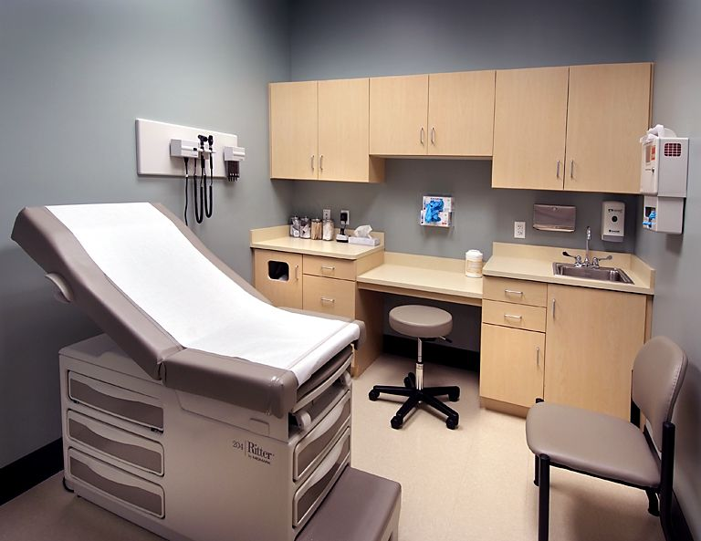
Services and Evolutions
Provider Clinics
Primary Care
Infectious Disease
Psychiatry/Telepsych
Women’s Health
Dental

Slide 12
Mental Health division
QMHP Duties
Risk assessments-routine and emergent
Follow-up assessments
Continuity of care reviews
Inmate administrative requests
Attend/assist psychiatry clinics
Discharge planning
4 QMHPs
1 QMHP shift-leader
1 Clinical Coordinator
1 Psychiatrist
1 NP-Psych (Telehealth)

Slide 13
Mental Health Services (cont.)
Psychiatry Clinic
Current clinic wait time 4-5 weeks-nonemergent
Emergent/urgent exams-priority; next clinic
Routine follow-up exams
Scheduled intervals
medication management
behavioral/security concerns

Slide 14
Mental Health Services (cont.)
Forensic Tracking
46.B Forensic waitlist 23
16.22 Total 71
16.22 Involuntary in-patient 28
16.22 Voluntary in-patient 16
Returned from the State Hospital 2
Compelled Rx orders 4

Slide 15
Telepsychiatry
Implemented March, 2023
300 clinic hours completed
400 patients evaluated to date
clinic wait times reduced 70%
Significant budgetary impact
cross-clinic usability of technology

Slide 16
Medications
Average of 51% of the jail population on Rx
61% of which are psychotropic
2,600 Rx to 501 patients
1,100 psychotropics to 309 patients
3.5 rx/mental health patient

Slide 17
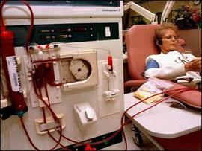
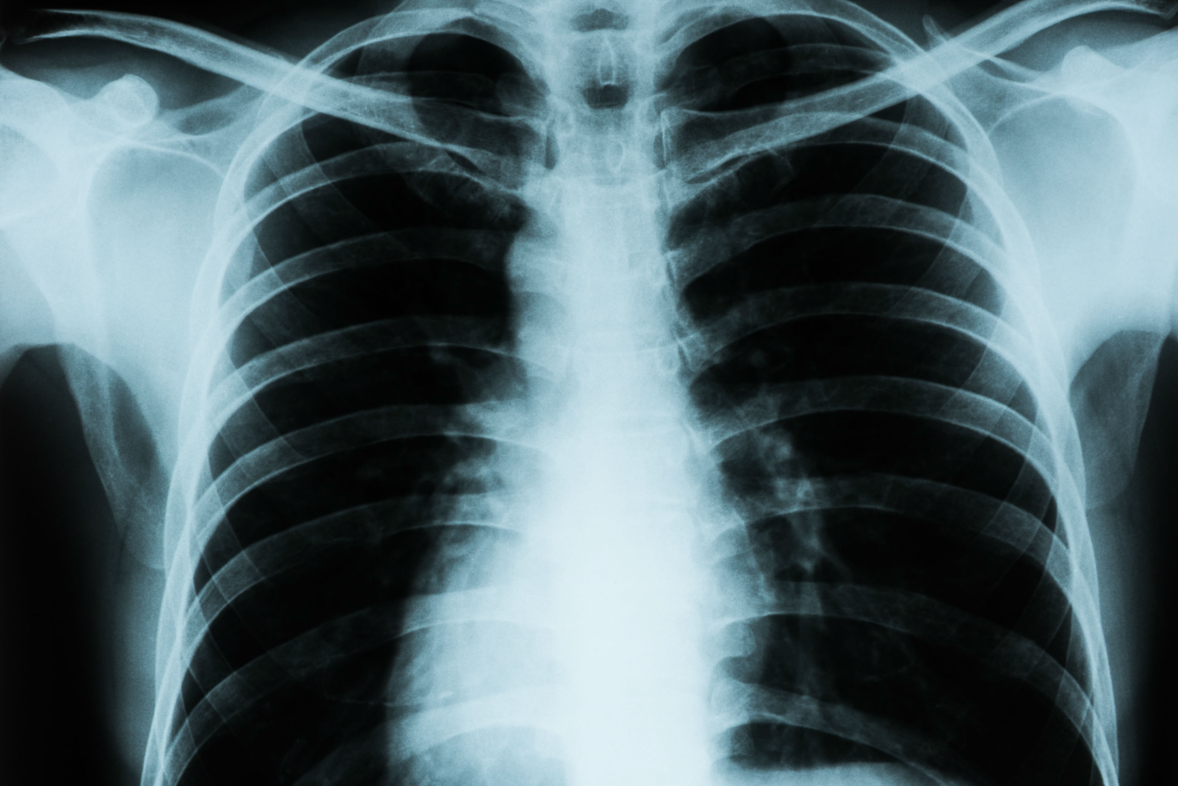
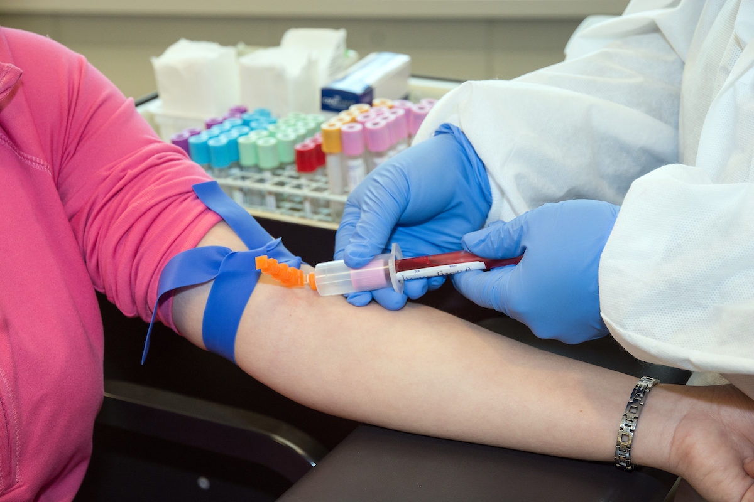
Inside -the -wall services
Labs, x-rays, Imaging, In-house sono. Dialysis
Point of Care Tests
Phlebotomy
X-ray/ultrasound
Dialysis
Physical Therapy

Slide 18
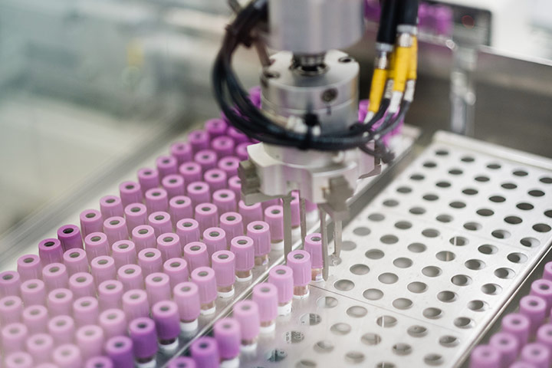
In-House services
225 studies YTD
1500 studies YTD
4 patients treated YTD

Slide 19
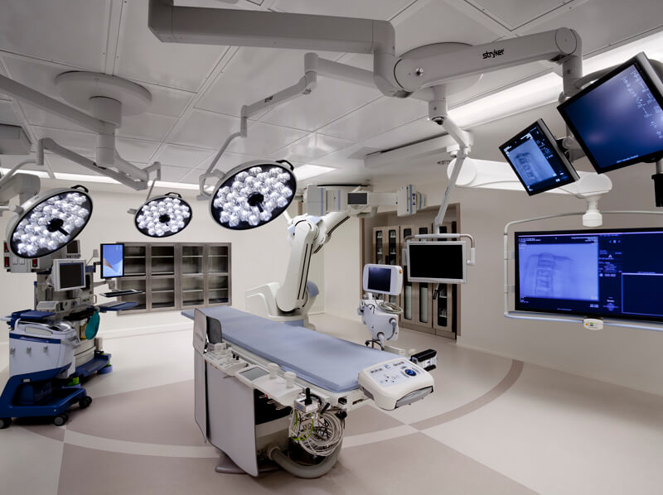
Outside –the- Wall services
Hospital Admissions
Surgery
Specialist Consultations
Chemotherapy/Radiation
CT/MRI

Slide 20
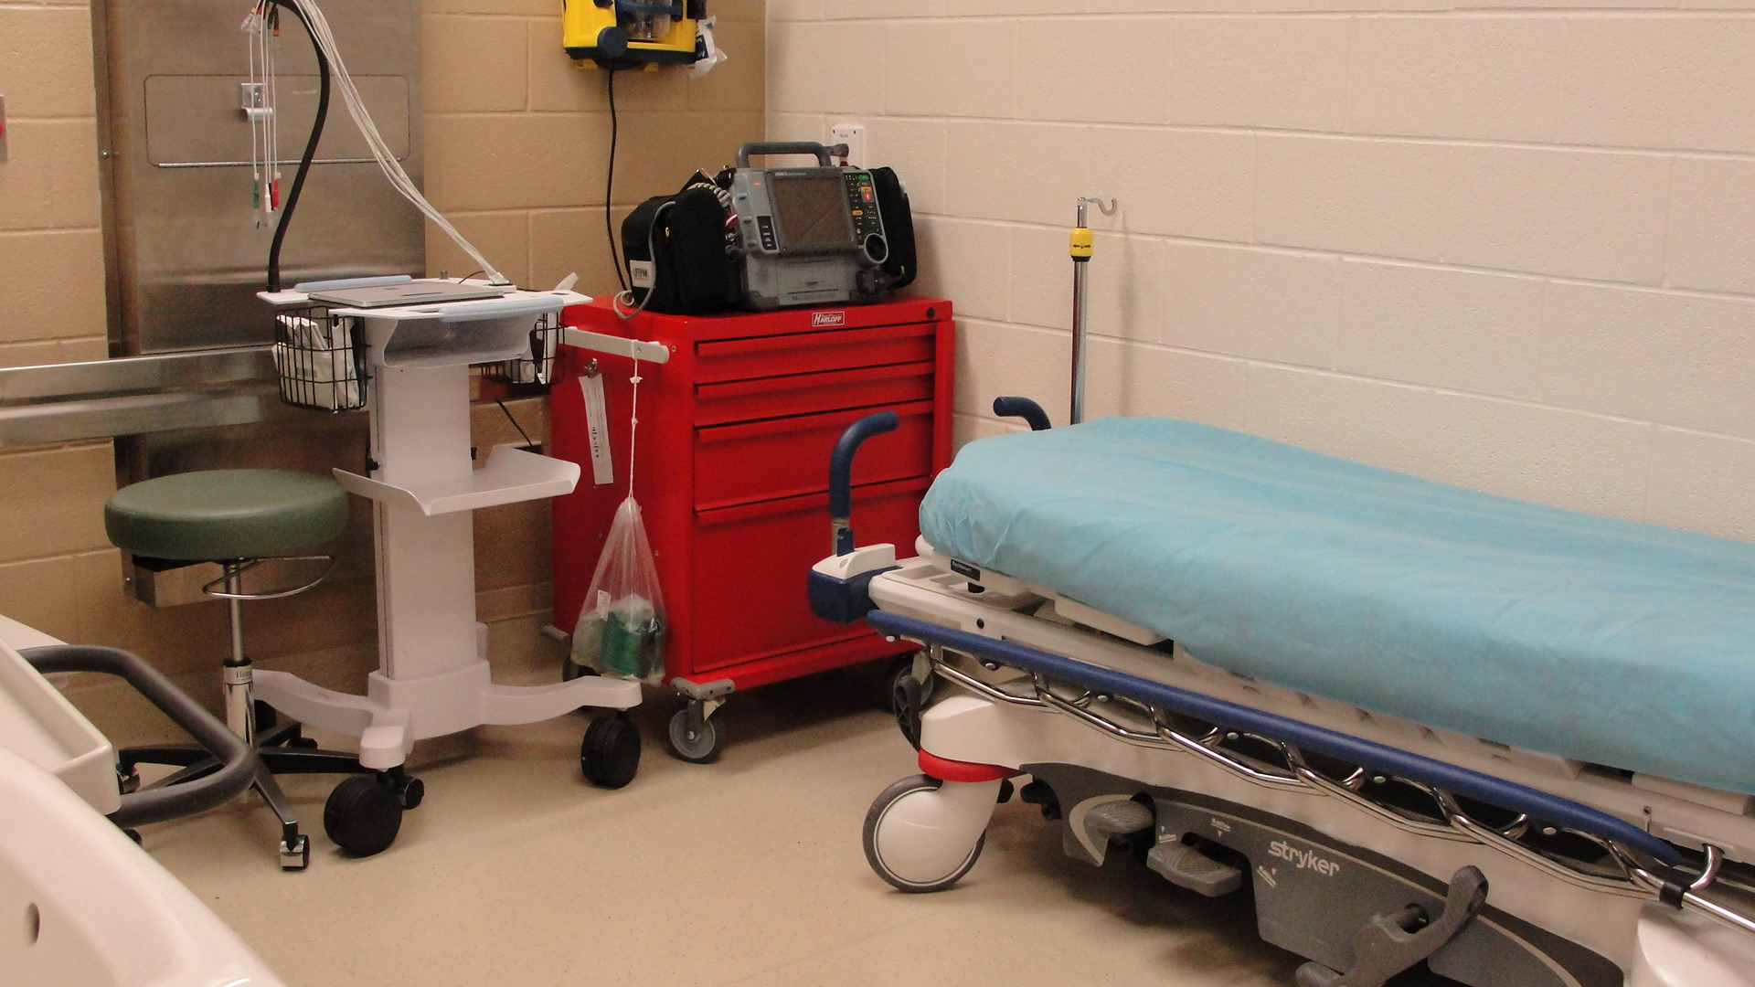
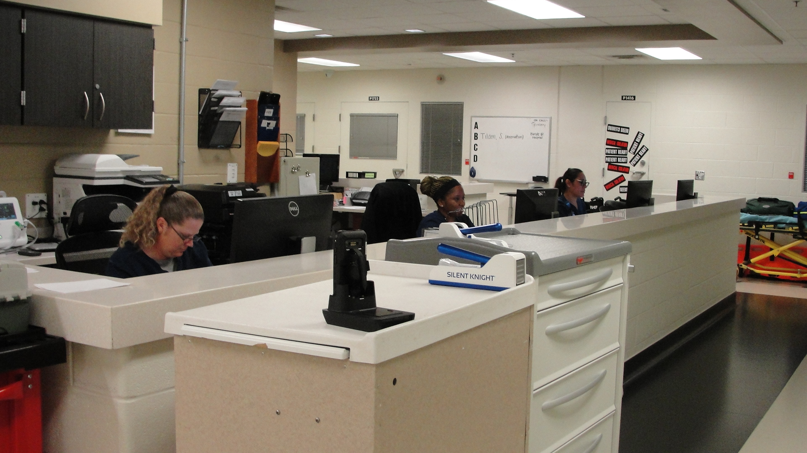
Daily Tasking
Shift change, phlebotomy, medication pass, sick-call, diabetic clinic, scheduling, documentation, medication pass, diabetic clinic, housekeeping, shift change, medication pass, diabetic clinic, phlebotomy, shift change,
Emergency Responses-Provider Clinics-Outside Appointments-Tuberculosis Testing- Vaccine Clinics-X-ray Clinics-Wound Care-Training- Medical Billing-Supply Ordering-Medication Processing-Dental Clinic-Medical Intake Assessments-Transfer Paperwork Processing-Court Testimony-Chart Review

Slide 21
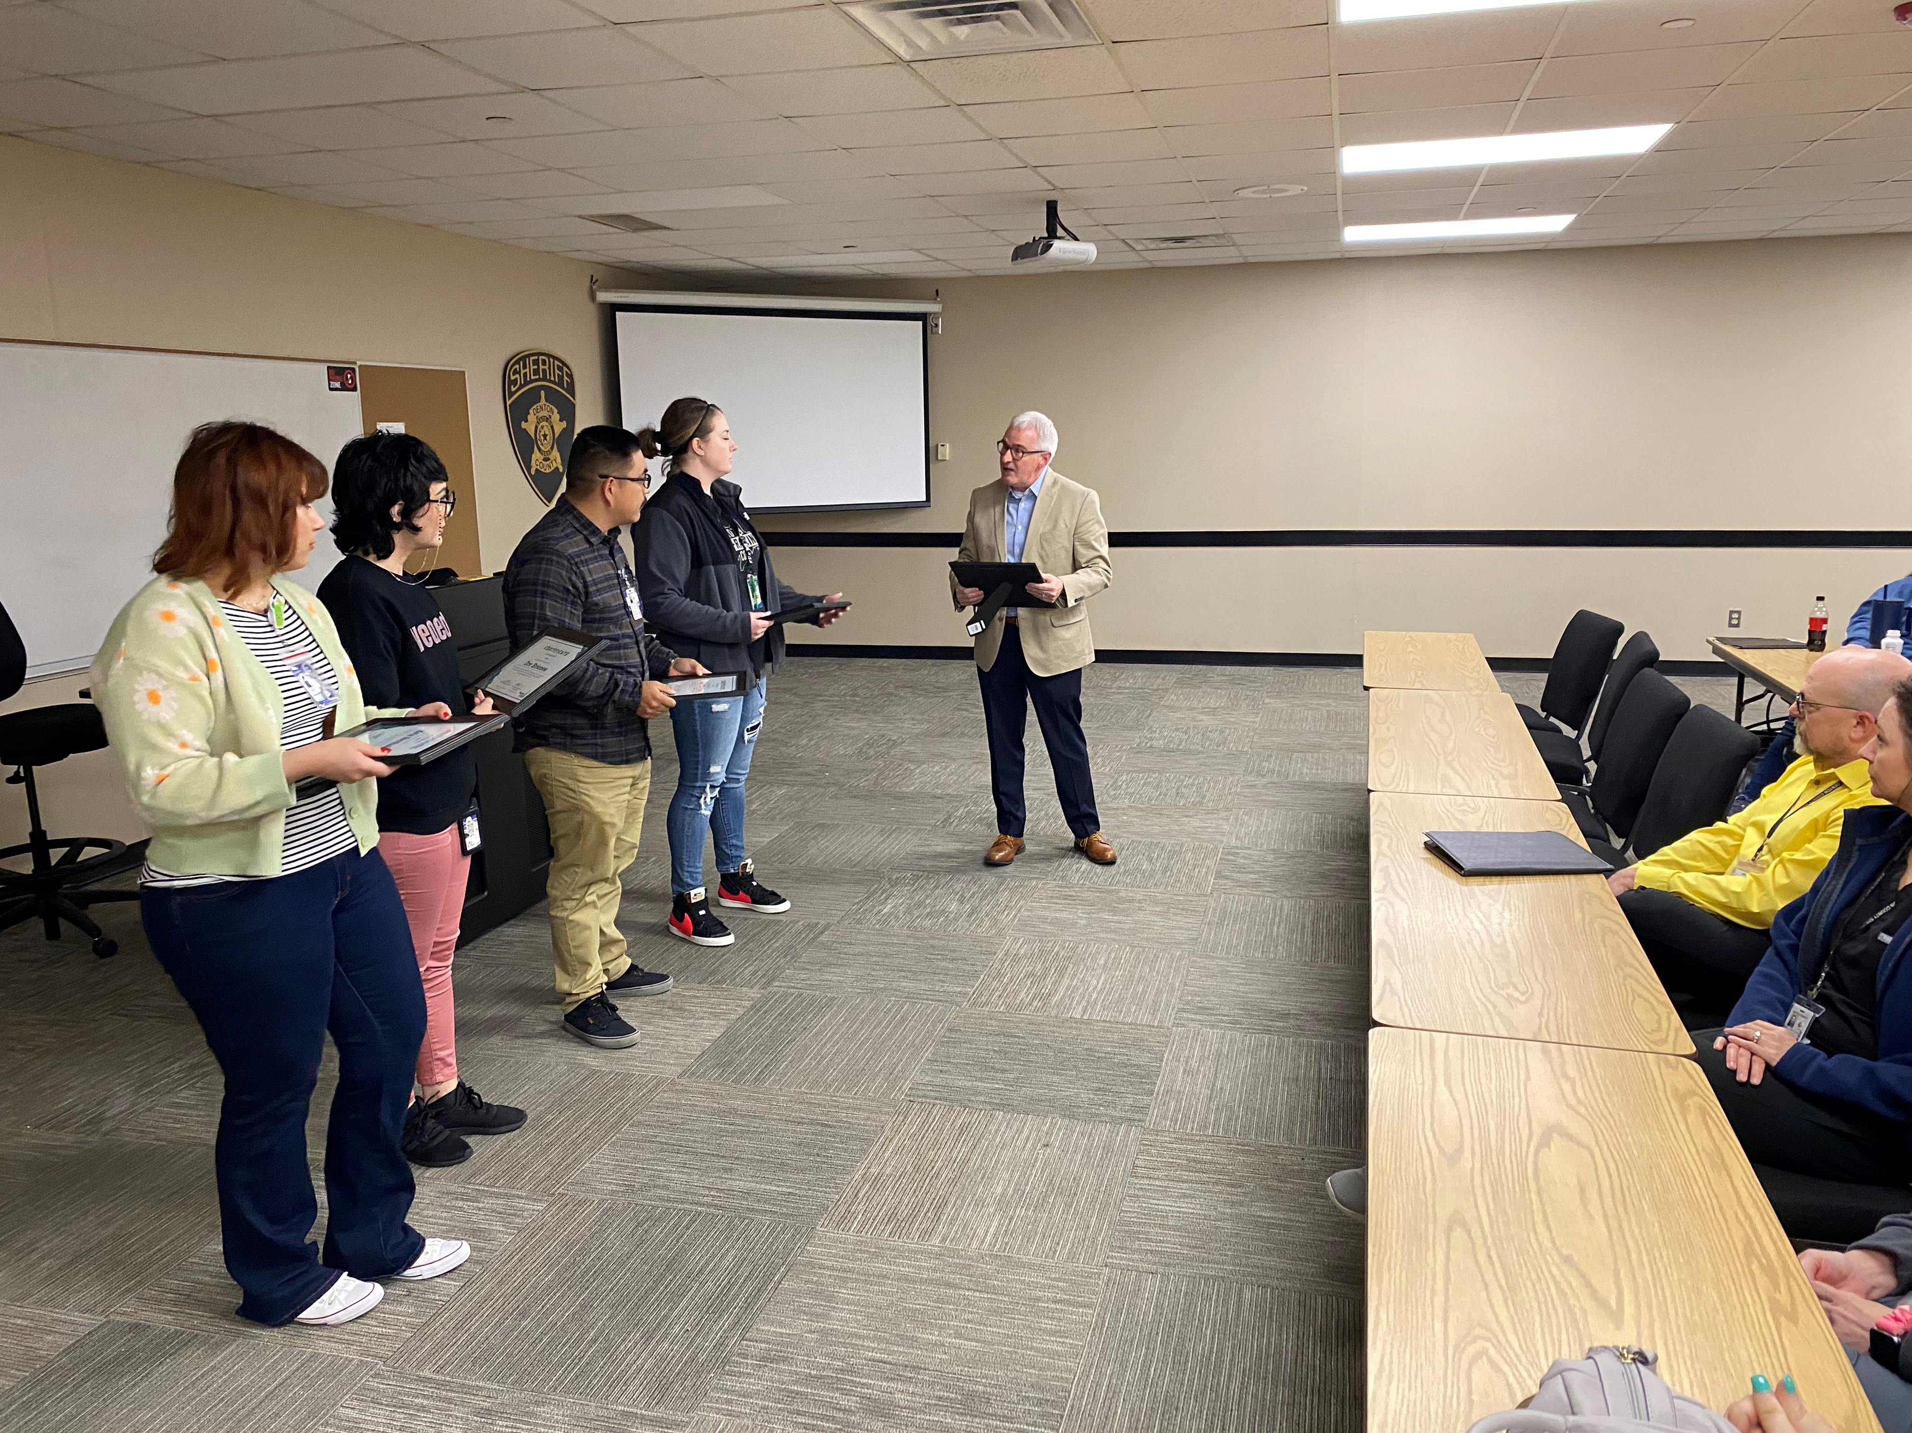
Continuous quality improvement
Required by Health Services Plan
Opioid toxidrome intervention
ACLS
BLS
Wound closure
General wound management
NCCHC Conferences

Slide 22
Demographics
FY22/23 To Date:
Medical Intake Assessments: 12,000
Scheduled nursing exams: 6,500
Scheduled lab tests: 1,500
Patient monitoring encounters: 25,000
Administrative actions 6000
Emergency Responses 350
Scheduled Psychiatry: 1000
Emergent Psychiatry: 450
Primary care exams: 450

Slide 23
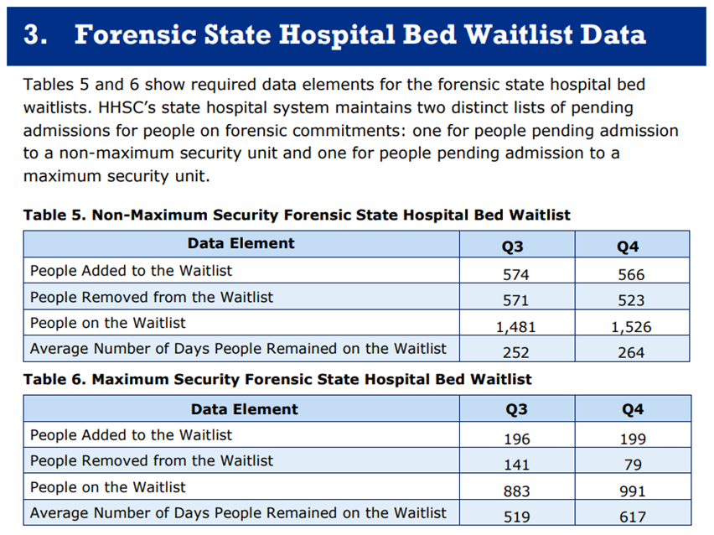
Forensic management
OCR/JBCR
HHSC monitoring and oversight
Staffing, education, reporting and housing requirements

Slide 24
Forensic Waitlist
Bed availability factors according to HHS
Staffing shortages
2500->1700 resulting in 315 bed vacancies
C19 backlog
<900 - > 2100
Reduced funding
65% forensic admissions
reduced revenue

Slide 25
Forensic Management alternatives
Sequential Intercept Model
Two prior workshops
Maps are tailored to systems
Intensive Outpatient Competency Restoration *
Involves community Services
Select candidates
Court Ordered Medications *
H&S 574
Select candidates
Mental Health Managed Counsel
Recognized by JCMH
Stakeholder commitment
Structured meetings
Jail Diversion
Specific patient qualifications
Dependent on local resources

Slide 26
Areas for improvement
Communication
Clearly define goals
Exchange of information
Provide details
Collaboration
Pledge time/resources
Commit to programs
Respect professional boundaries
Be mindful of others obligations

