Slide 1
MENTAL HEALTH & JAIL Art. 16.22 and Beyond
The Next Frontier…

Slide 2
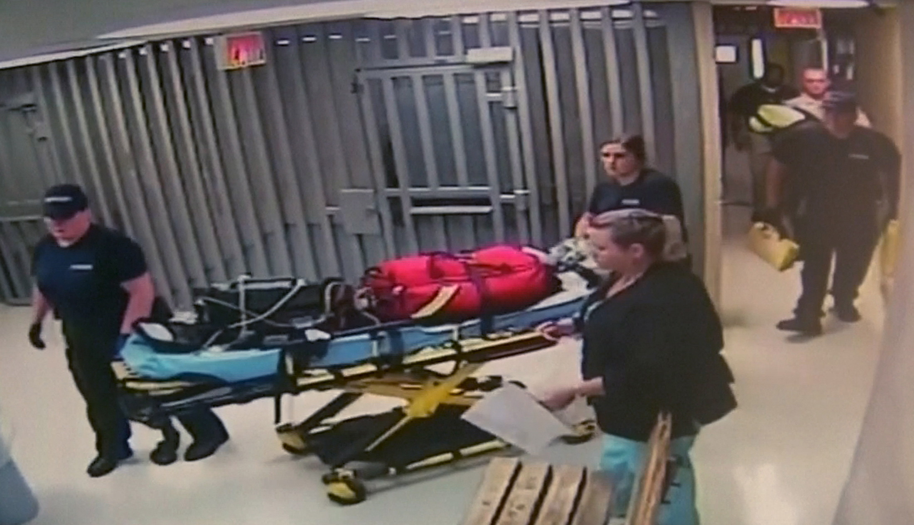

Slide 3
Sandra Bland Act (TCCP Art. 16.22)
While both TCCP Art. 15.17 and Art. 16.22 both existed well before the 85th Legislative Session…
The 85th Legislative Session implemented significant changes during the 85th legislative Session
Art. 16.22 of the T.C.C.P. became the embodiment of the “SANDRA BLAND ACT”
Additions and Modifications to Art. 16.22 were enacted by the 86th, 87th and 88th Legislatures.

Slide 4
85th Legis. Session - Senate Bill 1326: Amends T.C.C.P. Art. 15.17
SECTION 1. Article 15.17, Code of Criminal Procedure, is amended by adding Subsection (a-1) to read as follows:
(a-1) If a magistrate is provided written or electronic notice of credible information that may establish reasonable cause to believe that a person brought before the magistrate has a mental illness or is a person with an intellectual disability, the magistrate shall conduct the proceedings described by Article 16.22 or 17.032, as appropriate.

Slide 5
Changes: The 85th Legislative Session
While both TCCP Art. 15.17 and Art. 16.22 both existed well before the 85th Legislative Session…
The 85th Legislative Session implemented significant changes related to defendants in custody when an officer, jailer, magistrate or judge has reason to believe that a defendant has a mental illness or IDD
Art. 16.22 of the T.C.C.P. became the embodiment of the “SANDRA BLAND ACT”

Slide 6
86th Legislative Session
Re-enacted and shortened the time in which evaluations or interviews were to e conducted and alternatives for defendants who were unable to or unwilling to participate.
First outlined processes for release & transfer of case to mental health court under Ch. 574, Health & Code, for out-patient mental health services if offense is not assaultive
Provided for dismissal of offense and discharge by State’s attorney.
Substituted certain titles and words – such as “evaluation” to “interview” and “assessment” to “report”
Provided for payment of interview costs by County
Provided for ‘electronic” interview processes

Slide 7
87th Legislative Session
Further outlined processes by the trial court and resumption of criminal proceedings after Ch. 574 Health & Safety Code discharge
Allows judge of trial court to review and consider interview and expert’s report during punishment phase of trial
Allows judge of trial court to review and consider 16.22 interview and report prior to initiation of TCCP Art. 46B competency proceedings
Prior to trial on filed case, allows judge of trial court to refer defendant to speacialty court or allow release on bail if non-assaultive offense.

Slide 8
87th Legislative Session
Removes requirement that 16.22 process be initiated if defendant is no longer in custody
Allows release of defendant on personal bond without oath as required under TCCP 17.04, if the judge or magistrate finds the defendant has a mental illness or IDD
Expanded the list of persons or entities to which 16.22 report be provided to include:
sheriff or person responsible for medical records while confined;
any “personal bond office” (if applicable);
the director of the office or department supervising the defendant while on bail.

Slide 9
88th Legislative Session
Clarified application of Art. 16.22 processes related to Class C misdemeanor offenses
Permits, but does not require a judge to magistrate to order a 16.22 interview for defendants charged with fine only offense (Class C) under 16.22 (a)(1)

Slide 11
Step 1: Arresting Officer, Jailer or Sheriff Notification to Magistrate (TCCP 16.122)
The sheriff, a police officer or municipal jailer having custody of a defendant for an offense punishable as a Class B misdemeanor or any higher category of offense receives credible information that may establish reasonable cause to believe that the defendant has a mental illness or is a person with an intellectual disability.
NOT LATER THAN TWELVE (12) HOURS - The sheriff, a police officer or municipal jailer must provide written or electronic notice to the magistrate.
The written or electronic notice must include any information related to the sheriff's or municipal jailer's determination, such as information regarding the defendant's behavior immediately before, during, and after the defendant's arrest and, if applicable, the results of any previous assessment of the defendant.
NOTE: “Municipal Jailers” added, AND, no longer required to be “committed to the Sheriff’s custody.”

Slide 12
Sheriff/ Officer’s Notification and Screening Report
Sheriff Screens and prepares assessment form for defendants in custody
Transmits electronically or in writing assessment / screening to magistrate

Slide 13
Step 2: Magistrate Receives Notice and Required to Act (TCCP 16.22)
Magistrate required to review assessment and notice to determine if Defendant has a mental illness or intellectual disability
On a determination that there is reasonable cause to believe that the defendant has a mental illness or is a person with an intellectual disability, the magistrate, shall order the local mental health authority, local intellectual and developmental disability authority, or another qualified mental health or intellectual disability to:

Slide 14
Step 2: Magistrate Receives Notice and Required to Act (Cont.)
Mental Health Authority or Expert SHALL:
(A) collect information regarding whether the defendant has a mental illness as defined by Section 571.003, Health and Safety Code, or is a person with an intellectual disability as defined by Section 591.003, Health and Safety Code, including, if applicable, information obtained from any previous assessment of the defendant and information regarding any previously recommended treatment;
AND,
(B) provide to the magistrate a written assessment of the information collected under Paragraph (A) on the form approved by the Texas Correctional Office on Offenders with Medical or Mental Impairments under Section 614.0032(b), Health and Safety Code.

Slide 15
Assessment Not Always Required
Written assessment is not required if, within the last year, defendant already has been determined to have mental illness or intellectual disability
If defendant refuses to submit to information collection, then magistrate can order defendant to submit to an examination “in a jail or in another place determined to be appropriate” by the local authority “for a period not to exceed 72 hours” – instead of 21 days.

Slide 16
Step 3: Local Mental Health Authority Conducts Assessment (TCCP 16.22)
Local Mental Health Authority or Qualified Mental Health Expert conducts examination and evaluation of Defendant to determine if defendant has a mental illness or intellectual disability.
If the defendant fails or refuses to submit to the collection of information, the magistrate may order the defendant to submit to an examination in a jail or in another place determined to be appropriate by the local mental health [authority or local intellectual and developmental disability authority for a reasonable period not to exceed 72 hours.
NOTE: Examination no longer required in a “mental health facility” and must occur within 72 Hours – NOT 21 DAYS.
WITHIN NINETY-SIX (96) HOURS AFTER TIME ORDER IS ISSUED: Local Mental Health Authority or Qualified Mental Health Expert must provide assessment to magistrate if defendant still in custody. (30 days if released and no longer in custody.)

Slide 17
Assessment Form Prepared by Local Mental Health Authority
Local Mental Health Authority or Qualified Mental Health Expert examines Defendant
Completed Form Provided to Magistrate on Form Approved by Texas Correctional Office

Slide 18
Step 4: Magistrate Must determine if Personal Bond is Required or Allowed (TCCP 17.032)
A Magistrate SHALL RELEASE ON A PERSONAL BOND if:
(1) the defendant is not charged with and has not been previously convicted of a violent offense;
(2) the defendant is examined by the local mental health authority, or another qualified mental health expert;
(3) the expert, in a written assessment submitted to the magistrate under Article 16.22 , concludes that the defendant has a mental illness or is a person with an intellectual disability but is competent to stand trial; and recommends mental health treatment for the defendant;
(4) the magistrate determines, that appropriate community-based mental health services for the defendant are available; and
(5) the magistrate finds, after considering all the circumstances, a pretrial risk assessment, if applicable, and any other credible information provided, that release on personal bond would reasonably ensure the defendant's appearance in court as required and the safety of the community and the victim of the alleged offense.

Slide 19
Step 4 (Cont.): Treatment Required as a Condition If Released on Personal Bond
The magistrate, unless good cause is shown for not requiring treatment, shall require as a condition of release on personal bond that the defendant submit to outpatient or inpatient mental health treatment or intellectual disability services as recommended by the local mental health authority, local intellectual and developmental disability authority, or another qualified mental health or intellectual disability expert if the defendant's:
(1) mental illness or intellectual disability is chronic in nature; or
(2) ability to function independently will continue to deteriorate if the defendant is not treated.

Slide 20
Step 5: Magistrate Must Provide Copies of Written Assessment (TCCP 16.22)
The magistrate shall provide copies of the written assessment to defense counsel, the attorney representing the state, sheriff, trial court, and pre-trial supervision officer.
The written assessment must include a description of the procedures used in the collection of information under Subsection (a)(1)(A) and the applicable expert's observations and findings pertaining to:
(1) whether the defendant is a person who has a mental illness or is a person with an intellectual disability;
(2) whether there is clinical evidence to support a belief that the defendant may be incompetent to stand trial and should undergo a complete competency examination under Subchapter B, Chapter 46B; and
(3) any appropriate or recommended treatment or service.

Slide 21
Step 6: Magistrate Reporting Requirements
The magistrate shall submit to the Office of Court Administration of the Texas Judicial System on a monthly basis the number of written assessments provided to the court.

Slide 22
Step 7: Trial Court Responsibilities (TCCP 32A & 46B)
Upon receipt of assessment, TRIAL COURT (NOT THE MAGISTRATE) may :
Resume criminal proceedings and address release on personal bond if defendant is being held in custody
Resume or initiate competency proceedings under TCCP Article 46B
Use assessment in connection with punishment or conditions for community supervision
Refer defendant to appropriate specialty court

Slide 23
“The Challenge”
Jails are certainly not the ideal setting to evaluate and manage complex issues such as those posed by mental illness
In fact, jails are the perfect storm for mental health issues
The problem for magistrates, particularly in the context of magistrates for municipal jails is monitoring and follow-up without the benefit of case management through dockets and continuing contact.
Most magistrates rarely have the luxury of continued contact, docket settings or even continuing jurisdiction to manage any mental health evaluations ordered by them.

Slide 24
BUT PERHAPS…
THE NUMBER “23”
SHOULD COME BEFORE
THE NUMBER “22”…

Slide 25
T.C.C.P. ART. 16.23: JAIL DIVERSION
Art. 16.23. DIVERSION OF PERSONS SUFFERING MENTAL HEALTH CRISIS OR SUBSTANCE ABUSE ISSUE. (a) Each law enforcement agency shall make a good faith effort to divert a person suffering a mental health crisis or suffering from the effects of substance abuse to a proper treatment center in the agency's jurisdiction if:
(1) there is an available and appropriate treatment center in the agency's jurisdiction to which the agency may divert the person;
(2) it is reasonable to divert the person;
(3) the offense that the person is accused of is a misdemeanor, other than a misdemeanor involving violence; and
(4) the mental health crisis or substance abuse issue is suspected to be the reason the person committed the alleged offense.
(b) Subsection (a) does not apply to a person who is accused of an Alcohol offense involving use of vehicle, boat or airplane or intoxication manslaughter offense.

Slide 26
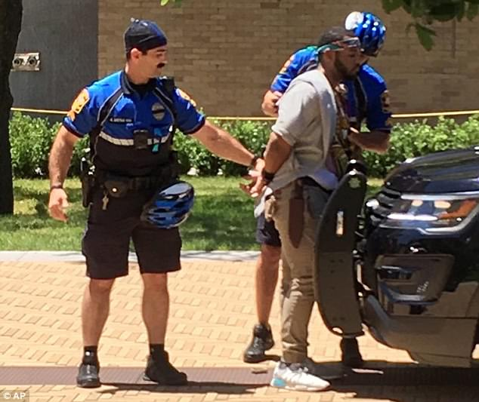
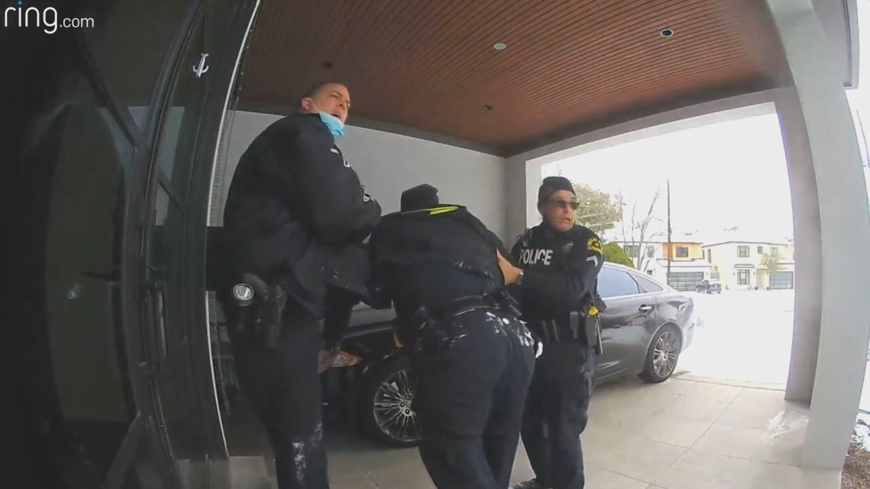
SPLIT SECOND DECISIONS AT GREAT PERSONAL RISK

Slide 27
No tougher job in the world…
Police face complex and serious problems on a DAILY BASIS
Our communities expect our front-line emergency responders to initially assess, react to, and be able to immediately distinguish between criminal acts and mental health issues
We expect our first responders to make correct mental health assessments
…In micro-seconds
…With little or no knowledge of context or personal history
…In fluid environments with multiple parties
And in many communities, without sufficient support or resources

Slide 28
DE-FUND THE POLICE??? How about, provide support instead…
As is true in all professions, training and education are key to improving performance and satisfaction
Police are FIRST-RESPONDERS… not treatment providers
We train peace officers to first protect victims and the community
Responding officers have to assess circumstances, identify parties and issues
Many situations are scenes of turmoil with people appearing out of nowhere
In many communities, officers cannot count on immediate back-up
Good officers are often demoralized by relatively low pay, high risk and lack of public support

Slide 29
Mental Health Crisis May Not Be Criminal But…
Often difficult to immediately distinguish between mental health issues, intoxication or criminal behavior
However, just because an individual may have mental health issues, does not mean they may not be dangerous to self or others
On the other hand, once a safe environment can be established, it is important to consider options or alternatives to arrest

Slide 30
MENTAL HEALTH / SOBERING CENTERS
Tarrant County Mental Health Diversion Court:
Tarrant County's mental health jail diversion center seeing success a year later - CBS Texas (cbsnews.com)

Slide 31
If the Justice System has anything, … It has time
An officer is not obligated to make an immediate or “on-view” arrest for what may appear to be criminal behavior
An officer is only obligated to arrest in circumstances of threat to community or victim safety or when a felony is committed in their presence.
Initial detention may be necessary to identify persons or calm the situation

Slide 32
MULTI-DISCIPLINARY TEAMS
Communities may have to come together to create 24- Hour teams available to respond to and support initial responders
Facilities will need to be appropriately staffed and provided with reasonable security
Significant funding and community investment

Slide 33
Available Mental Health Resources
Texas Judicial Council Resource Materials
Resources and information available through Office of Court Administration: www.txcourts.gov/oca/
Bench materials
Competency Restoration Checklist
Flowcharts for initial screening/assessment and competency restoration process

