Slide 1
Denton County LOSS
Jorden Clifton –LOSS Team Coordinator
jordenc@dentonmhmr.org
(940)205-6706

Slide 2
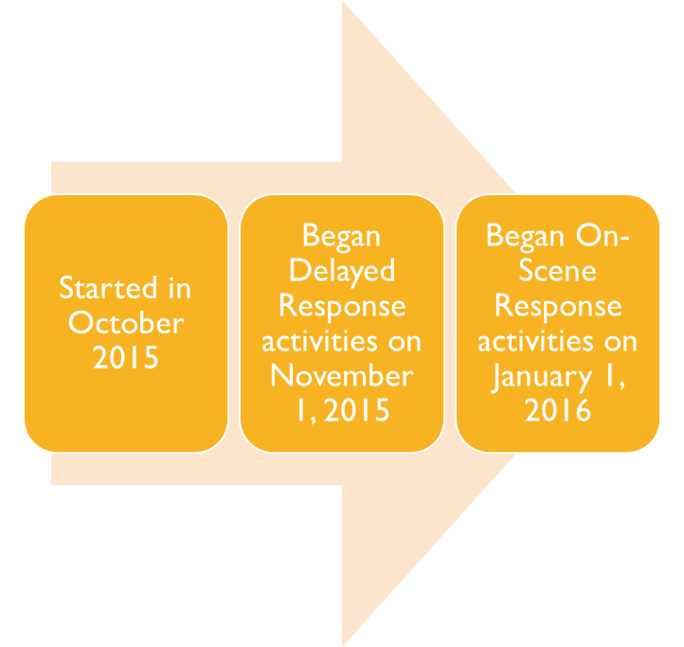
What is the Loss team
Local Outreach to Suicide Survivors
Offers support, resources and instillation of hope to individuals impacted by suicide in Denton County
Comprised of volunteers, one paid full-time staff, and one PRN staff
Funded by grants, fundraising and donations
Functions under Crisis as a service of DCMHMR

Slide 3
History
Dr. Frank Campbell, PhD, LCSW, CT: Developed the Active Postvention Model (APM)
Based on Dr. Edwin Shneidman’s concept of “postvention as prevention for the next generation”
Multi-generational impact of the legacy of suicide
Baton Rouge Crisis Intervention Center: Average length of time from death to seeking help pre-LOSS team: 4.5 years (Campbell, 2003). APM LOSS Team model: 39 days

Slide 4
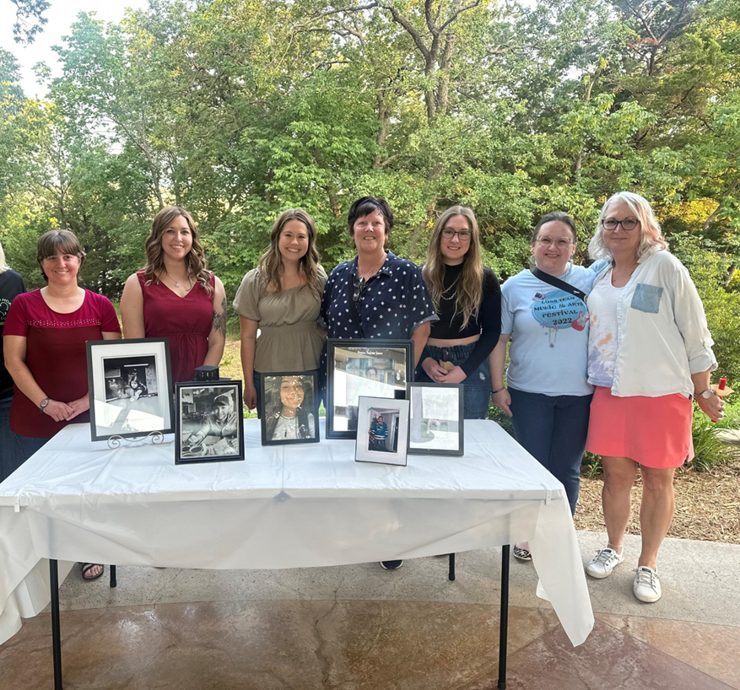
Loss duties
On-scene Response
Delayed Response
Follow up and support suicide survivors
Community Outreach
Education
Coalition Partnership

Slide 5
Why is Loss team important
Shock and Numbness
Denial
Search for reasons why**
Guilt and responsibility
Blaming and Scapegoating
Anger
Lack of social support

Slide 6
2022 Suicide Data
Age Range | Number of Suicides
Number of youth 18 and younger | 5
5 – 14 | 1
15 – 24 | 15
25 – 34 | 21
35 – 44 | 13
45 – 54 | 23
55 – 64 | 22
65 – 74 | 23
75 – 84 | 2
85+ | 3
123 Suicides
93 Males; 30 Females
100 Caucasians, 11 Hispanics, 6 Blacks, 6 Asians
75 GSW; 24 Hanging

Slide 7
Chuck bird
Loss volunteer

