Slide 1
C0Care: Community Care Crisis Intervention Unit

Slide 2
partnership
Notes:
CoCare was to be made up of
1- Supervisor (resources sergeant)
2- LPD mental health police officers
3- LFD paramedics/police officers

Slide 3
CONCEPTION
Mental Health Calls take 3 times longer than other calls
Increase in mental health calls –Nationwide
Specialized response to relieve patrol officers and paramedics
Build trust with mental health patients
Remove barriers
Follow up services

Slide 4
Program goals
Reduce CFS for Patrol / Paramedics
CoCare follow-ups
Patients and families to contact the unit directly when they need assistance
Get MH Patients and their Families the Help they Need
Offer more and better continuing assistance
Build Relationships
MH patients, families, MHMR, MH hospitals, ER, DA MH unit and MH judge
Increase CoCare’s On-Scene to Crisis CFS
Not eliminate a patrol response (safety) but assist and relieve them of the time required

Slide 5
CoCare DATA 2022
429
CoCare Responded to the Scene of the Incident
233
Involuntary removal to a Mental Heath facility
1337
Number of follow ups conducted by CoCare
Notes:
Cocare responded to 32% of mental health calls in 2022. The goal is to improve this number.
In 2023 numbers from Jan-July show Cocare response is up to 39%
1358 Mental Health Calls last year
113 Average a Month
Difficult to build a clear picture with numbers and charts Our goal is to prevent or reduce MH crisis CFS through follow-up Hard to quantify and chart preventive numbers
Cocare response numbers. Why only 429 out of 1358? Few reasons for this, as mentioned earlier. First was getting the program set up, and dealing with the many changes in the unit, vision and logistically balancing follow-up responsibilities with crisis scene responses.
Scheduling is another major factor. These calls for service come in 24 hours a day 7 days a week, and the Cocare team has set hours and days. The unit is small, so they work primarily one shift, not 24 hours a day. Many Mental health calls come in late evenings and early mornings when the unit is not working. Most mental heath facilities and assistance programs are staffed to help patients during normal business hours, so Cocare needs to work their hours to offer the most to each patient (during follow-up investigations especially)

Slide 6
Notes:
57% June 2023 The highest on-Scene response by CoCare to date.
Notable data:
January Outlier - We hadn’t changed MH reporting for all MH cases until Feb
No Increase: Previous years have shown increases in Mental Health CFS until now
CFS Decline: 6 of the last 7 Months have shown a decline in MH Calls from last year
This was a PRIMARY GOAL from the inception of CoCare
July 76 CFS and now Aug with 69 are the lowest monthly CFS reported in the last 2 years (since we have been tracking numbers)

Slide 7
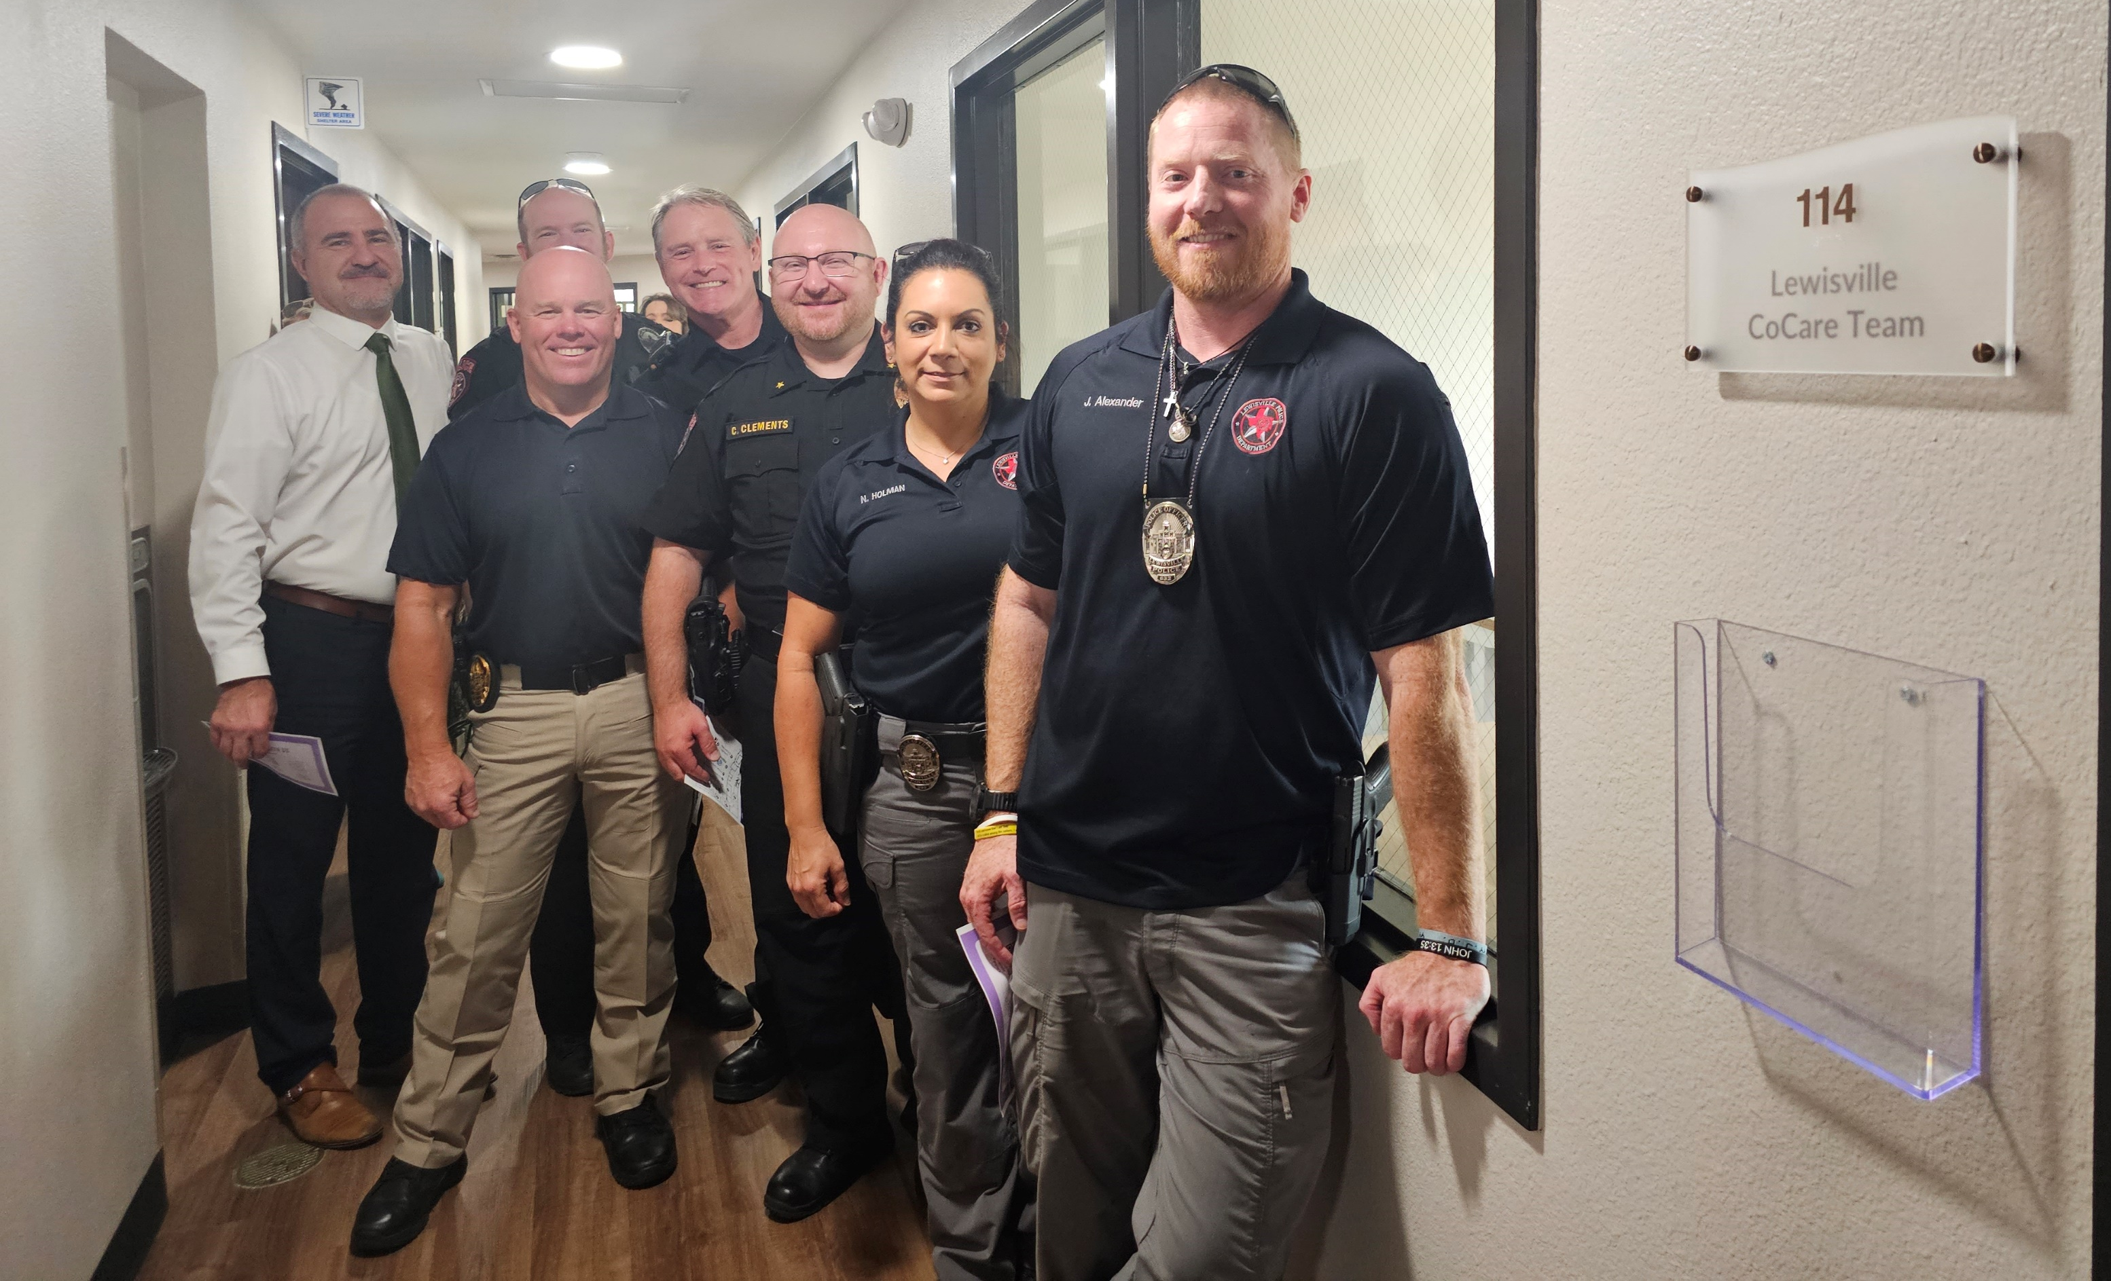
What’s Next
Notes:
SERVE Lewisville:
Opened in July- CoCare will move in this Nov
One-stop shop
CoCare unit office
MHMR offices
Boys and Girls clubs
MHMR partnership with CoCare unit
Increase CFS CoCare response to scenes
Increase CFS CoCare response to scenes.
Mitigate the challenge of the balance between acute crisis response vs follow-up

