Slide 1
Denton County MHMR’s
Mental Health and Judicial/Law
Enforcement Collaborative Summit
September 20, 2024

Slide 2
Observations from the Bench
Hon. David W. Jahn – Probate Court No. 1

Slide 3
Judicially Involved in Denton County 2024
957 Civil Commitment Cases filed as of yesterday = 25+ per week
Daily average of approximately 350 DCSO inmates on mental health list.
Jail Medical provides MH treatment to approximately 40 -50 inmates per week.
On average 65 defendants on a 46b Competency Restoration hold in the DCSO Jail. (Wait time for a State Bed 230+days)
16.22 Magistrate Ordered Assessments = 350+

Slide 4
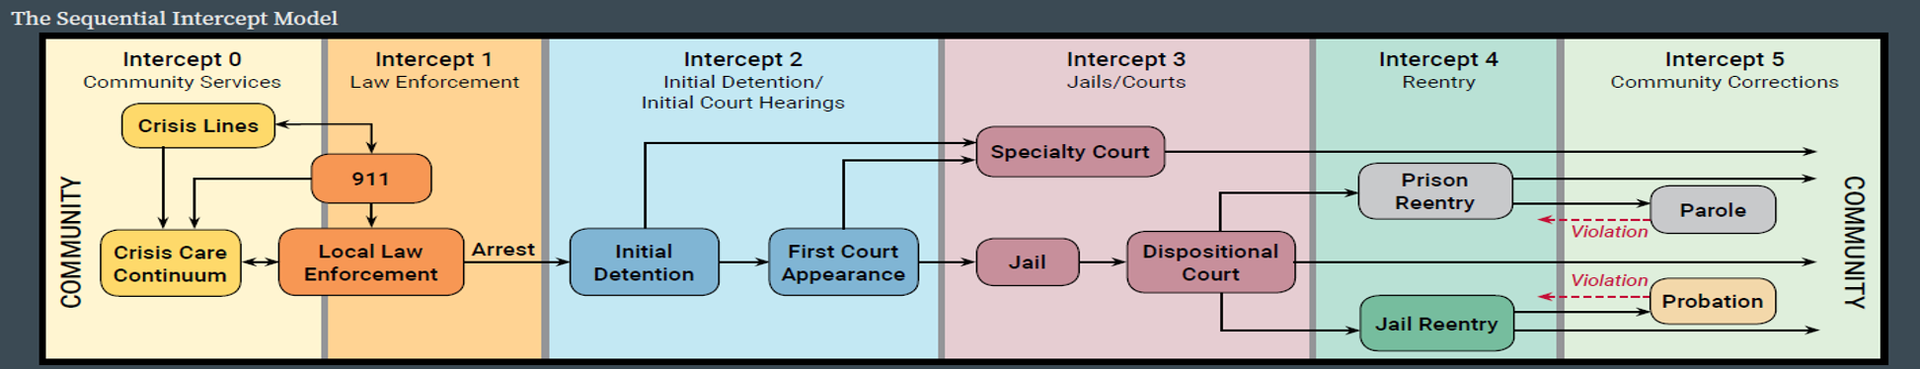
THE SEQUENTIAL INTERCEPT MODEL
https://ps.psychiatryonline.org/doi/pdf/10.1176/ps.2006.57.4.544

Slide 5




Why Consider a Different Approach.
Law Enforcement
Judicial System
Inpatient Hospitalization
Jail

Slide 6


Slide 7
Sec 571.002 Purpose of the Texas Mental Health Code
  Provide to each person having a severe mental illness access to humane care and treatment
    Most appropriate setting;
    Enabling the necessary evaluation, care, treatment, and rehabilitation with the least trouble, expense, and embarrassment to the person and the person’s family;
    Eliminate the traumatic effect on the persons mental health of public trial and criminal like procedures;
    Safe guard the patient’s rights so as to advance and not impede the therapeutic and protective purposes of involuntary care.

Slide 8
Sec. 571.019 Limitation of Liability
Sec. 571.019. LIMITATION OF LIABILITY.
(a) A person who participates in the examination, certification, apprehension, custody, transportation, detention, treatment, or discharge of any person or in the performance of any other act required or authorized by this subtitle and who acts in good faith, reasonably, and without negligence is not criminally or civilly liable for that action.
(b) A physician performing a medical examination and providing information to the court in a court proceeding held under this subtitle or providing information to a peace officer to demonstrate the necessity to apprehend a person under Chapter 573 is considered an officer of the court and is not liable for the examination or testimony when acting without malice.
(c) A physician or inpatient mental health facility that discharges a voluntary patient is not liable for the discharge if:
(1) a written request for the patient's release was filed and not withdrawn; and
(2) the person who filed the written request for discharge is notified that the person assumes all responsibility for the patient on discharge.

Slide 9
Sec. 571.020 Criminal Penalties
Sec. 571.020. CRIMINAL PENALTIES.
(a) A person commits an offense if the person intentionally causes, conspires with another to cause, or assists another to cause the unwarranted commitment of a person to a mental health facility.
(b) A person commits an offense if the person knowingly violates a provision of this subtitle. * (H&SC Title 7 Subtitle C Texas Mental Health Code)
(c) An individual who commits an offense under this section is subject on conviction to:
(1) a fine of not less than $50 or more than $25,000 for each violation and each day of a continuing violation;
(2) confinement in jail for not more than two years for each violation and each day of a continuing violation; or
(3) both fine and confinement.
(d) A person other than an individual who commits an offense under this section is subject on conviction to a fine of not less than $500 or more than $100,000 for each violation and each day of a continuing violation.
(e) If it is shown on the trial of an individual that the individual has previously been convicted of an offense under this section, the offense is punishable by:
(1) a fine of not less than $100 or more than $50,000 for each violation and each day of a continuing violation;
(2) confinement in jail for not more than four years for each violation and each day of a continuing violation; or
(3) both fine and confinement.
(f) If it is shown on the trial of a person other than an individual that the person previously has been convicted of an offense under this section, the offense is punishable by a fine of not less than $1,000 or more than $200,000 for each violation and each day of a continuing violation.

Slide 10
Sec. 571.023 Civil Penalties
Sec. 571.023. CIVIL PENALTY.
(a) A person is subject to a civil penalty of not more than $25,000 for each day of violation and for each act of violation of this subtitle or a rule adopted under this subtitle. In determining the amount of the civil penalty, the court shall consider:
(1) the person's or facility's previous violations;
(2) the seriousness of the violation, including the nature, circumstances, extent, and gravity of the violation;
(3) whether the health and safety of the public was threatened by the violation;
(4) the demonstrated good faith of the person or facility; and
(5) the amount necessary to deter future violations.
(b) The department or party bringing the suit may:
(1) combine a suit to assess and recover civil penalties with a suit for injunctive relief brought under Section 571.022 or 577.019; or
(2) file a suit to assess and recover civil penalties independently of a suit for injunctive relief.
(c) At the request of the department, the attorney general or the appropriate district or county attorney shall institute and conduct the suit authorized by Subsection (b) in the name of the state.
(d) On his own initiative, the attorney general, district attorney, or county attorney may maintain an action as authorized by Subsection (b) for a violation of this subtitle or a rule adopted under this subtitle in the name of the state.
(e) The department and the party bringing the suit may recover reasonable expenses incurred in obtaining injunctive relief, civil penalties, or both, including investigation costs, court costs, reasonable attorney fees, witness fees, and deposition expenses.
(f) A penalty collected under this section by the attorney general shall be deposited to the credit of the general revenue fund. A penalty collected under this section by a district or county attorney shall be deposited to the credit of the general fund of the county in which the suit was heard.
(g) The civil penalty and injunctive relief authorized by this section and Sections 571.022 and 577.019 are in addition to any other civil, administrative, or criminal remedies provided by law.

Slide 11
Texas Mental Health Code (cont.)
573 – Emergency Detention
- Subchapter A
– Apprehension by Police Officer w/o warrant
– Guardian’s Application for Emergency Detention
-Subchapter B
– Judge’s or Magistrate’s Order for Emergency Detention
- Subchapter C
– Emergency Detention, Release and Rights

Slide 12
Sec. 573.001 Apprehension by a Peace Officer
Without a Warrant
(a) A peace officer, without a warrant, may take a person into custody, regardless of the age of the person, if the officer:
(1) has reason to believe and does believe that:
(A) the person is a person with mental illness; and
(B) because of that mental illness there is a substantial risk of serious harm to the person or to others unless the person is immediately restrained; and
(2) believes that there is not sufficient time to obtain a warrant before taking the person into custody.
(b) A substantial risk of serious harm to the person or others under Subsection (a)(1)(B) may be demonstrated by:
(1) the person's behavior; or
(2) evidence of severe emotional distress and deterioration in the person's mental condition to the extent that the person cannot remain at liberty.

Slide 13
(c) The peace officer may form the belief that the person meets the criteria for apprehension:
(1) from a representation of a credible person; or
(2) on the basis of the conduct of the apprehended person or the circumstances under which the apprehended person is found.

Slide 14
(d) A peace officer who takes a person into custody under Subsection (a) shall immediately:
(1) transport the apprehended person to:
(A) the nearest appropriate inpatient mental health facility; OR
(B) a mental health facility deemed suitable by the local mental health authority, if an appropriate inpatient mental health facility is not available; or
(2) transfer the apprehended person to emergency medical services personnel of an emergency medical services provider in accordance with a memorandum of understanding executed under Section 573.005 for transport to a facility described by Subdivision (1)(A) or (B).

Slide 15
(e) A jail or similar detention facility may not be deemed suitable except in an extreme emergency.
(f) A person detained in a jail or a nonmedical facility shall be kept separate from any person who is charged with or convicted of a crime.
(g) A peace officer who takes a person into custody under Subsection (a) shall immediately inform the person orally in simple, nontechnical terms:
(1) of the reason for the detention; and
(2) that a staff member of the facility will inform the person of the person's rights within 24 hours after the time the person is admitted to a facility, as provided by Section 573.025(b).
(h) A peace officer who takes a person into custody under Subsection (a) may immediately seize any firearm found in possession of the person. After seizing a firearm under this subsection, the peace officer shall comply with the requirements of Article 18.191, Code of Criminal Procedure.

Slide 16
Texas Mental Health Code (cont.)
574 – Court Ordered Mental Health Services
Subchapter A – Application for MH Services
  Application (filed by CA, DA, or other adult. Only the CA or DA can file w/o a CME.)
  Appointment/Duties of Attorney (w/in 24 hours)
  Hearing set w/in 14 days after application filed (may be extended to 30 days by motion or agreement of parties.)
  Attorney entitled to disclosure of information.
  Must have two CMEs on file by different physicians

Slide 17
Texas is a Crisis Commitment State
Sec. 574.034 Health and Safety Code
Inpatient findings:
  Patient is a person with mental illness.
  As a result of that mental illness
      Likely to cause serious harm to self or others; OR
      Is
        Suffering severe and abnormal mental, emotional, or physical distress; AND
        Experiencing substantial deterioration of the persons ability to function; AND
        Unable to make rational or informed decision to submit to treatment

Slide 18
Texas Mental Health Code (cont.)
574 – Court Ordered Mental Health Services
Subchapter A – App. for MH Services (cont.)
  § 574.011 Certificate of Medical Exam for Mental Illness (CME) must contain:
    Name and address of both patient and doctor
    Date and place of examination
    Brief diagnosis of patient’s physical and mental condition
    Period under physician’s care
    Accurate description of MH treatment, if any
    Examining physician’s opinion/diagnosis

Slide 19
Emergency Detention and Civil Commitment Hospitals
Regular Basis:
UBH
Mayhill
Carrolton Springs
Consistent
Methodist Richardson
Millwood
Haven Frisco
Wellbridge Plano
THR Seay Center
Perimeter Dallas
Green Oaks
North Texas State Hospital
On Occasion
Springwood
Glen Oaks
Dallas VA Medical Center
UT South western
Wellbridge Fort Worth
16

Slide 20
SB 362
Effective September 1, 2019
Provides a new and clear path to divert persons with Mental Illness or IDD into Civil Courts

Slide 21
If the offense charged does not involve an act, attempt, or threat of serious bodily injury to another person.

Slide 22
CCP Sec.16.22
16.22(C)(5) if the offense charged does not involve an act, attempt, or threat of serious bodily injury to another person, release the defendant on bail while charges against the defendant remain pending and enter an order transferring the defendant to the appropriate court for court-ordered outpatient mental health services under Chapter 574, Health and Safety Code.

Slide 23
CCP 16.22 Continued
(c-1) If an order is entered under Subsection (c)(5), an attorney representing the state shall file the application for court-ordered outpatient services under Chapter 574, Health and Safety Code.
(c-2) On the motion of an attorney representing the state, if the court determines the defendant has complied with appropriate court-ordered outpatient treatment, the court may dismiss the charges pending against the defendant and discharge the defendant.

Slide 24
Sec. 574.0345. ORDER FOR TEMPORARY OUTPATIENT MENTAL HEALTH SERVICES.
patient is a person with severe and persistent mental illness;
if not treated, experience deterioration of the ability to function independently to the extent that the proposed patient will be unable to live safely in the community
outpatient mental health services are needed to prevent a relapse that would likely result in serious harm to the proposed patient or others; and
inability to participate in outpatient treatment services effectively and voluntarily, demonstrated by:
  (i) any of the proposed patient's actions occurring within the two-year period that immediately precedes the hearing; or
  (ii) specific characteristics of patient's clinical condition that significantly impair the patient's ability to make a rational and informed decision whether to submit to voluntary outpatient treatment.

Slide 25


https://texasjcmh.gov/publications/bench-books/

Slide 26

https://texasjcmh.gov/media/erwfq1mp/eliminate-the-wait-toolkit-1-19-22-final.pdf

Slide 27
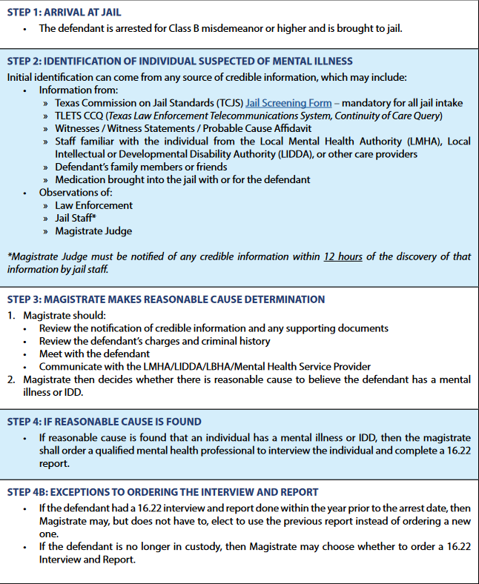
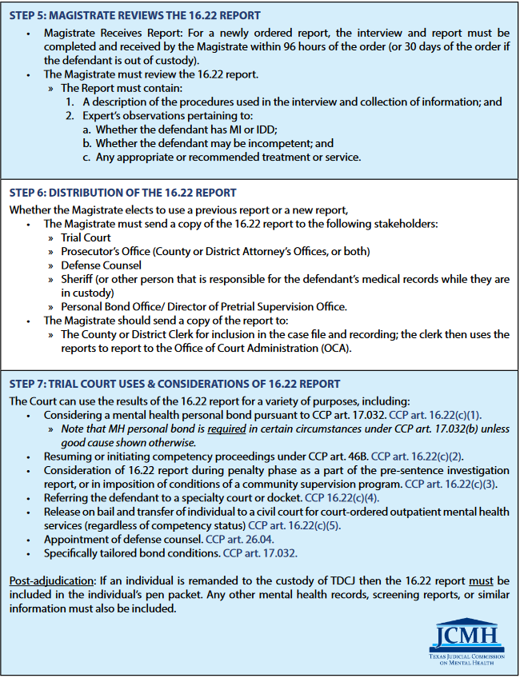
The 16.22 Process Step by Step

Slide 28

https://texasjcmh.gov/media/wuyludp3/16-22-guide-september-2023-for-web-v2.pdf

Slide 29

https://texasjcmh.gov/publications/code-book/

Slide 30

All further questions should be delivered to Judge Waddil for answering during his presentation

