Slide 1
Addressing Complex Trauma in Overlooked Populations
Presented by:
Landon Dickeson, MS, LPC, C-DBT
Executive Director
Ranch Hands Rescue and Bob’s House of Hope

Slide 2
FOUNDATIONAL DEFINITIONS
Trauma: Any experience that overwhelms safety and coping
Post Traumatic Stress: Symptoms that occur in the aftermath of a traumatic experience
Complex Trauma: When traumatic experiences recur repeatedly over a period of time
  Complex trauma during key developmental periods disrupts the normal development of self-regulation, healthy communication, relationship formation, and self-concept
Complex PTSD: Chronic behavioral, emotional, cognitive, and interpersonal difficulties, as well as frequent somatic complaints, that significantly disrupt an individual’s ability to function across a range of domains

Slide 3
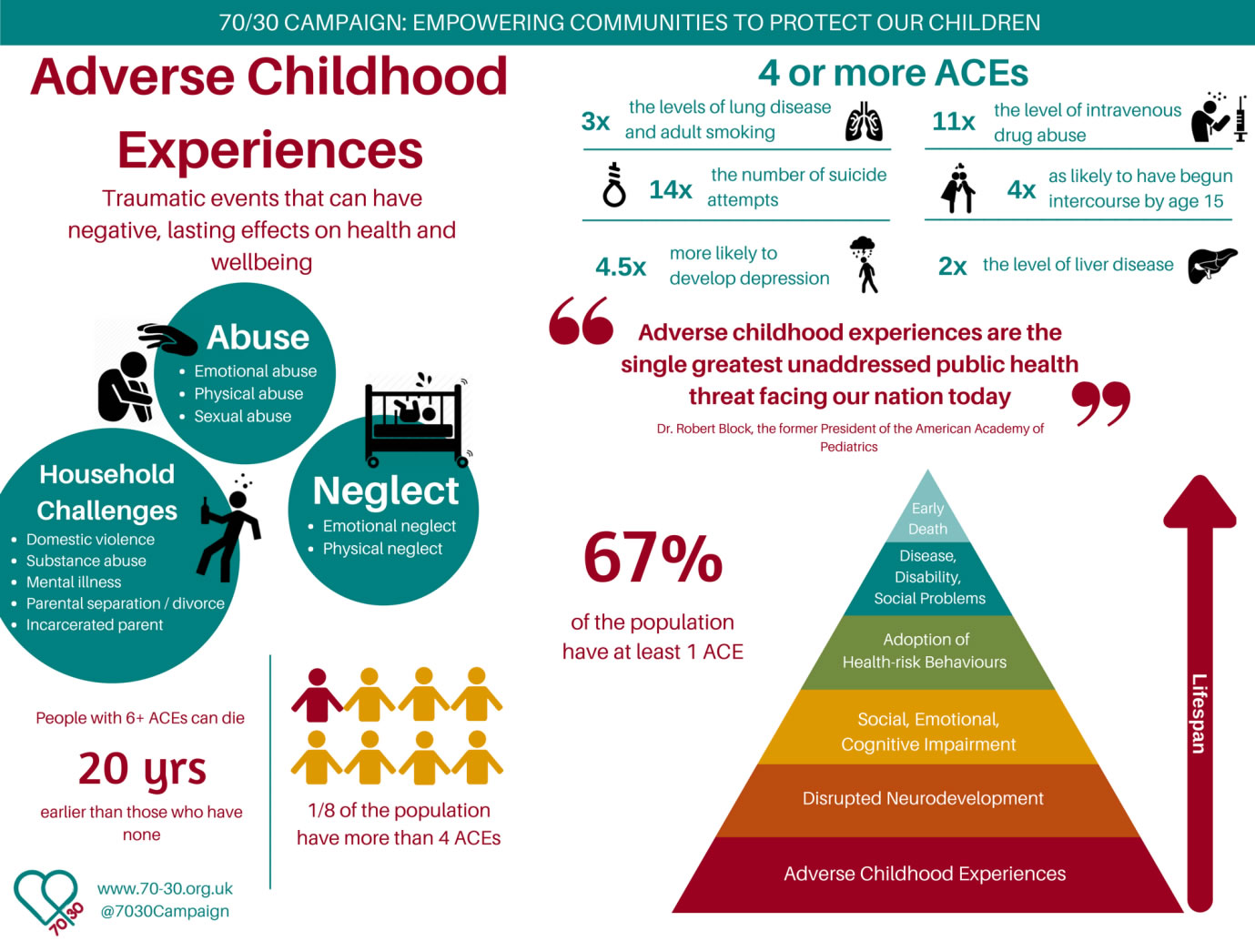
HOW TRAUMA EFFECTS PEOPLE
Anger, Irritability, Mood swings
Fear, Anxiety
Guilt, Shame, Blame
Isolation, Suicidal thoughts
Hopelessness, Depression
Disconnected, Numb, Dissociated
Intrusive thoughts, Nightmares, Flashbacks
Memory loss, Time loss
Disorientation, Confusion
Addiction, Self-harm

Slide 4
C-PTSD SURVIVORS
Recognizing Complex Trauma Survivors in Treatment
History of several disparate diagnoses
History of many divergent medications
History of unsuccessful treatments
Inability to accurately assess safety
Poor boundaries (inter and intrapersonal)
Hyper and atypical assessment responses
History as a “lightning rod” for harm
“Treatment-resistant”
Personality Disorders?

Slide 5
C-PTSD SURVIVORS
Recognizing Complex Trauma Survivors in Treatment
Luis: 18, m, Hispanic, heterosexual, Hx of abandonment, cartel violence, drug mule, numerous sexual assaults and violent relationships, poly substance abuse, suicide attempts, flashbacks, night terrors, ongoing SI and HI, Diagnoses of, CPTSD, ODD, MDD, and GAD.
Carl: 19, m, Native American/Hispanic, LBGTQ, Hx of abandonment, foster care, incest, sex trafficking, poly substance abuse, failing school, Diagnoses of CPTSD, MDD, ADHD.
Andy/Amelia: 22, m → f, Caucasian, LGBTQ, Hx of abandonment, incest, DV, sex trafficking, and, poly substance abuse, numerous suicide attempts, SI and HI, flashbacks and night terrors, Diagnoses of BPD, CPTSD, MDD, and GAD.

Slide 6
Red Flags of Trafficking
Male Specific
All Victims
History of repeated involvement with law enforcement or juvenile justice
Multiple placements in foster care
Frequent & repeated admission to psychiatric hospitals & emergency care
Clear signs of emaciation
Lack of personal belongings
Demanding & aggravated presentation
Tattoos or brands
Signs of physical injuries & abuse
Avoiding eye contact, social interaction, & authority figures
Seeming to adhere to scripted or rehearsed responses
Lacking official ID
Presenting with nice jewelry & clothes but no car or home
Having multiple new phones
Checking into motels with older adults
Poor physical & dental health
Tattoos that mark ownership
Untreated or repeat STIs

Slide 7
Types of Trafficking and Targeting
We have observed all categories and tactics that have been formally identified (pimp-controlled, “Romeo,” survival sex, gang-controlled, etc.)
  Most common type: “Romeo” and survival sex
Romeo style luring has been a common thread
  Promises of money, drugs, job, etc.
  Marriage
  A “way out” from family circumstances
Preying upon experience of being “misunderstood” by the “system”
Online exploitation that is often self-initiated then built upon

Slide 8
OVERLOOKED POPULATION:
SEX TRAFFICKED MALES
Up to 50% of CSEY victims are boys
  The DOJ stated in a study 36% and that it is vastly underreported
  ECPAT International stated 38% and that it is vastly underreported
  51% of missing foster children are male and multiple studies have cited missing foster youth as the highest risk population
Missing youth are at significantly increased risk
The vast majority of victims have experienced prior abuse and/or neglect for 2+ years prior to being exploited
Most youth do not understand that they are being exploited and do not seek help or identify as victims, especially the boys
There is an assumption that the "buyer" is looking for a female and that males “cannot be raped.”

Slide 9
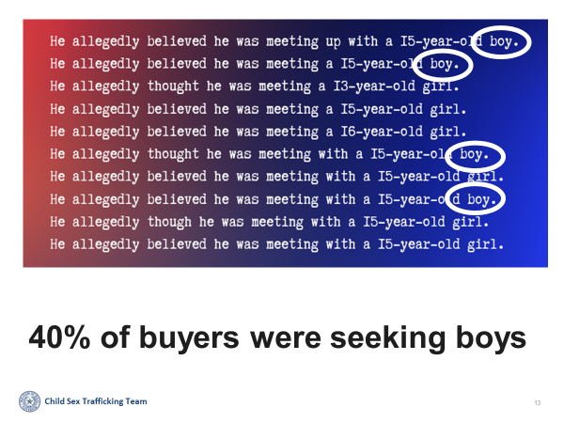
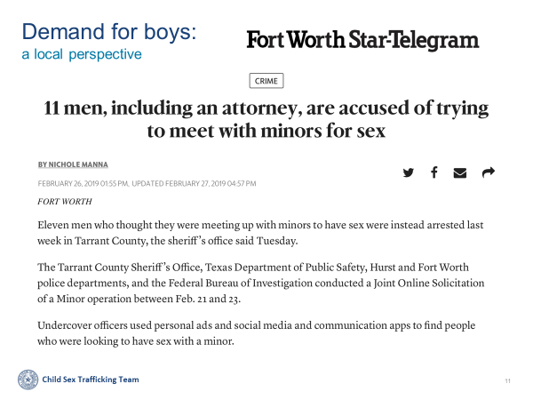
OVERLOOKED POPULATION:
SEX TRAFFICKED MALES

Slide 10
OVERLOOKED POPULATION:
SEX TRAFFICKED GLBTQ+
GLBTQ+ youth are at higher risk than heterosexual youth, with transgender youth at the highest risk
  Homelessness and a high ACEs score are common risk factors
CSE victims have increased rates of suicidal & homicidal ideation, criminal behavior, self-harm, PTSD, sexually transmitted infections/diseases, and suicide attempts
Pre-existing vulnerabilities are preyed upon by exploiters
  The odds of being sex trafficked and LGBTQ+ was 2.41 times higher (95% CI: 1.22, 4.74) compared to being a cisgender heterosexual
  2019 YES interviews indicate the majority had a boyfriend relationship with their sex trafficker
Stigma, lack of awareness, fear of not being believed, lack of access, and more increase GLBTQ+ youth’s risk of remaining in or returning to sex trafficking

Slide 11
OVERLOOKED POPULATION:
SEX TRAFFICKING OF THOSE WITH
DISABILITIES
Those with severe disabilities are nearly 6x more likely to be sex trafficked than those without (Franchino-Olsen et al., 2020).
“Children with disabilities are nearly 4x more likely to be neglected and physically abused, more than 3x more likely to experience sexual abuse, and more than 2x as likely to be victimized by violent crimes compared to children without disabilities” (NHTD Working Group, 2018).
Physical impairment, ASD, IDD, and other functionally disabling disorders lead to increased risk for sexual exploitation
There is an extreme lack of research, assessment, and programming options for these populations

Slide 12
Criminalization
Exploited cis-males remain largely invisible due to stigma and misidentification
Because males are seen to be "choosing" their exploitation, they are often prosecuted and jailed rather than identified and deferred to treatment
Cis-male victims can be seen as potential exploiters who need to be stopped
  Victimization and perpetration can be linked for exploited youth
  Cis-female youth are more likely to be seen as victims of exploitation compared to their male counterparts
Cis-male and TGNC victims receive heavier and longer sentencing for petty crimes compared to their female counterparts
  In some cases, victims are receiving longer prison sentences than their trafficker
Males are typically seen as only perpetrators and rarely considered as victims

Slide 13
The Role of Technology
All use technology for survival sex and access to drugs
  Exchange of goods/services instead of money
Communication via chat features on gaming platforms
  Common thread and major breach point for many programs
Online ads
  Common websites: mintboys.com, friendboy.pro, megapersonals.eu, jock2go.eu, tsescorts.com, Grindr, Facebook, Craigslist, WhatsApp, TikTok, OnlyFans
Normalize problematic sexual behavior and exploitation
  Often starts as a source of approval and gratification
  This is part of the grooming process

Slide 14
COMMON MISTAKES WHEN INTERACTING WITH SURVIVORS
Taking safety for granted
Blinded by stigma, myths, and misconceptions
Taking treatment “failures” personally
Discomfort with expanding scope of role
Poor boundary navigation
Lack of repetition and consistency
Failure to recognize “benefits” of maladaptive coping strategies
Failure to recognize overlap with exploiter’s tactics
Forgetting that connection and relationship are the most important part of our work, not medication or model of therapy

Slide 15
WHAT CAUSES ESCALATIONS
Fear
Chaotic/Noisy environment
Long Periods of unstructured time
Over stimulating Multi-media
Excessive Talking
Communicating from a distance
Sarcasm
Complex Directives
Contingency based consequences
Too many people becoming involved

Slide 16
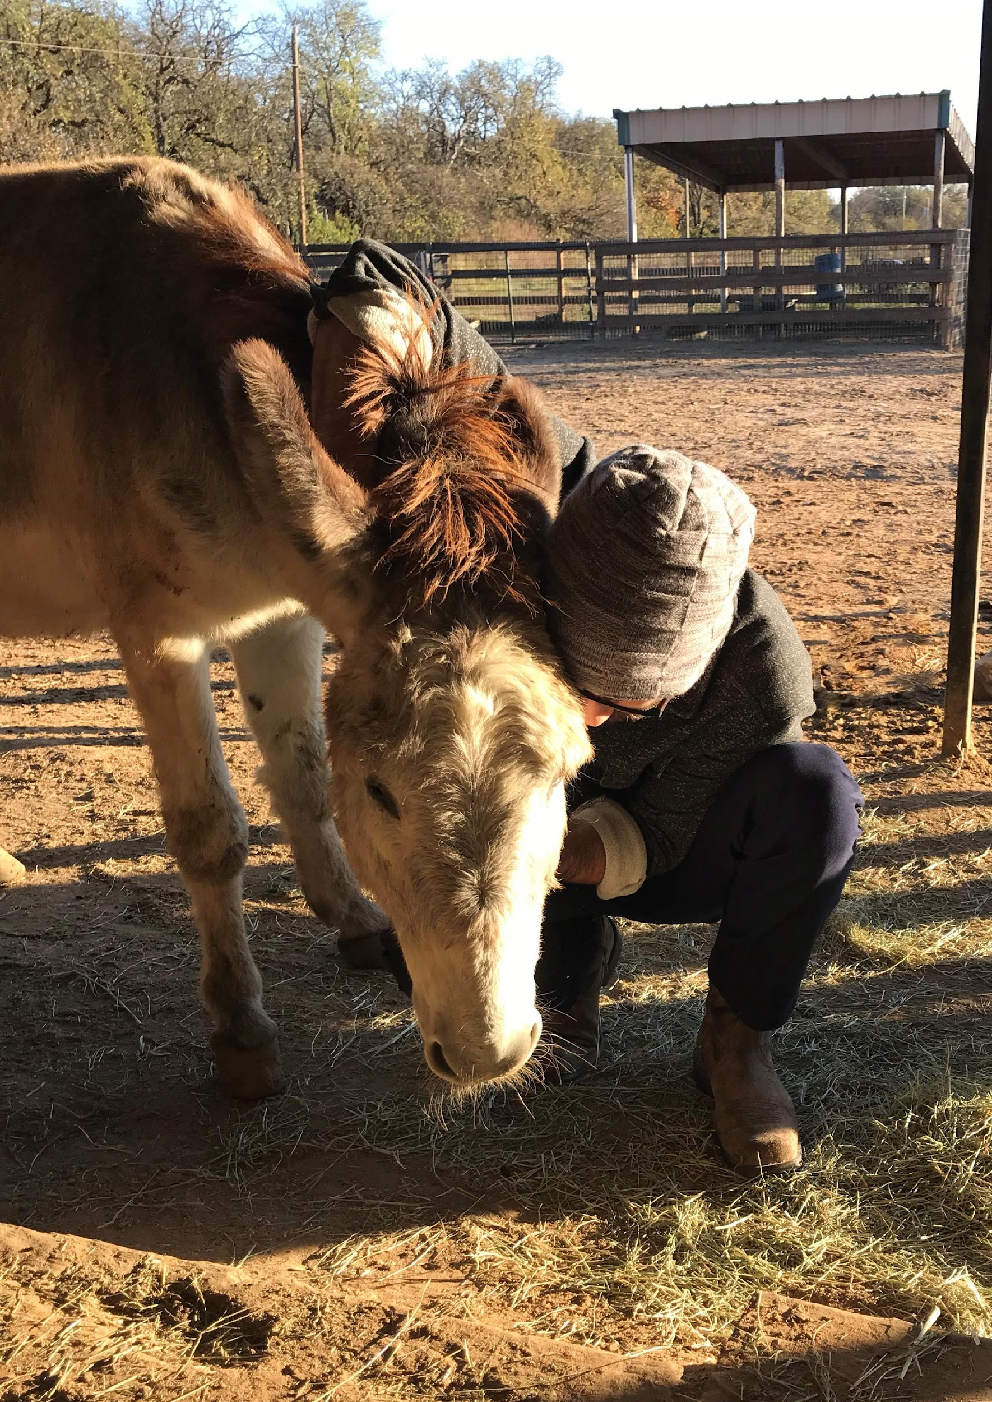
FOUNDATIONAL PRINCIPLES FOR ADDRESSING COMPLEX TRAUMA
Safety -> Trust -> Connection
Focus on stability
Refer to medical as needed
Destigmatize and normalize
Psychoeducation
Patience for relapse
Understand adaptive response
LISTEN, LISTEN, LISTEN
"Trauma and our responses to it cannot be understood outside the context of human relationships." "The most traumatic aspects of all disasters involve the shattering of human connections." Dr. Bruce Perry

Slide 17
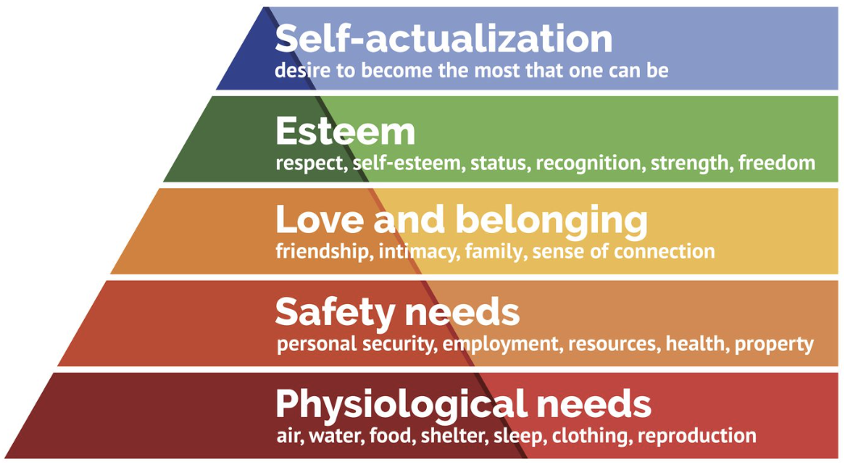
Care of Survivor
The Bob’s House of Hope Approach
Utilizing a Maslow-integrated approach, the holistic support of unseen survivors is both effective and trauma-informed
Stable implementation of safety is required to counter complex trauma
  Felt safety is NOT equivalent to physical safety
Acknowledging survivor-perceived priority
of needs demonstrates that we hear them
Meet needs holistically & practically
  Physical, Medical, Mental, Emotional, & Spiritual
Comprehensive case management
Meet the survivor where they are at
Tolerate relapses as part of recovery
Maslow's Hierarchy of Needs

Slide 18
Tips for Service Providers and Law Enforcement
Believe their story
  Many have been denied services simply because they were not believed
  Many were labeled as “just a bad kid” without any inquiry as to why they were acting out
Apply trauma-informed care even in the face of anger and acting out
  Relapses are part of recovery
Increased training on the identification of males and male tailored services
  Ex: SANE exams for males (not commonly available)
Increased funding for and opportunities to receive services for males, especially those identified as missing from foster care

Slide 19
QUESTIONS AND RECOMMENDATIONS
What are we missing?
Insurance allowing for longer session times when working on Trauma, especially for more complex modalities such as EMDR
How can we fill these identified gaps?
How do we improve access to services for victims/survivors?
We need more research on Complex PTSD AND the sex trafficking of males, GLBTQ, ethnic/racial minorities, and persons with disabilities
We need an official C-PTSD or Developmental PTSD diagnosis recognized in the DSM and by insurance providers
We need to develop treatment programs aimed specifically at addressing C-PTSD

Slide 20
REFERENCES
Fischer, J (1999). The work of stabilization in trauma recovery. The Trauma Center Lecture Series.
Herman, J. L. (1997). Trauma and recovery. New York: BasicBooks.
Nichols, Andrea and Heil, Erin (2022) "Human Trafficking of People with a Disability: An Analysis of State and Federal Cases," Dignity: A Journal of Analysis of Exploitation and Violence: Vol. 7: Iss. 1, Article 1. DOI: 10.23860/dignity.2022.07.01.01
Rogers, C. R. 1. (1995). On becoming a person: a therapist's view of psychotherapy. Boston: Houghton Mifflin.
Van, . K. B. A. (2014). The body keeps the score: Brain, mind, and body in the healing of trauma.
https://polarisproject.org/2019-us-national-human-trafficking-hotline-statistics/
ECPAT-USA (2013). And boys too. New York.
https://www.dhs.gov/science-and-technology/news/2020/03/18/snapshot-combatting-human-trafficking-analytics
https://www.usatoday.com/story/news/investigations/2019/07/29/12-trafficking-statistics-enormity-global-sex-trade/1755192001/
https://www.ncbi.nlm.nih.gov/pmc/articles/PMC5699805/
https://www.cdc.gov/violenceprevention/aces/index.html
Bruce Perry: Attachment and Developmental Trauma | "Don't Try This Alone" (attachmentdisorderhealing.com)

