Slide 1
Mobile Crisis Outreach
Team (MCOT)

Slide 2
What is MCOT?
MCOT stands for the Mobile Crisis Outreach Team
MCOT carries out Risk of Harm Assessments 24/7/365 days a year.
Between the hours of 8am-5pm, MCOT also provides outpatient crisis services including but not limited to follow ups, counseling, case management, and liaison work.
Individuals interested in crisis outpatient services can receive weekly case management, weekly counseling, and medication management, for a 90-day period.
2

Slide 3
What is a
Risk of Harm Assessment?
MCOT receives referrals from all over Denton County: Local medical and behavioral health hospitals, law enforcement, city jails, Denton County jail, stand alone emergency rooms, doctors offices, friends, family members, Tarrant County Crisis Line, and more.
When MCOT receives these referrals, MCOT will complete a triage assessment to determine whether the individual meets criteria for a full Risk of Harm assessment. If the individual does not meet the criteria, the individual will be provided appropriate referrals and resources.
The Risk of Harm assessment consists of questions regarding risk to self and/or others. MCOT obtains a detailed timeline of individuals’ suicidal and homicidal thoughts and behaviors, and significant symptoms of deterioration. Additionally, MCOT assess for acute and chronic risk factors, mood symptoms, symptoms of disturbed thinking, physical health, trauma, substance use, and more.
The primary goal of a Risk of Harm assessment, is to make a recommendation using least restrictive measures.
  Suicidal/Homicidal thoughts and/or behaviors within the last 2 weeks
  Significant Deterioration
  Medical Clearance needed
  Outpatient- with or without an Ensure of Safety and CRU
  Inpatient- voluntary or involuntary
3

Slide 4
How do we get the Risk of Harm timeline?
Case Approach (The Chronological Assessment of Suicide Events)
  Ideations
  Planning
  Behaviors
  Desire
  Intent
Clinicians can determine more accurately the dangerousness of an individual by bringing to the surface hidden elements of the individuals reflected intent.
4

Slide 5
Case Approach Validity Technique
Examples
  Behavioral Incidents
    “Exactly how many pills did you take? What did you do next? Where were you when you took the pills?”
  Gentle Assumptions
    “What other ways have you thought of killing yourself? What types of drugs have you used?”
  Denial of Specifics
    After asking “have you thought of killing yourself?” without a response from the individual, will then lead us to specific questions: “Have you thought of overdosing?”
  Symptom Amplification
    “How many times have you attempted to kill yourself? 50, 75, 100?”
5

Slide 6
C-SSRS (Columbia-Suicide Severity Rating Scale)
The Columbia-Suicide Severity Rating Scale (C-SSRS) is a helpful assessment tool to incorporate alongside of the CASE approach during Risk of Harm assessments.
  The C-SSRS is a standardized assessment which assists the clinician in conceptualizing an individual’s risk of harm.
  The C-SSRS consists of three subsections:
    Suicidal Ideation
    Intensity of Ideation
    Suicidal Behavior
Utilizing the C-SSRS will strengthen the reliability of the CASE Approach.
6

Slide 7
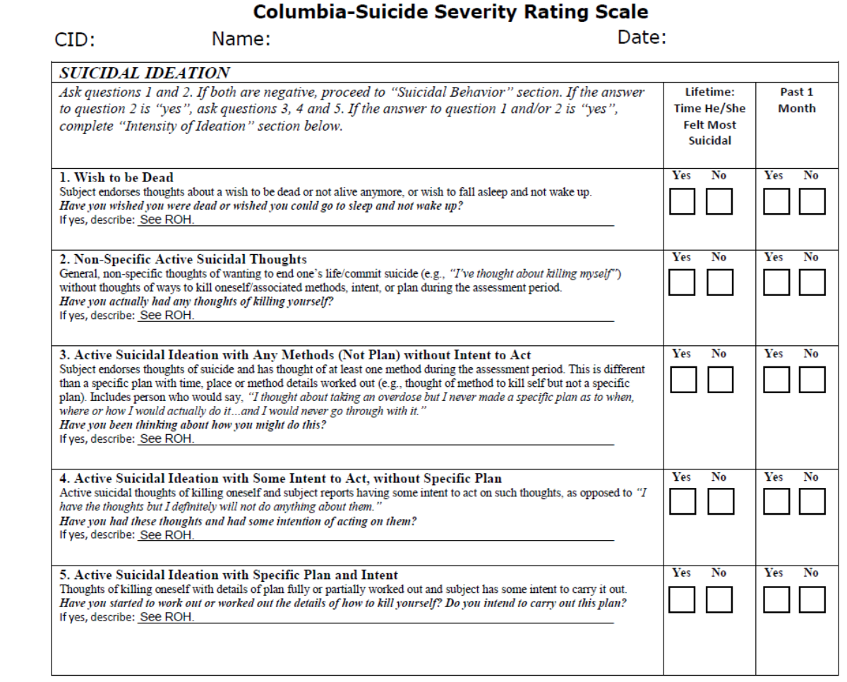
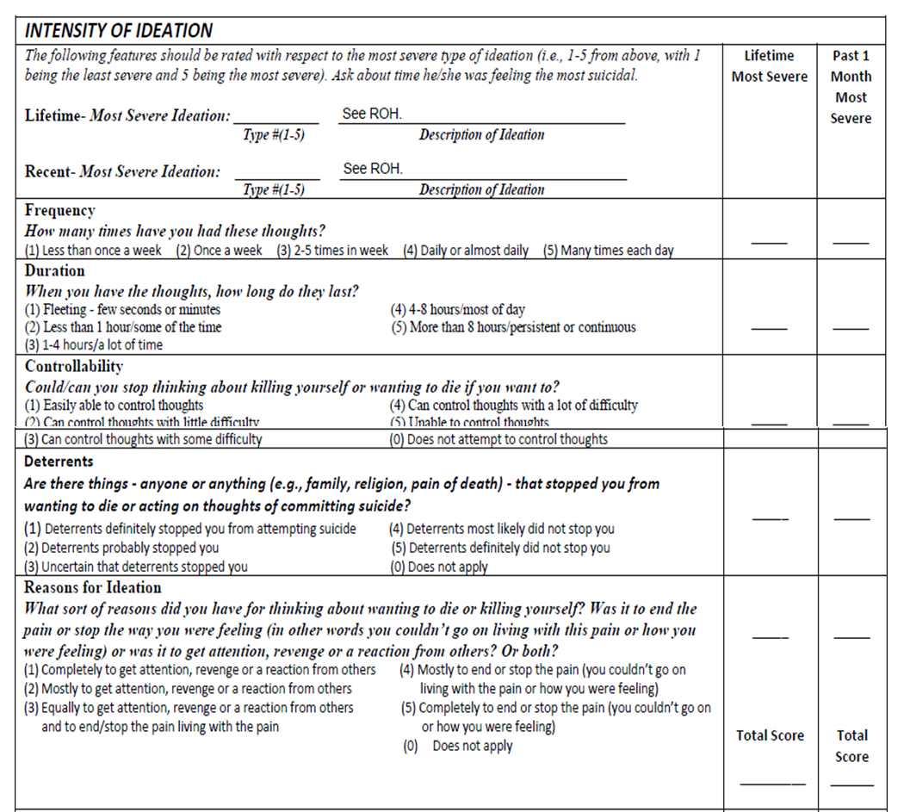
7

Slide 8
8

Slide 9
How do our recommendations get carried out?
Outpatient recommendations
  Outpatient
    Phone check-ins
    Minimum of 2 follow-ups
    Referrals (including Center outpt)
  Outpatient with Ensure of safety
    Phone check-ins
    Ensure of Safety agrees to stay with individual (eye-sight and ear-shot) until their 24-hour follow-ups appointment.
    Minimum of 2 follow-ups
    Referrals (Including Center outpt)
  Outpatient to Crisis Residential Unit (CRU)
    7-14 days (not a homeless shelter, halfway house, or detox center)
    8 beds (4 male, 4 female and 1 special population bed)
    Skills training groups, stabilization, and re-integration
    Step down from inpatient psychiatric hospitalizations and incarcerations.
Inpatient
  Voluntary – The Center will search for placement at our contracted hospitals (UBH, Millwood, and Springwood).
    Individuals without insurance will receive, on average of 3 Center funded days, if additional days are needed a clinical assessment is completed.
    Individuals with insurance can be placed at any hospital who will accept the individuals insurance.
  Involuntary – The MCOT staff will reach out to local law enforcement, Crisis Intervention Response Team (CIRT), or Mental Health Deputies who will then determine appropriateness for Emergency Denton Order (EDO).
    Some will ask for our help finding placement and we will attempt to secure a bed at our contacted hospitals.
9

Slide 10
24-hour and 2nd Follow-ups
• Individuals screened by a Center crisis team who received an outpatient recommendation will receive a 24-hour follow-up (face-to-face preferred), regardless of county of residence or level of care that they qualified for.
  During this 24-hour follow-up MCOT staff will inquire about the their interest in continuing mental health related services.
  If the individual expresses interest in Center services, they can be enrolled into a level of care at their 2nd follow-up.
  If they would prefer to follow up with a private outside provider, resources will be provided, and we will check in at their 2nd follow-up.
• Individuals who went inpatient on a voluntary or involuntary recommendation will receive a 24-hour follow-up in the hospital they were placed at. The follow-up is conducted by our hospital liaison staff and behavioral health hospital staff by phone. Hospital liaison staff continue to follow up until the individual's discharge.
10

Slide 11
LOC5
90-days
Weekly case management
  Skills training
  Coping skills
  Transportation
  Referrals
  Advocation
Weekly Counseling (Optional)
  Cognitive Behavioral Therapy (CBT)
Medication Management (Optional)
Goal- stabilization and transition
11

Slide 12
Who are we?
Chief Operations Officer
  Fonny Cooper Wright, MAMFC, MARE, LPC-S, LCPAA
Senior Director of Crisis Services
  Dallas Hamilton, LPC/QMHP-CS
Director of Crisis Services
  Elisabeth Davenport, MS, CRC, LPC-Associate
Program Manager of MCOT (Monday-Friday 8am-5pm)
  Danelle Dixon, BS, QMHP-CS
Program Manager of MCOT On-call (After Hours)
  Yesenia Moreno , BS, QMHP-CS
MCOT Daytime (23 staff)
  11 QMHP/LPHA Assessors
  4 LOC5 Crisis Case managers
  2 Crisis Follow Up Case managers
  1 Crisis Counselor
  1 LPHA Team Lead
  1QMHP Team Lead
  3 MCOT Interns
MCOT On-call (18 staff)
  1 Crisis Follow Up QMHP
  16 QMHP/LPHA Assessors
  1 RN Assessor
12

Slide 13
Thank You
Nelly Dixon, B.S., QMHP-CS
Program Manager of MCOT
940-594-1022
danelled@dentonmmr.org

Slide 14
Liaison Team
Makala Burgess, MS, QMHP-CS
Program Manager of Liaison Services

Slide 15
The liaison team connects with various community providers to ensure ongoing continuity of care for individuals seeking mental health resources within Denton County.
15

Slide 16

Crisis Prevention Liaison
  The Crisis Prevention Liaison (CPL) works to intervene prior to a crisis occurring.
  They work closely with local law enforcement to engage individuals who are often accessing crisis or law enforcement services.
  The CPL also visits local shelters to meet with individuals who are interested in accessing mental health services.
16

Slide 17
Court Liaisons
When an individual is involuntarily committed to a hospital, the hospital must file a Notice of Emergency Detention (NOED) with the Mental Health Court and allow the individual to present with a court appointed attorney.
The MHMR court liaisons meet with the individual and their court appointed attorney at court to assess the least restrictive recommendation.
  When preparing to make a recommendation, the court liaisons and the district attorney obtain information from the Certification of Medical Examination (CME), Notice of Emergency Detention (NOED), the individual’s report, hospital report, and family/friend reports.
  It is important that both the CME and NOED are very detailed, accurate, and legible to ensure the liaisons, district attorney, and judge can utilize the information provided to make a clinically appropriate recommendation.
17

Slide 18
16.22 Magistrate Orders
16.22s are Magistrate ordered assessments for individuals that are incarcerated to determine whether an individual has a mental health diagnosis.
Anyone can send a 16.22 referral to the Magistrate Court. The Magistrate reviews all referrals and sends an order for the ones that qualify for a 16.22 assessment.
The Magistrate Court sends the 16.22 Order to MHMR, via email, along with any pertinent information that has contributed to the reason for the order, such as the:
  16.22 Request
  Book-in Affidavit
  Intake Assessment
  Incident Reports
MHMR makes a recommendation using the information provided in these documents, the individual’s report, speaking with jail staff, and speaking with family and friends.
18

Slide 19
16.22 Magistrate Orders
The jail liaisons or other designated staff complete two in-person follow ups with the individuals who were assessed. These follow-ups are completed within 24-hours and another follow up is completed within 48-hours.
If an individual is referred and accepted to a psychiatric hospital, MHMR hospital liaisons completes a follow up call to the hospital.
When the individual returns to the jail, the jail liaison or MHMR staff completes another in-person follow up with the individual.
  During these follow ups, the individual is asked questions about risk of harm, disturbed thinking, and asks if the individual has any questions regarding mental health services.
19

Slide 20
Forensic Waitlist/ 46b Assessments
One of the jail liaison’s primary roles is to meet monthly with individuals who are on the forensic waitlist, who are awaiting a bed to North Texas State Hospital (NTSH).
  The individuals on the Forensic waitlist have been deemed not competent to stand trial, the individual is waiting for a Forensic bed in order to be admitted to the State Hospital for competency restoration, then once the individual is declared competent, the individual will return back to jail.
46b is an assessment that must be completed before an individual is transferred from Denton County Jail to a state hospital.
  The Denton County Sheriff’s Office sends an email to the Center to inform Jail Liaison staff of the transfer, and Jail Liaison staff completes the assessment before the individual is transferred to the state hospital. A copy of the assessment is maintained by the Center and the Sheriff’s Office.
20

Slide 21
17.032 Bond Conditions
17.032 is an assessment that is completed when an individual is bonded out of the Denton County Jail, and is ordered to participate in mental health treatment, as a stipulation of their bond requirements.
  The bond conditions are emailed to MHMR by the Court, and we complete the assessment the same day, or discuss a time with the court to plan for this assessment.
  Jail liaisons provide an update on these individuals before they are scheduled to appear in court each month. A jail liaison also attends these dockets to provide information regarding these individuals.
21

Slide 22
Jail Re-Entry Program
Denton County MHMR has recently been awarded 3 grant-funded positions that will be officed in the Denton County Jail. These positions consist of 2 Qualified Mental health professionals (QMHP’s) and 1 Peer Support Specialist.
  The purpose of these positions is to prepare incarcerated individuals for re-entry into the community by providing necessary resources, such as obtaining ID forms, Supplemental Nutrition Assistance Program (SNAP) benefits, Social Security Income (SSI)/Social Security Disability Income (SSDI), budgeting, skills training, and joining housing waitlists.
22

Slide 23
Participation in the Jail Re-Entry Program
  Individuals are referred to the Re-Entry Program through Denton County Jail staff, MHMR staff, attorneys, or self-referral (through letters or requests).
Willing and able to participate in the program
Able to identify and work towards goals
Capable of leaving jail within the statutes of their charges
23

Slide 24
Re-Entry QMHPs
The re-entry QMHPs meet with all individuals who were assessed by the Center.
The QMHP’s determine eligibility and ask all individuals who they meet with about participation in the program.
The QMHP will meet with everyone on their caseload at a minimum of weekly while the individual is incarcerated.
Will connect individuals to outpatient mental health after release from incarceration, providing a seamless transition.
24

Slide 25
Re-Entry
Peer Support Specialist
An individual with lived experience in the criminal justice system who provides emotional support, guidance, and resources to incarcerated individuals.
The Peer Support Specialist fosters a sense of hope and trust,
Offer non-judgmental listening,
The Peer Support Specialist helps inmates navigate the challenges of incarceration, including issues related to mental health, substance abuse, and reintegration into society.
Serve as a bridge between them and the community, connecting them to available services towards their personal goals.
25

Slide 26
Re-Entry
Peer Support Specialist
Services
Voluntary Service
Services the Peer Specialist Offers:
  Peer Sessions
  Follow Ups
  Connection with services in the community & outside peer support services for continuity of care.
What they are NOT: Counselor, Case Manager, Skills Trainer
Jail Peer Support Specialist: Amber St. John
26

Slide 27
Other Liaison Services
Hospital Liaison’s
  The Center has multiple hospital liaison positions, including 1 adult state hospital liaison, 1 child and adolescent state hospital liaison, 2 full time community hospital liaisons, and 2 part-time community hospital liaisons.
  The hospital liaison staff complete aftercare appointments with individuals discharging from inpatient treatment and help coordinate services while individuals are receiving inpatient treatment.
School Liaison
  The school liaison works closely with school counselors to build relationships with each school for better coordination of services for individuals served.
27

Slide 28
Thank You

Slide 29
Multisystemic Therapy Services (MST)
Sharon Jones, LCSW-S
Senior Director of Clinical Services

Slide 30

What is Multisystemic Therapy (MST)?
Community-based and family-driven treatment for antisocial and/or delinquent behavior in youth.
Focus is on empowering caregivers to solve current and future problems.
The primary goals of MST are to decrease youth criminal behavior and out-of-home placements.
Highly structured clinical supervision and quality assurance processes.
30

Slide 31
Anti-Social Behaviors
Theft and other criminal behaviors
Aggressive, Violent, Assaultive Behavior
Abusing and/or Selling Substances
Chronic School Absences and/or Problem Behaviors at School
Disregard for their own safety and the safety of others
31
Notes:
Repeated behaviors is what makes it antisocial

Slide 32
Goal of the MST Program
For Parents:
To empower
parents with skills
and resources
needed to
address the
difficulties that
arise in
raising teenagers.
For Teens:
To empower youth
to cope with
problems from
family, peers, school,
and community
through skill building
strategies that help
reduce recidivism.
For Families:
Prevent out-of-home placements,
Significantly improve family functioning.
32

Slide 33
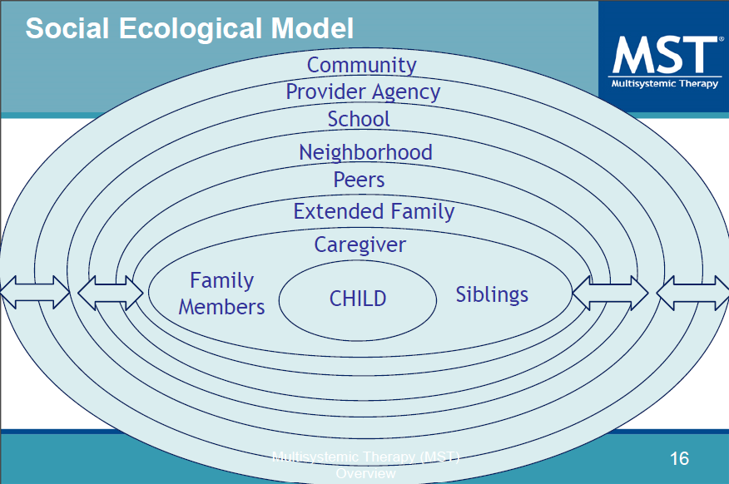
33
Notes:
MST reduces delinquent and antisocial behavior by addressing the core causes of such conduct. MST strives to promote positive behavior change in the youth’s natural environment, using the strengths of each system (family, peers, school, support network.)

Slide 34
Who is appropriate for MST?
Youth aged 12-17 years old.
Youth at-risk for out of home placement due to anti-social or delinquent behaviors, including substance abuse.
Youth has multiple arrests or are chronic offenders.
Youth deeply involved with delinquent peers.
Youth who have committed sexual offenses in conjunction with other anti-social behavior.
Experiencing Severe Issues at School.
34

Slide 35
Who does NOT Qualify for MST?
Youth living independently.
Sex offending in the absence of other anti-social behavior.
Youth with moderate to severe autism.
  Having difficulties with social communication, social interaction, and repetitive behaviors
Primary reason for referral is psychiatric or have severe and serious psychiatric problems.
Actively homicidal, suicidal, or psychotic.
35

Slide 36
What to Expect
After a referral is made, the MST Clinical Supervisor will determine eligibility.
Frequency: 2 times per week
Duration: 3-5 months
Therapists will complete a full assessment of the youth in context of their families, school, neighbor hood and peers.
Therapists will seek to understand the ‘fit’ between the youth’s problems and contributing factors.
Therapists are on-call 24/7 to provide caregivers tools they need to address needs of youth.
Focusing on parents receiving support from social networks in their community.
Emphasize long-term change that families can maintain after MST treatment is over.
36

Slide 37
Success Rate of MST
Over 70 published studies found:
91% of youth that successfully completed the MST program remain living in the home instead of being sent away.
86% of youth that successfully completed the MST program remain in school or hold down a full-time job.
87% of youth that successfully completed the MST program had no further juvenile arrests.
37
Notes:
Research shows that MST reduces criminal activity and other undesirable behavior.

Slide 38
Anyone Can Send a Referral.
Families must be informed of the referral.
Our Website: www.dentonmhmr.org
Email to: mst@dentonmhmr.org
MST Clinical Supervisor for Denton County MHMR Center:
Sherri McCarthy, LPC-S
38

Slide 39
Thank You

