Slide 1

Denton County Jail Health

Slide 2



Mental Health Division
Manager
Mental Health Shift Leader
QMHPs
Psychiatrist
Psychiatric NP-remote

Slide 3
Risk of Harm Assessments
    Procedural /Administrative
        Immediate screening at intake
        CCP 16.22/46.B follow-up
    Clinical Presentation
        Overt acts
        Community concerns
        Jail staff observations
        Inmate notifications

Slide 4
Intake Screening Form
Implemented by TCJS October 2015
Risk assessment tool
Provides notification guidance
13,358 YDT
728 advanced to SW

Slide 5
Mental Health Clinics
Psychiatrist/Nurse Practitioner
        Examinations
        Evaluations
2585 1291

Slide 6
Psychotropic Medications

Slide 7
Forensic waitlist

Slide 8
Compelled Medications
Texas HSC Title 7, Chapter 574
5 Inmate-patients
Criminal Commitment (CCP 46.B)
Lacks clinical capacity
Demonstrable danger to themselves and others
In the best interest of the patient

Slide 9
State Hospital Discharge
8 Inmate-patients
      7 Competent
          4 sentenced
          3 awaiting trial
1 Remains incompetent

Slide 10
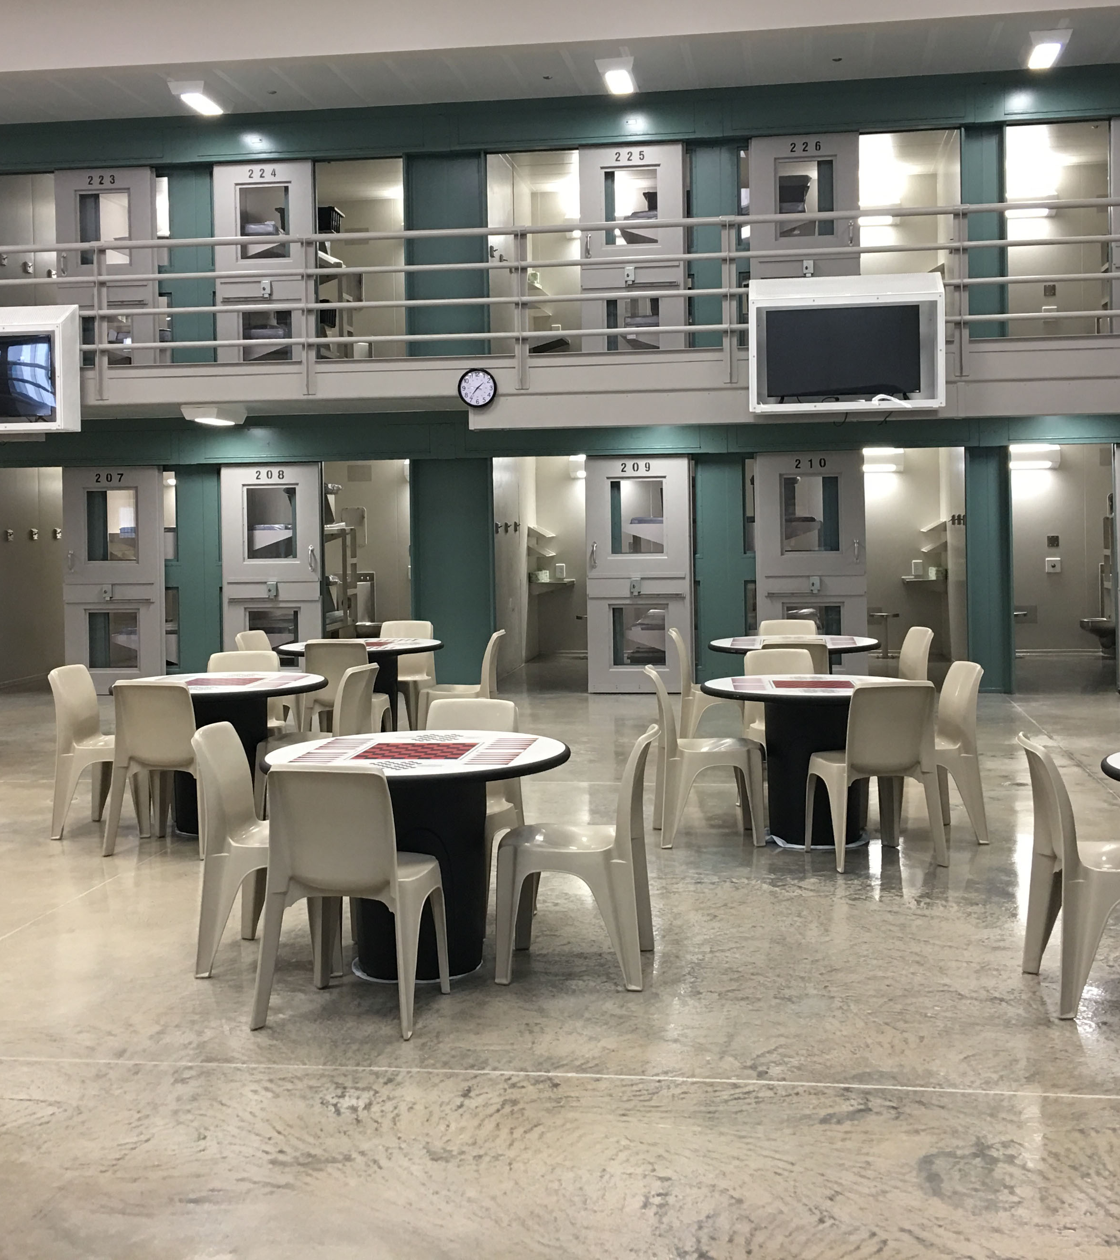
Thank you
John Kissinger
john.kissinger@dentoncounty.gov
940-349-1966

