Slide 1


Assisted Outpatient Treatment (AOT)
Presented by:
Melissa Hsi, LPC, LPHA
AOT Program Manager
David W. Jahn
Presiding Judge Denton County
Probate Court 1
Presentation Created by AOT LPHA Vashti Armendariz

Slide 2

Agenda
Introduction to AOT
Essential Elements of AOT
Denton County MHMR’s AOT Program Overview
AOT Referral process

Slide 3
Assisted Outpatient Treatment Defined
Assisted outpatient treatment (AOT) is the practice of providing outpatient treatment under civil court order to individuals with severe mental illness (SMI) who have demonstrated difficulty engaging with treatment on a voluntary basis. When systematically implemented and adequately resourced, AOT can dramatically reduce hospitalization, criminalization, and other adverse outcomes for its target population.
(Treatment Advocacy Center, 2022)

Slide 4
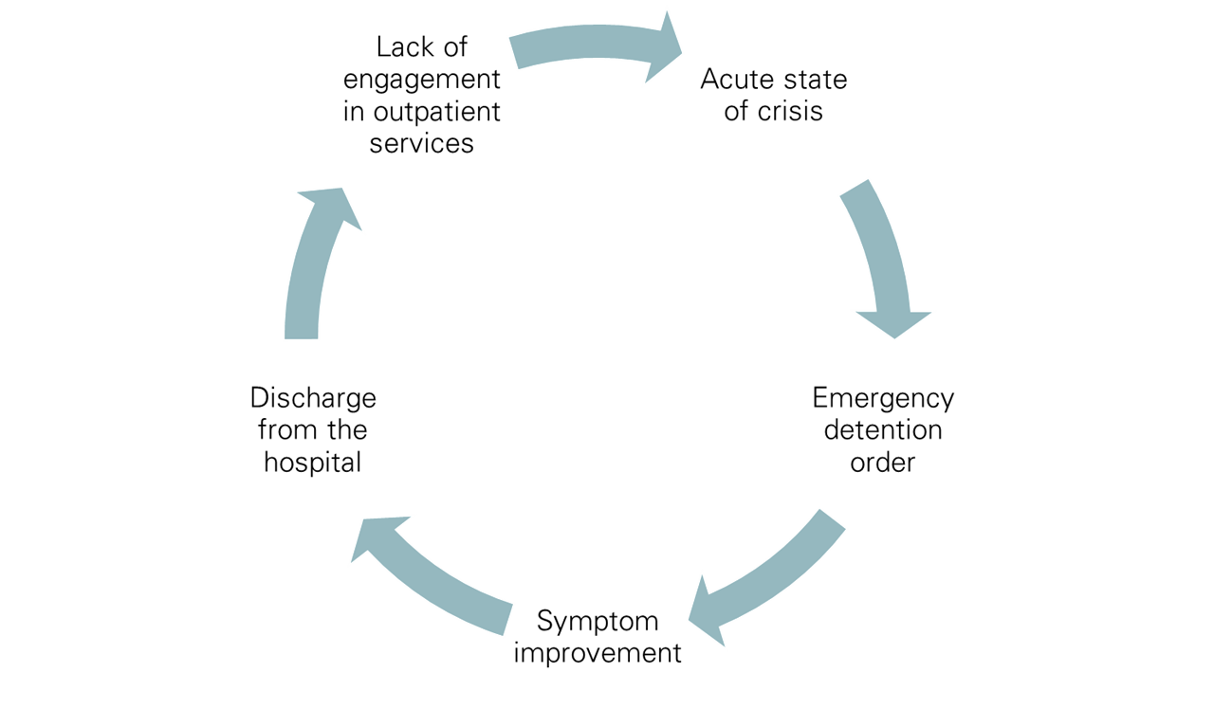
The Criminal Justice and Mental Health Systems
Untreated mental illnesses cause cycling through criminal justice and healthcare systems
Cycle of Recidivism
AOT prevents episodes that lead to arrests by providing consistent mental health care.
(National Alliance on Mental Illness (NAMI), n.d.)

Slide 5
Types of Assisted Outpatient Treatment
Temporary AOT
Duration up to 90 days
Texas Health and Safety Code 574.0345(a) provides criteria:
The person has a severe and persistent mental illness and could be at risk to suffer deterioration to the extent of being unable to safely live in the community.
The person requires outpatient mental health treatment to prevent symptom increase that would be likely to result in serious harm to self or others.
The person is unable to participate in outpatient mental health treatment effectively and voluntarily.

Slide 6
Extended AOT
Duration up to 1 year
Texas Health and Safety Code 574.0355(a) and (b) provide criteria:
Requires all criteria of temporary AOT, in addition to:
The person’s condition is expected to continue for longer than 90 days.
The person has received any of the following:
Types of AOT Cont.
Court ordered inpatient mental health services for a cumulative total of 60 days over the last year.
Court-ordered outpatient mental health services during the last 60 days.
A previous order of extended court ordered mental health services.

Slide 7






Denton County Mental Health Court Statistics 2024
69
22
7
Had 2 involuntary commitment cases
Had 4 involuntary commitment cases
1288
Had 3 involuntary commitment cases
Involuntary commitment cases
7
5
108
Had 5 involuntary commitment cases
With more than one involuntary commitment
Had 6 involuntary commitment cases

Slide 8

Denton County MHMR’s AOT Program
Funding
4-year grant through the Substance Abuse and Mental Health Services Administration (SAMHSA)
75 unduplicated individuals served per grant year
300 total individuals over 4 years

Slide 9
Program Goals
Decrease participant involvement with the criminal justice system
Motivate individuals to engage in mental health services
Ensure the safety and well being of program participants and the community
Increase access to care for individuals engaged in the program
Decrease re-hospitalizations for program participants

Slide 10


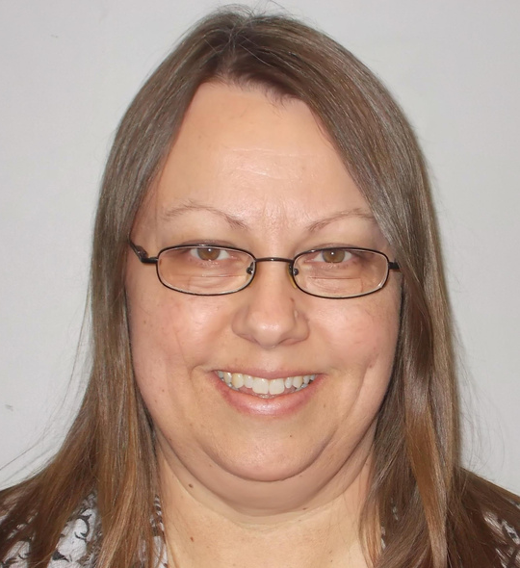
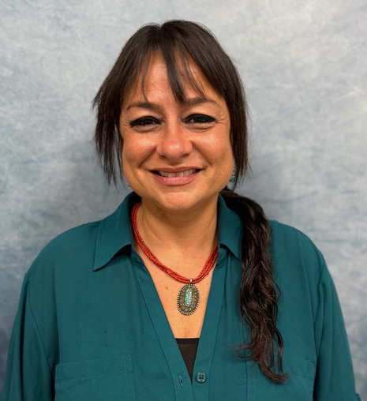

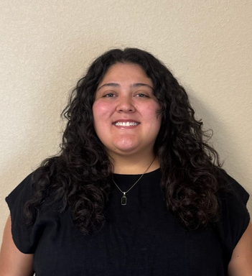


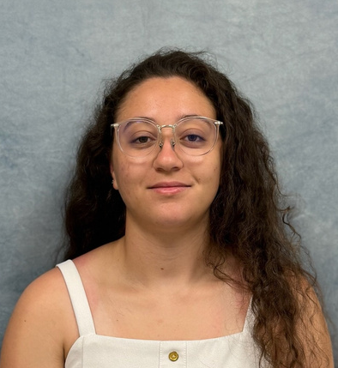
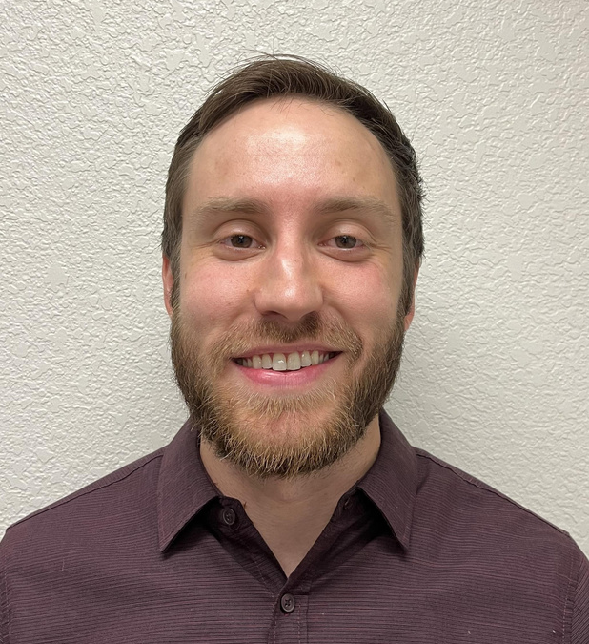

Meet the Team!
WAKEELAH ADELEGAN
REBECCA PEDERSEN
ADELA FRANCIS
Chief Clinical Officer
MELISSA HSI
AOT APRN
VASHTI ARMENDARIZ
AOT Peer Support Specialist
AOT Program Manager
AOT LPHA
GRACE TUCKER
STAR BRADFORD
CHARLOTTE SCHUESSLER
AOT Rehab Specialist
PAUL DALEO
AOT RN
LESLIE MORALES
AOT Rehab Specialist
AOT Rehab Specialist
AOT PCA

Slide 11

Services Provided
Intensive Case Management
Counseling
Peer Support Services
Medication Management
Judge Check-Ins (either bi-weekly or monthly)

Slide 12
Service Delivery
•Face to face (preferred) or a HIPAA compliant virtual option
•Community and office based
•Transportation for appointments can be provided
•Individual’s support system is included in treatment

Slide 13
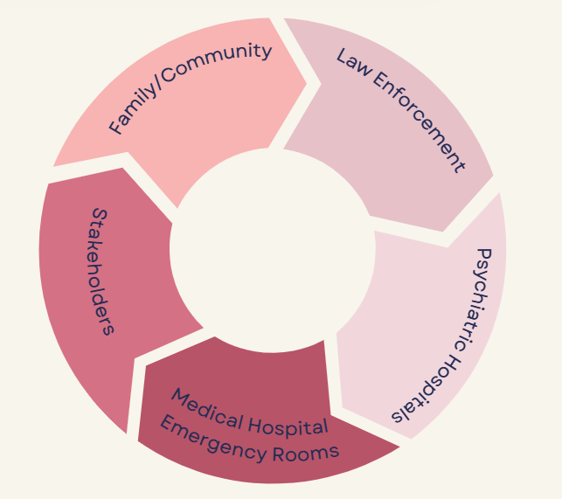
Referral Sources

Slide 14
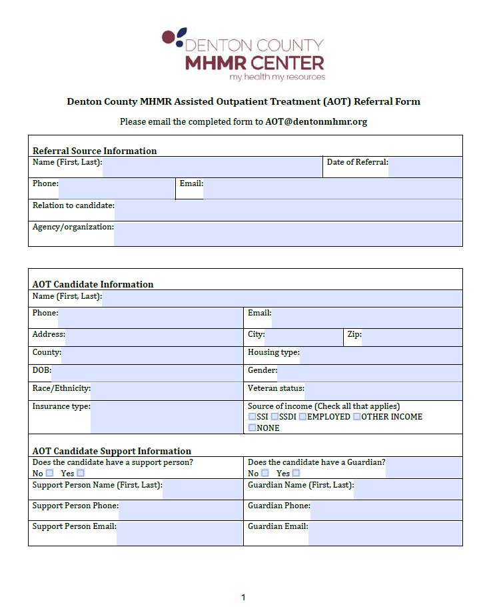
Referral Form
Fill out our referral form and email it to
aot@dentonmhmr.org
The AOT Program Manager will review the referral to determine program eligibility.
The earlier a referral is made the better!
A link to the referral form can be found on the Denton County MHMR website: https://www.dentonmhmr.org/services/special-programs/

Slide 15
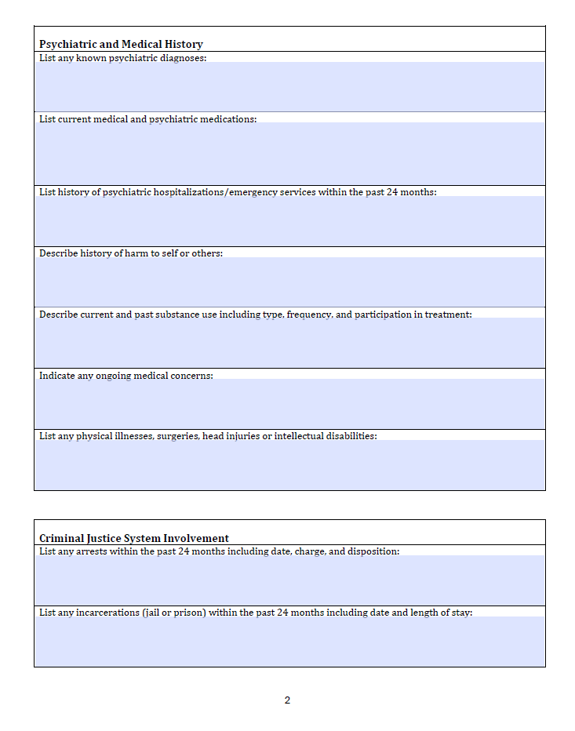
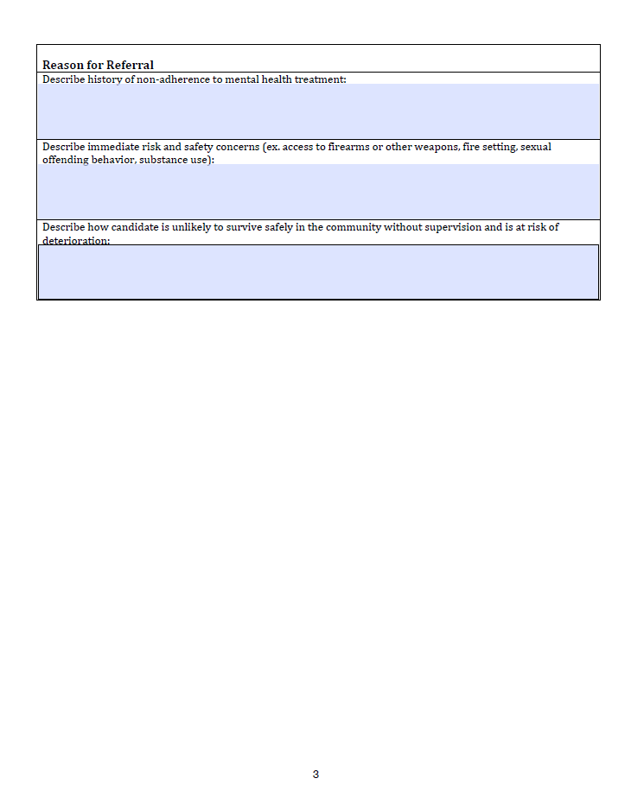

Slide 16
AOT Resources
https://www.tac.org/
https://www.tac.org/reports-publications/
https://texasjcmh.gov/media/svlj51l4/texas-aot-practitioners-guide.pdf
https://www.nami.org/
https://statutes.capitol.texas.gov/Docs/HS/htm/HS.574.htm

Slide 17
Connect With Us!
Please feel free to reach out to Melissa Hsi with any questions:
email: melissah@dentonmhmr.org
phone: 940-231-3268

Slide 18
Texas Health and Human Services Commission. (2023). Evaluation of Assisted Outpatient Treatment (AOT) programs in Texas.
National Alliance on Mental Illness (NAMI). (n.d.). The role of Assisted Outpatient Treatment in reducing criminal justice and healthcare cycling.
Treatment Advocacy Center, Texas Tech University School of Law, National Alliance on Mental Illness. (2022). Texas AOT Practitioners Guide.
National Alliance on Mental Illness (NAMI). (n.d.). Re-entry Post Incarceration NAMI Public Policy Position. nami.org. https://www.nami.org/wp-content/uploads/2023/07/Re-entry-for-web.pdf
References

