Slide 1

Boys are Sex Trafficked TOO: Training for First Responders
Landon Dickeson, MS, LPC, C-DBT
Chief Operating Officer

Slide 2
Important Definitions
Commercial Sexual Exploitation of Children (CSEC): Occurs when a child under the age of 18 exchanges sexual activity for money, material goods, or anything of value.
Sex Trafficking: Sex trafficking is the recruitment, harboring, transportation, provision, obtaining, patronizing, or soliciting of a person for the purpose of a commercial sex act in which a commercial sex act is induced by force, fraud, or coercion, or in which the person induced to perform such act has not attained 18 years of age.
Labor Trafficking: Labor trafficking involves the use of force, fraud, or coercion to compel a person to provide labor or services against their will and for the financial gain of another.
Survival Sex: A form of CSE; the selling of sex to meet subsistence needs. Because survival is at stake, this form of exploitation is not a choice.
Involuntary Servitude: A condition where a person is forced to work against their will through threats, coercion, or abuse, often with no freedom to leave or fair compensation. Labor trafficking often leads to involuntary servitude, but not all involuntary servitude arises from trafficking.
Human Smuggling: The illegal transportation of people across borders or into restricted areas, often to evade customs duties or import/export restrictions. It involves the facilitation of illegal entry of individuals across borders, often linked to other criminal activities such as trafficking and financial fraud.

Slide 3

Males Are The Most Overlooked Victims
Male-identifying youth represent up to 50% of sex trafficking victims
  The DOJ released a study citing 36% and that it is vastly underreported
  ECPAT International released a study citing 38% and that it is vastly underreported
  51% of missing foster children are male and multiple studies have cited missing foster youth as the highest risk population
There is overlap in the risk factors for males and females, but differences emerge in how they are perceived by providers and by the victims themselves
  Providers tend to diminish or overlook signs of trauma and exploitation that are more common in boys and men
  Males have a much higher rate of criminalization connected to exploitation than females
  Males are also far less likely to self-identify as victims

Slide 4

Red Flags of Trafficking
Male Specific
All Victims
History of repeated involvement with law enforcement or juvenile justice
Multiple placements in foster care
Frequent & repeated admission to psychiatric hospitals & emergency rooms
Clear signs of emaciation
Lack of personal belongings
Demanding & aggravated presentation
Tattoos or brands
Signs of physical injuries & abuse
Avoiding eye contact, social interaction, & authority figures
Seeming to adhere to scripted or rehearsed responses
Lacking official ID
Presenting with nice jewelry & clothes but no car or home
Having multiple new phones
Checking into motels with older adults
Poor physical & dental health
Tattoos that mark ownership
Untreated or repeat STIs

Slide 5
Types of Trafficking and Targeting
We have observed all categories and tactics that have been formally identified (pimp-controlled, “Romeo,” survival sex, gang-controlled, etc.)
  Most common type: “Romeo” and survival sex
Romeo style luring has been a common thread
  Promises of money, drugs, job, etc.
  Marriage
  A “way out” from family circumstances
Preying upon experience of being “misunderstood” by the “system”
Online exploitation that is often self-initiated then built upon

Slide 6
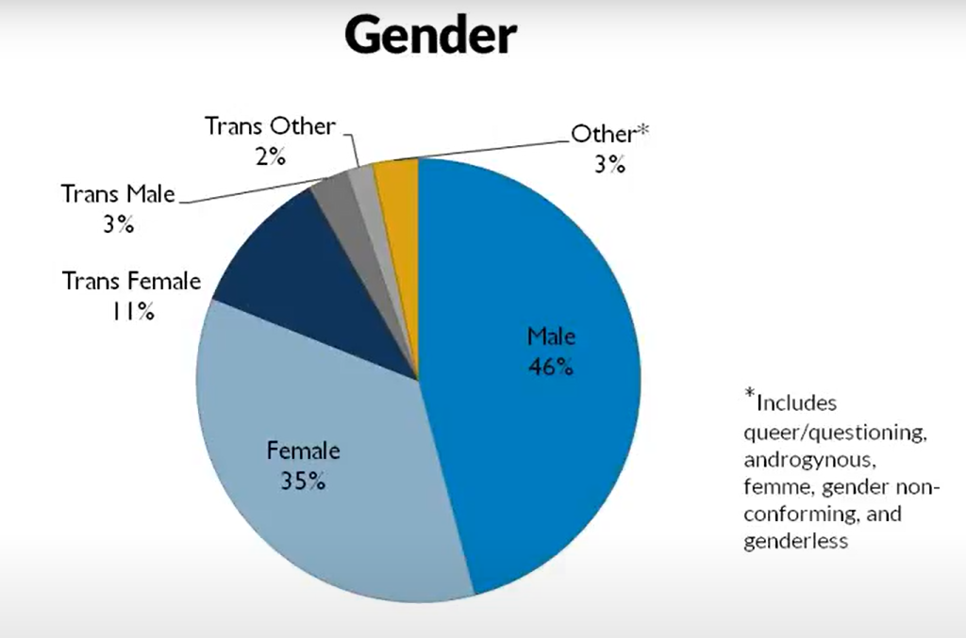
Survival Sex
Providers and society do not see survival sex as exploitation
  Most believe that exploitation MUST involve a third-party
Cis-males and TGNC individuals are highly likely to be exploited via survival sex
  Victims do not call it survival sex and often do not even recognize that they are being exploited. The fulfillment of a need such as nutrition, shelter, clothes, and safety can elicit what is termed survival sex.
  Drug exchanges are also forms of survival sex, as the use of the substance can be seen as equivalent to, and often more important than, the fulfillment of survival needs.
The justice system still prosecutes victims of survival sex, especially cis-males and TGNC individuals
The Urban Institute

Slide 7
Criminalization
Exploited cis-males remain largely invisible due to stigma and misidentification
Because males are seen to be "choosing" their exploitation, they are often prosecuted and jailed rather than identified and deferred to treatment
  There is a false personal agency of "choosing" to be exploited assigned to males that is not assigned to females
Male victims can be seen as potential exploiters who need to be stopped
  Victimization and perpetration can be linked for exploited youth
  Female youth are more likely to be seen as victims of exploitation compared to their male counterparts
  Males are typically seen as only perpetrators and rarely considered as victims
Male victims receive heavier and longer sentencing for petty crimes compared to their female counterparts
  In some cases, victims are receiving longer prison sentences than their trafficker

Slide 8
The Role of Technology
All victims use technology for survival sex and access to drugs
Communication via chat features on gaming platforms
  Common thread and major breach point for many programs
Online ads
  Common websites: mintboys.com, friendboy.pro, megapersonals.eu, jock2go.eu, tsescorts.com, Grindr, Facebook, Craigslist, WhatsApp, TikTok, OnlyFans
Normalize problematic sexual behavior and exploitation
  Often starts as a source of seeking approval and gratification
Grooming often starts with online communication

Slide 9
Tips for First Responders
Believe their story
  Many have been denied services simply because they were not believed
  Many were labeled as “just a bad kid” without any inquiry as to why they were acting out
Apply trauma-informed care even in the face of anger and acting out
  Relapses are part of recovery
Increased training on the identification of males and male tailored services
  Ex: SANE exams for males (not commonly available)
Increased funding for and opportunities to receive services for males, especially those identified as missing from foster care

Slide 10
Community Response
Gaps for Male Victims
Solutions for Male Victims
Lack of housing & comprehensive treatment response
Limited training for all first responders, teachers, service providers, and business owners
Uncoordinated emergency & long-term response
Underdeveloped cross jurisdictional collaboration at local, state, & national levels
Low funding priority for operational costs
Housing that is trauma-informed and holistic
Mandate training on myths, misconceptions, & best practices
Invest in collaborative efforts across multiple social domains
Develop partnerships across state lines that enhance services for survivors
Increase funding for frontline response and long-term treatment

Slide 11
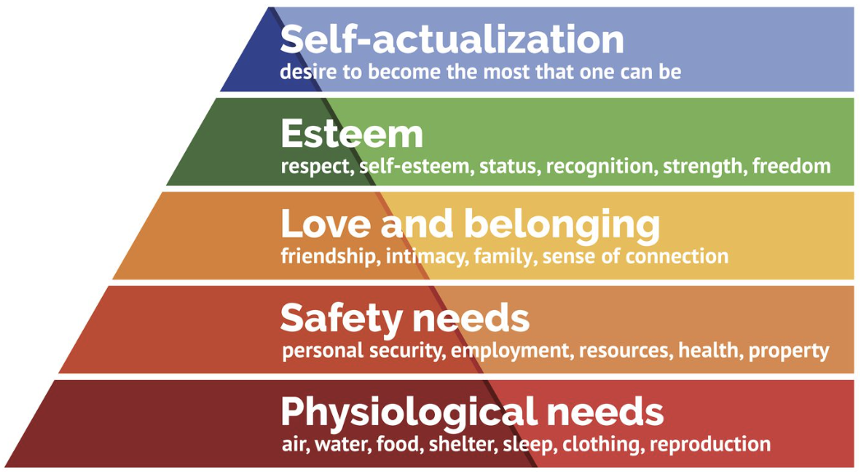
Survivor Care
Utilizing a Maslow-integrated approach, the holistic support of unseen survivors is both effective and trauma-informed
Stable implementation of safety is required to counter complex trauma
Stages of the program mirror the developmental stages of childhood
Meet needs holistically, practically, and quickly
  Physical, Medical, Mental, Emotional, and Spiritual
Comprehensive case management
Meet the survivor where they are at
Tolerate relapses as part of recovery
Maslow's Hierarchy of Needs

Slide 12
Bob’s House of Hope
The first, and only, safe house in the country for male youth who have been sex trafficked
Free, safe housing for up to 4yrs
Medical & Dental care
Legal assistance
Psychiatric and Psychological evaluation
Medication management
Proper nutrition
Trauma-informed counseling
Spiritual and religious services
Survivor Advocacy
GED and Higher Education
Career skills development
Intensive case management
Mentorship
Single occupancy rooms
Individualized treatment plan
Life skills development
Community reintegration
Extracurricular and experiential learning

Slide 13
References
Hopper, E. (2020). Maslow's hierarchy of needs explained. Thoughtco.com. https://www.thoughtco.com/maslows-hierarchy-of-needs-4582571
Lillywhite, R., & Skidmore, P. (2006). Boys Are Not Sexually Exploited? A Challenge to Practitioners. Child Abuse Review, 15(5), 351–361. https://doi.org/10.1002/car.952
Perry, D., Basson, D., Cuevas, S., & Tebow, C. (2023). Exploitation and Gender: Increasing the Visibility of Cismale, Transgender, and Gender Nonconforming Youth. Oakland, CA. WestCoast Children’s Clinic.
Swaner et al., Youth Involvement in the Sex Trade, 36.
Willis, B., Roberts, N., & Friedman, S. A. (2013). And Boys, Too. ECPAT-USA.
Yalom, I.D.(2017). The gift of therapy: An open letter to a new generation of therapists and their patients. Harper Perennial.
1in6, Sexual Abuse & Assault of Boys, (n.d.).
https://combatinghumantrafficking.com/risk-factors-protective-factors-and-preventing-human-trafficking/
https://www.acf.hhs.gov/sites/default/files/documents/fysb/acf_issuebrief_htprevention10202020final508.pdf
https://www.acf.hhs.gov/blog/2023/02/teen-dating-violence-can-lead-human-trafficking-healthy-relationships-can-prevent-both
https://polarisproject.org/
https://www.ilo.org/
https://www.hhs.gov/
https://nij.ojp.gov/topics/articles/practical-guide-interviewing-potential-human-trafficking-victims
Data was further pulled from various articles published by DOJ, AG, DFPS, and other government agencies.

