Slide 1


Denton Co. MHMR Center
CRISIS RESIDENTIAL UNIT

Slide 2
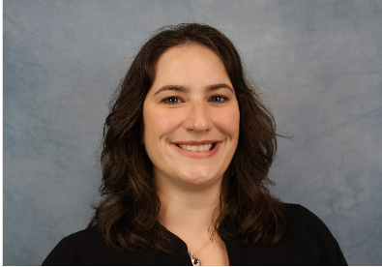

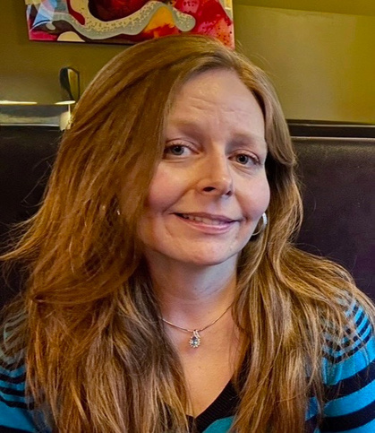
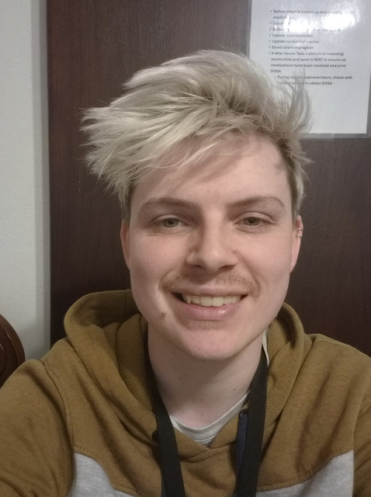
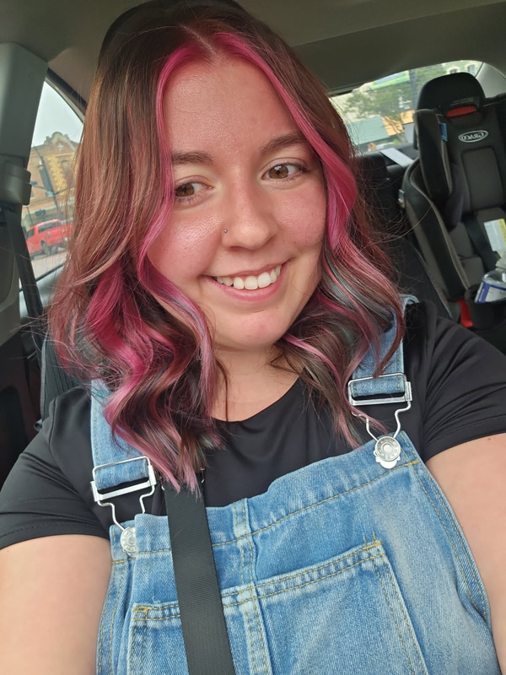
About the Team:
Morgan Quinnelly, B.A., QIDP,
Chief Integration Officer
Lilliesha Grandberry, M.Ed, LPC-S
Senior Director, Community Integration Services
Amanda Lechner, B.A, QMHP-CS
CRU Team Lead
Jacob Gerik, QMHP-CS
CRU Team Lead
Rachel Shifflett, LVN CRU Nurse

Slide 3
What is a Crisis Residential Unit?
Our Crisis Residential Unit (CRU) is a 9-12 bed facility that provides short-term, 24/7 residential support for individuals experiencing a mental health crisis. It offers a safe and structured environment to stabilize, heal, and prepare for the next steps toward recovery.

Slide 4
What we Provide?
  Compassionate & caring staff
    9 Qualified Mental Health Professionals (QMHP-CS)
    3 Psych Techs
    2 Team Leads
    1 Case Manager
    1 Weekday LVN
  Therapeutic support tailored to individual needs
  A calm, home-like setting away from hospitals

Slide 5
Our Approach
Educational and Skills-based groups*
CRU provides a secure, structured setting designed to promote stabilization, healing, and readiness for the next phase of the individual’s mental wellness journey.
Case Management services
Psychiatric Services
24/7 Support
*Pathways for collegiate and professional development starting Winter 2025

Slide 6
Who Can Benefit?
CRU is designed for individuals facing:
  Acute emotional distress or mental health crises
  A need for a safe place as an alternative to hospitalization
  Support to transition from inpatient care back to community living
Family members and caregivers also benefit from knowing their loved ones are in supportive hands.

Slide 7
How to Access our Crisis Residential Unit:
Referral or Self-Referral:
  Referrals accepted from hospitals
  Medical/mental health providers
  Law enforcement
  Universities or colleges
  Families, or individuals themselves can walk-in to our Psych Triage for assistance
CRUREFERRALS@DENTONMHMR.ORG

Slide 8
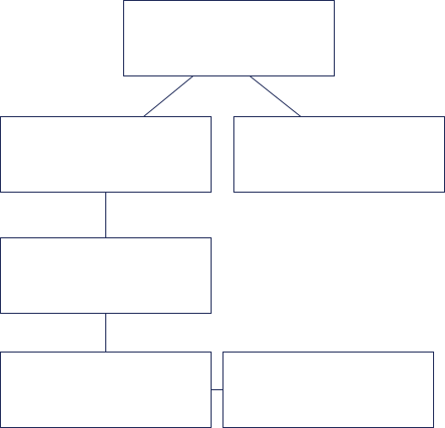
Admission Process
Referral submitted from community partner
Meets Criteria, Assessment scheduled
Does not meet criteria - referred to other resources
Provisional Acceptance
Proceed to Nursing Assessment
Successful admission to CRU

Slide 9











Day in the Life
Breakfast/
Medication time
Stress Mgt.
Group
Morning Process Group
Expressive Arts Group
Snack Time / Coping Sklls group
Dinner / Chores
Lunch/Chores/ Medication time
Individual wellness time
Boundaries
Group
Evening Process Group
Snack Time
Lights Out

Slide 10
Thank you!
Lilliesha Grandberry, M.Ed, LPC-S
Senior Director, Community Integration Services
Lillieshag@dentonmhmr.org

