Slide 1

Denton County LOSS Team
Providing solace, hope, and strength for those affected by suicide

Slide 2
Our Mission
The Denton County LOSS Team (Local Outreach to Suicide Survivors) exists to provide immediate, compassionate, and ongoing support to individuals and families who have lost a loved one to suicide. Through timely on-scene response, personalized grief resources, and follow-up care, we help survivors navigate the earliest stages of loss with dignity, connection, and hope—ensuring that no one in Denton County faces suicide loss alone.

Slide 3
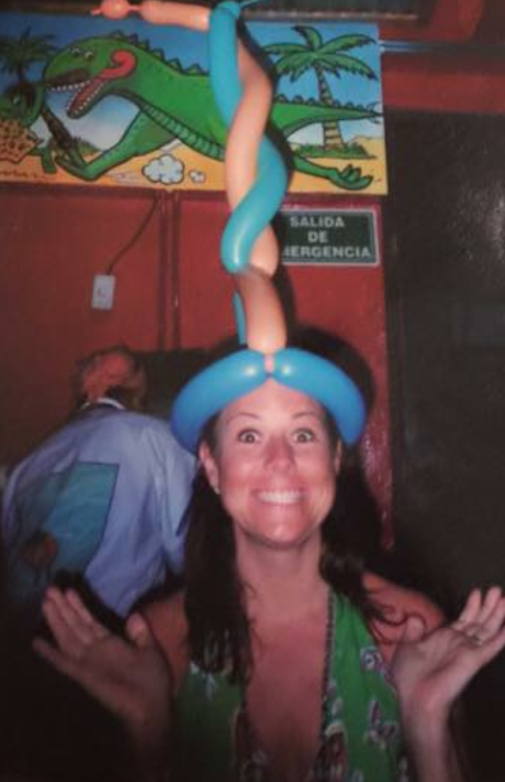
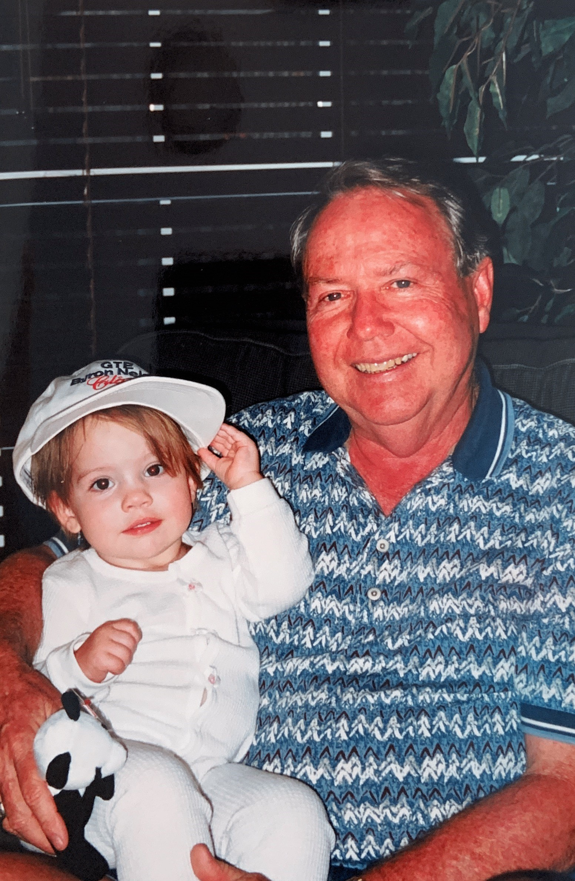
My Story
1970 - 2015
1931 - 2021

Slide 4
Suicide Death Rates Per 100,000

Slide 5
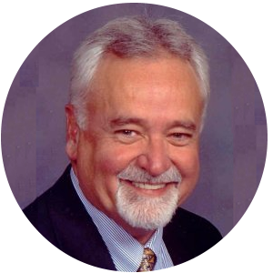
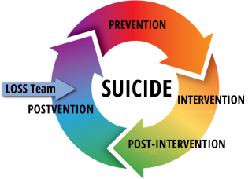
History of L.O.S.S.

Slide 6
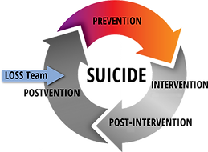
Circular Model of Suicide Reduction

Slide 7
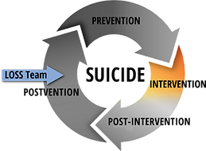
Circular Model of Suicide Reduction

Slide 8
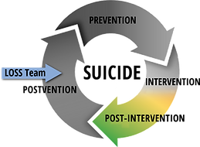
Circular Model of Suicide Reduction

Slide 9
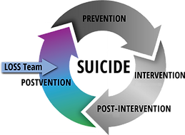
Circular Model of Suicide Reduction

Slide 10
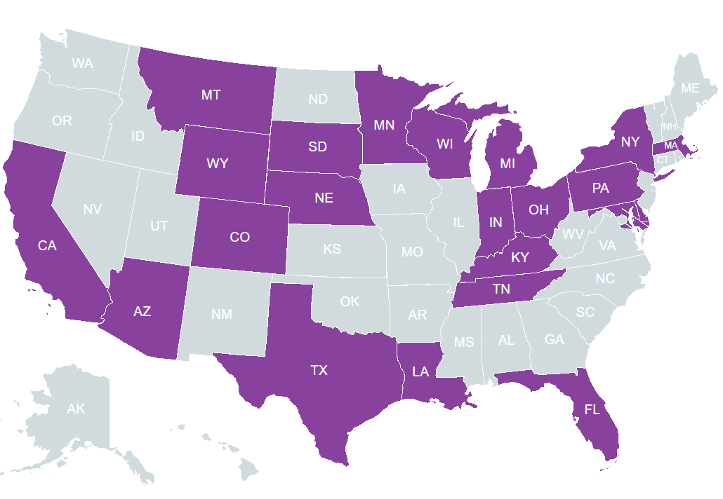
Our Mission

Slide 11
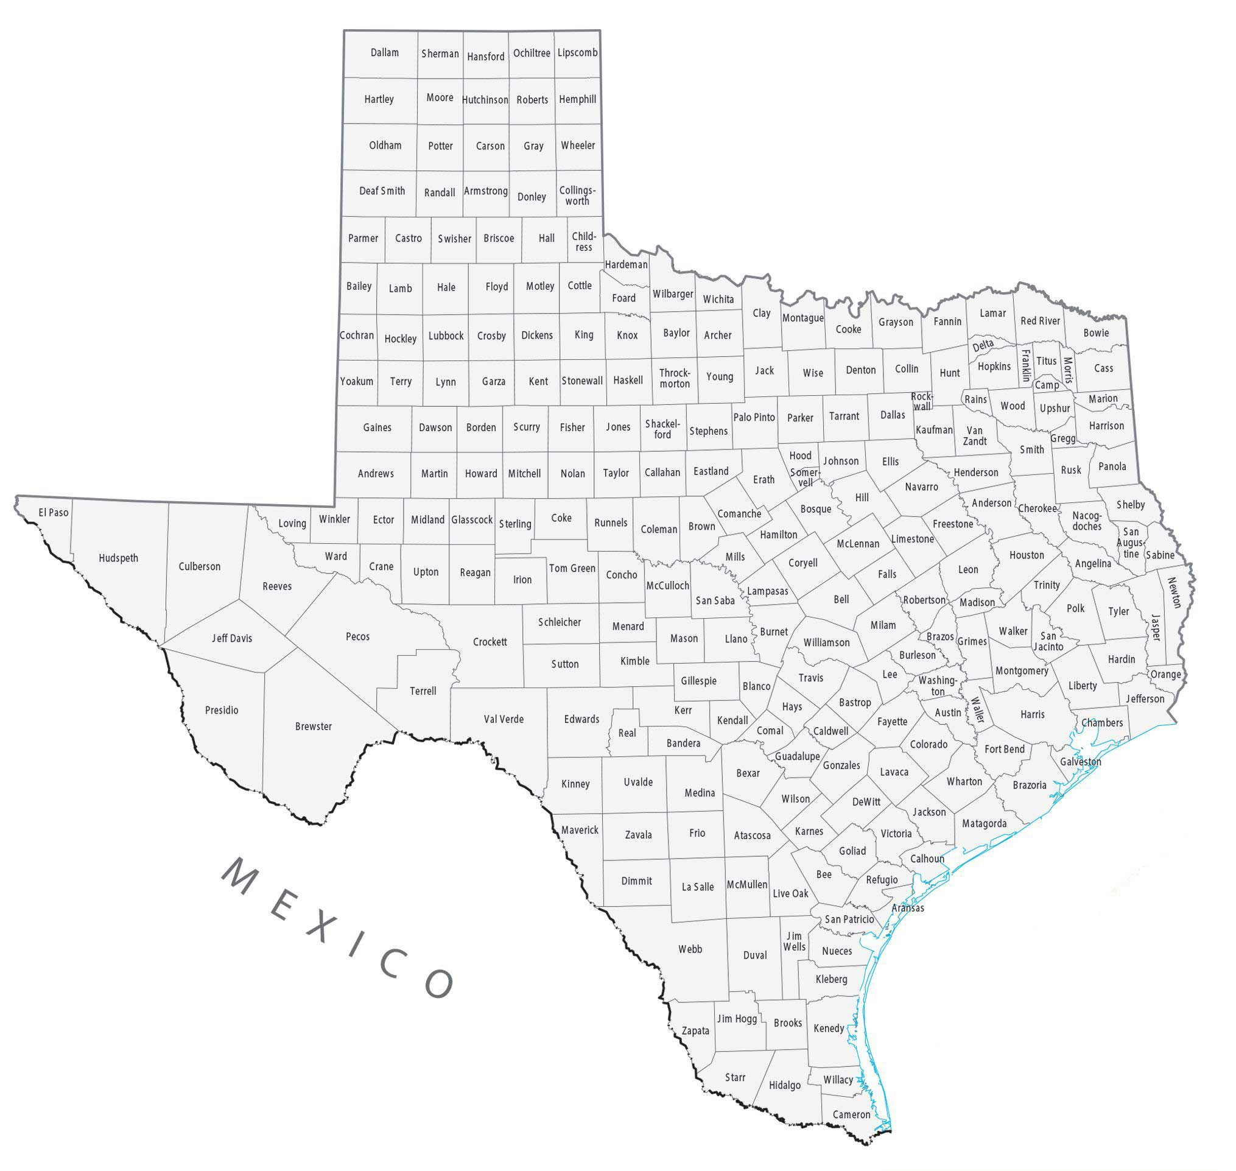
Notes:
A LOSS (Local Outreach to Suicide Survivors) Team consists of two or more trained volunteers who are activated by the local authorities (Coroner’s/M.E. Office, Law Enforcement) when there is a suspected suicide loss. While LOSS Teams may function uniquely from community to community, there are three consistencies across teams.

Slide 12
1
2
3
L.O.S.S Teams share the same purpose. To be an instillation of hope to the newly bereaved.
L.O.S.S. Team members provide support, a connection to resources, and most importantly – they plant seeds of hope.
L.O.S.S Teams are contracted by local authorities to proactively reach out to those left behind after a suspected suicide loss.
L.O.S.S Teams are peer-based. At least one of the two volunteers has lost someone close to them to suicide.
Notes:
A LOSS (Local Outreach to Suicide Survivors) Team consists of two or more trained volunteers who are activated by the local authorities (Coroner’s/M.E. Office, Law Enforcement) when there is a suspected suicide loss. While LOSS Teams may function uniquely from community to community, there are three consistencies across teams.

Slide 13
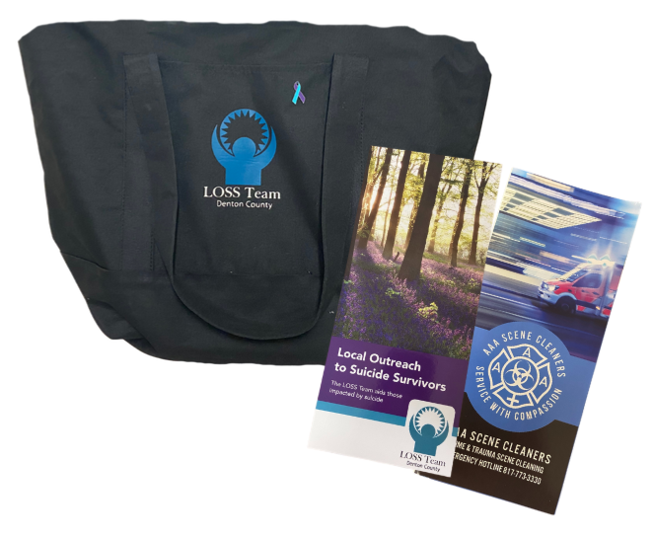
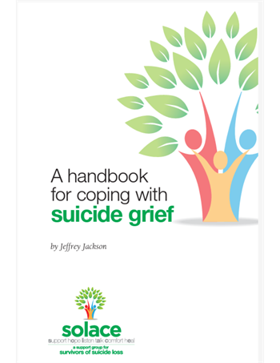
Immediate, on-scene support:
When a suicide occurs, the Denton County L.O.S.S. Team responds within hours to provide compassionate presence and crisis resources, ensuring families are not alone in their most vulnerable time.

Slide 14
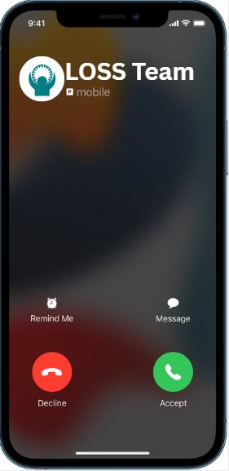
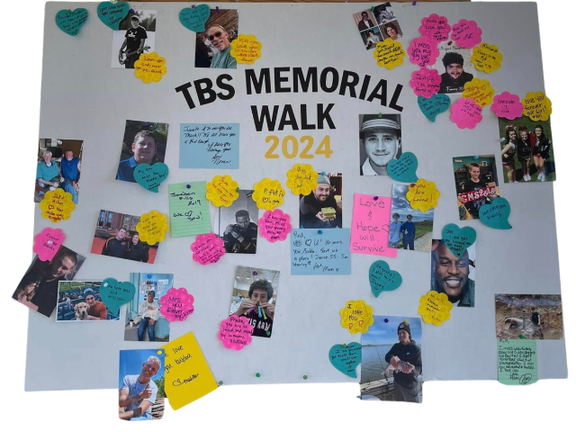

Long-term care:
We follow up regularly—within the first week, month, and up to a year—through visits, phone calls, and check-ins to help reduce isolation and the risk for additional suicide deaths.

Slide 15
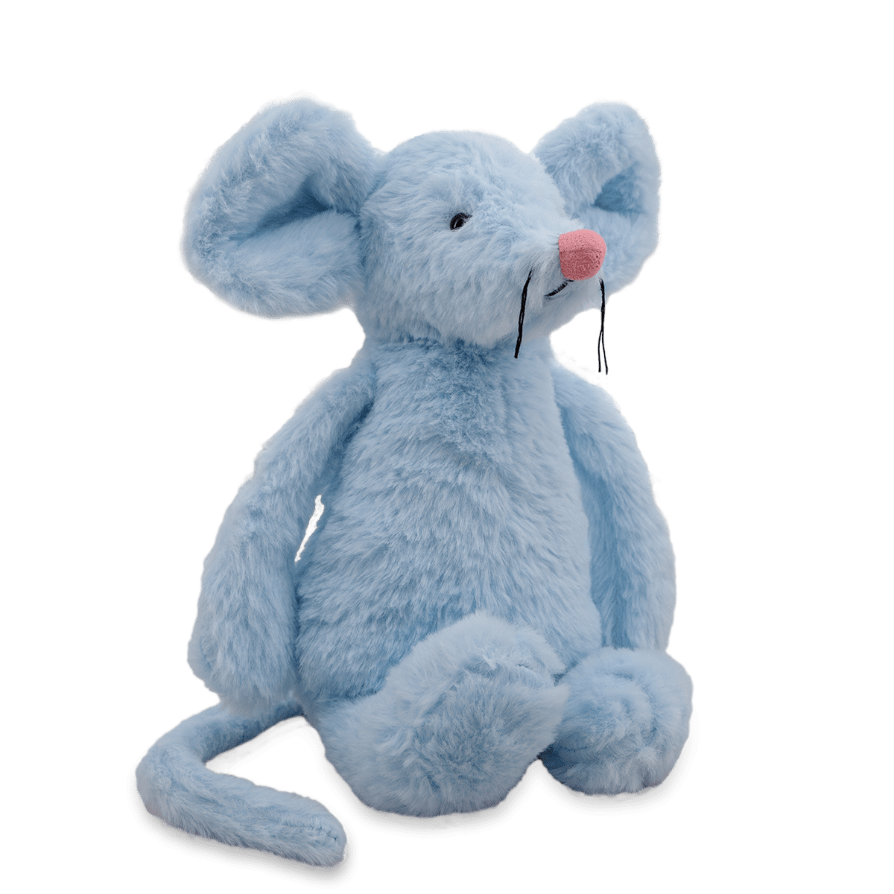



Free grief resources:
From comfort kits for children (stuffed animals, blankets) to guidance books for adults, and even funding for biohazard cleanup, we ease the immediate burden on families.

Slide 16

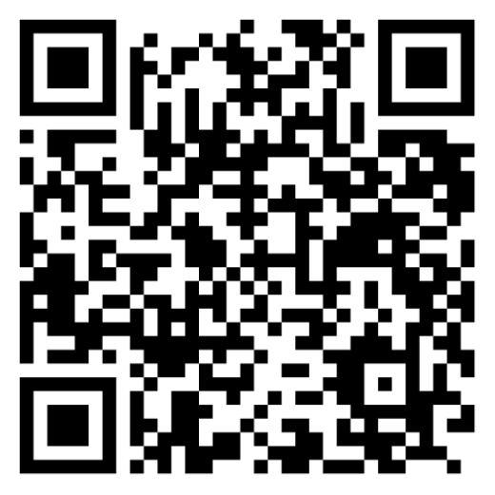

Slide 17
Denton County LOSS Team
thanks you

