Slide 1

Mobile Crisis Outreach Team (MCOT)

Slide 2
What is MCOT?
Mobile Crisis Outreach Team (MCOT) is a team that is comprised of Qualified Mental Health Professionals and/or a licensed professional, who complete Risk of Harm Assessments for individuals experiencing a mental health crisis.
MCOT staff are available to complete Risk of Harm Assessments 24 hours a day, 7 days a week, 365 days a year.
Assessments are completed both in person (anywhere in Denton County) and virtually.
Between the hours of 8am-5pm, MCOT also provides outpatient crisis services including but not limited to follow ups, counseling, and case management.
There is a mobile crisis outreach oncall team that works overnights and weekends.
Individuals interested in crisis outpatient services can receive weekly case management, weekly counseling, and medication management for a 90-day period.

Slide 3
What is a Risk of Harm Assessment?
MCOT receives referrals from all over Denton County. Referrals can come from:
Local medical and behavioral health hospitals
Law enforcement
Denton County and City jails
Stand alone emergency rooms
Doctors offices
Friends and family members
Tarrant County Crisis Line and more
The Risk of Harm assessment consists of questions regarding risk to self and/or others. Information MCOT assessors will obtain:
A detailed timeline of the individual’s suicidal and homicidal thoughts and behaviors
Significant symptoms of deterioration
Disturbed thinking
Physical health
Trauma
Exploitation
Substance use
Primary goal of a Risk of Harm assessment: to make a recommendation for treatment using least restrictive measures.

Slide 4
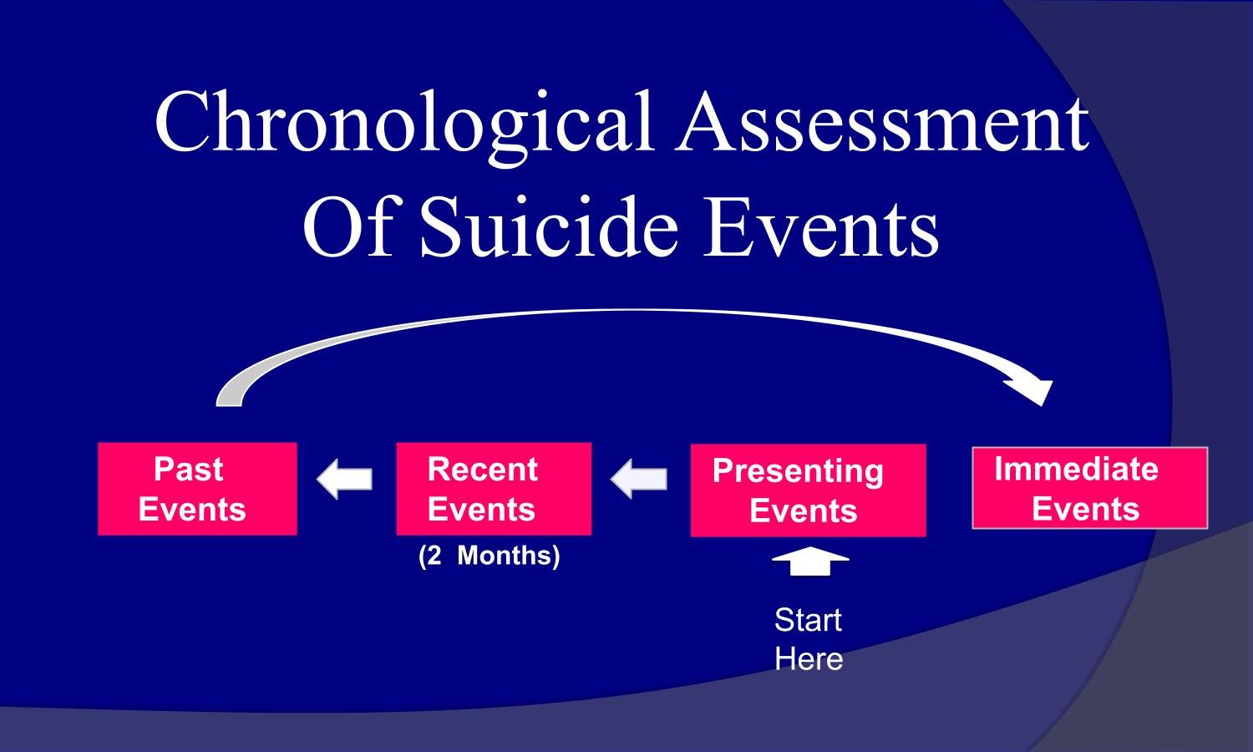
How do we get the Risk of Harm Timeline?
Case Approach (Chronological Assessment of Suicide Events)
The Case approach is used to help uncover suicidal ideation by engaging the individual in a conversational fashion. This approach helps the clinician and individual build rapport.
The clinician asks direct questions which uncover the risk of harm timeline.
Presenting events (past 48 hours); what prompted the current assessment?
Recent events (past two months); Examines other suicidal thoughts, plans, or behaviors.
Past events: examine past suicide attempts with the focus on the most recent and most lethal.
Immediate events (right now): This focuses on current ideation and intent.

Slide 5
Case Approach Validity Technique Examples
Behavioral incidents
“How many pills did you take? Did you tell anyone that you took the pills? Where were you when you took the pills?”
Gentle Assumptions
“What other ways have you thought of killing yourself? What types of drugs have you used?”
Denial of Specifics
After asking “have you thought of killing yourself?” without a response from the individual, the clinician will then ask specific questions: “Have you thought of overdosing?”
Symptom Amplification
“How many times have you attempted to kill yourself? 5, 50, 75?”

Slide 6
How do our Recommendations get carried out?
Outpatient Recommendations
Outpatient
Phone check-ins
Minimum of 2 follow up’s
Referrals (including the Center’s outpatient services)
Outpatient with Ensure of Safety
Phone check-ins
Ensure of Safety agrees to stay with the individual (eye-sight and ear-shot) until their 24-hour follow-up appointment.
Minimum of 2 follow-ups.
Referrals (including the Center’s outpatient services)
Outpatient to Crisis Residential Unit (CRU)
7-14 days (not a homeless shelter, halfway house, or detox center)
8 beds (4 male, 4 female and 1 special population bed)
Skills training groups, stabilization, and re-integration
Step down from inpatient psychiatric hospitalizations and incarcerations
Inpatient
Voluntary – The center will search for placement at our contracted hospitals.
Individuals without insurance will receive, on average of 5 center funded days, if additional days are needed a clinical assessment if completed. Individuals with insurance can be placed at any hospital who will accept the individual's insurance.
Involuntary – The MCOT staff will reach out to local law enforcement, Crisis Intervention Response Team (CIRT), or Mental Health Deputies who will then determine appropriateness for Emergency Detention Order (EDO). Some will ask for our help finding placement and we will attempt to secure a bed at our contracted hospitals

Slide 7
What is Safety Planning?
After a Risk of Harm assessment clinician and client work collaboratively to create a safety plan.
Safety plans can be re-used when future crisis or suicidal ideation returns as they help the individual identify:
Warning signs
Internal coping strategies to use in times of crisis
Family members/friends who can help during a crisis
Mental Health Professionals
Ways Reduce access to lethal means
Ways to make their environment safe
Reason for living

Slide 8
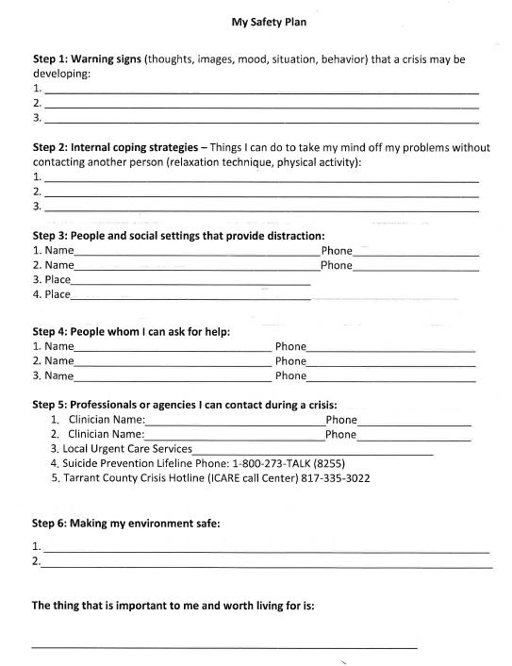
Safety Plan

Slide 9
24-hour and 2nd Follow-up
Individuals screened by a Center crisis team who received an outpatient recommendation will receive a 24-hour follow-up (face-to-face preferred), regardless of county of residence or level of care that they qualified for.
During this 24-hour follow-up, MCOT staff will inquire about their interest in continuing mental health related services.
If the individual expresses interest in Center services, they can be enrolled into a level of care at their 2nd follow-up.
If they would prefer to follow-up with a private outside provider, resources will be provided, and center staff will check-in at their 2nd follow-up.
Individuals who went inpatient on a voluntary or involuntary recommendation will receive a 24-hour follow-up in the hospital they were placed at. The follow-up is conducted by hospital liaison staff and behavioral health hospital staff by phone. Hospital Liaison staff continue to follow up until the individual is discharged.

Slide 10
LOC5
90-days
Weekly Case management
Skills Training
Coping Skills
Transportation
Referrals
Advocation
Weekly Counseling (Optional)
Cognitive Behavior Therapy (CBT)
Medication Management (Optional)
Goal-Stabilization and transition

Slide 11
What is Psychiatric Triage?
The Center’s Psychiatric Triage Facility is available to individuals experiencing a mental health crisis.
Monday through Friday, staff are available:
On-site from the hours of 7:00am -10:00pm and,
Virtually 11:00pm – 7:00am
On the weekends, staff are available:
Virtually from 9:00am – 5:00pm
The Psychiatric Triage Staff complete a risk of harm assessment for individuals experiencing a mental health crisis to determine appropriate level of care and ensure safety.
Psychiatric Triage Contact Number: (940) 381-9965, option 7

Slide 12
Thank you
Catherine Pike, MS, QMHP, CRC, LPC-Associate
Director of Crisis Services
Supervised by Marsha Wells-Pegram LPC-S
catherinep@dentonmhmr.org

