Slide 1
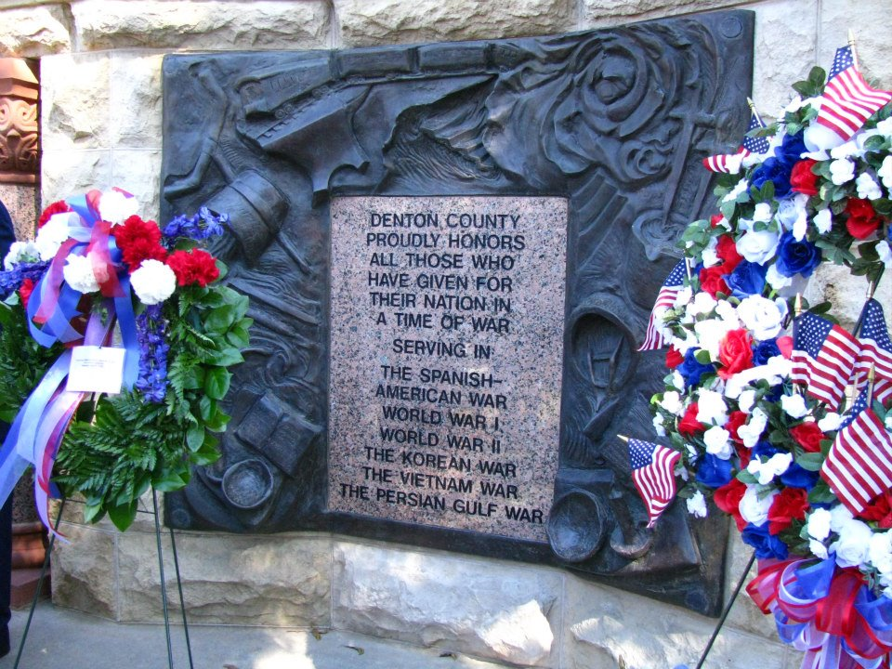
Veteran Service Office
1996

Slide 2
VSO Services
The Department of Veterans Affairs (DVA) benefit programs available to veterans and/or dependents.
They are:
  Home Loan (Guarantee)
  Burial
  Compensation & Pension
  Health Care (VA Mission Act)
  Education (Post 9/11 GI Bill, Jan 2013 Forever Bill)
  Vocational Rehabilitation (Veteran Readiness and Employment)
  Life Insurance
  Appeals Process
  Veteran Community Navigator *

Slide 3
Denton County Veterans
41,319

Slide 4
Veteran Community Navigators
Success:
358 Client Referrals 2025
Case Managers Employees of Denton County
$300,000+ Emergency Financial Assistance Funds*
90% Clients referred/given MH Treatment
Homeless Veteran Program
Transportation
Food/Clothing
Navigation of Veteran Resources

Slide 5
The PACT Act August 10, 2022
Gulf War, Post 9/11 and Vietnam Era Veterans
Expands VA health care and benefits for Veterans exposed to burn pits, Agent Orange, and other toxic substances
TERA – Toxic Exposure Risk Assessment claims
For Gulf War and Post 9/11 Veterans, over 20+ Presumptive Disabilities
  Cancers
  Respiratory Conditions
Vietnam Veterans
  5 Locations added for Agent Orange exposure (Laos, Cambodia, Thailand, Guam and Johnson Atoll
  Two disabilities added: HTN and MGUS (Now 19 total presumptives)
3 New Response efforts for Radiation Presumptive Locations
  Cleanups at Enewetak Atoll, B-52 Palomares Spain, and Thule AFB Greenland

Slide 6
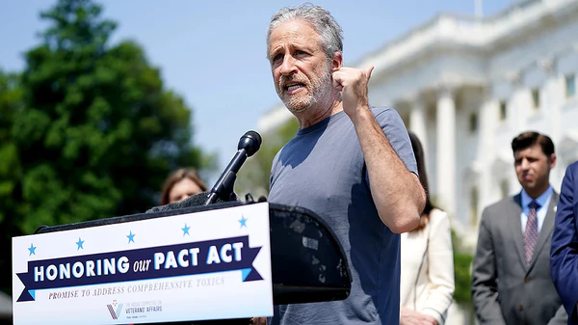
Jon Stewart, renowned comedian, writer, and host of "The Daily Show”. Stewart's efforts have been instrumental in raising awareness and pushing for legislative changes, such as the Honoring Our PACT Act of 2022

Slide 7
Benefits to Denton County
FY 2024
  $508 Million $420 Million Comp/Pen
FY 2023
  $594 Million $384 Million Comp/Pen
FY 2022
  $515 Million $337 Million Comp/Pen
FY 2021
  $428 Million $265 Million Comp/Pen

Slide 8
STAFF
Donald Phillips
Assistant County Service Officer
Spencer Kimball
Assistant County Service Officer
Stella Bartlett
Assistant County Service Officer
Eric Anders
Assistant County Service Officer
Liz Emerson
Veteran Community Navigator
Nikki Perez
Veteran Community Navigator
Mary Rodriguez
Administrative Assistant

Slide 9
All Services Provided
by
Appointment
940-349-2950
QUESTIONS?

