Slide 1
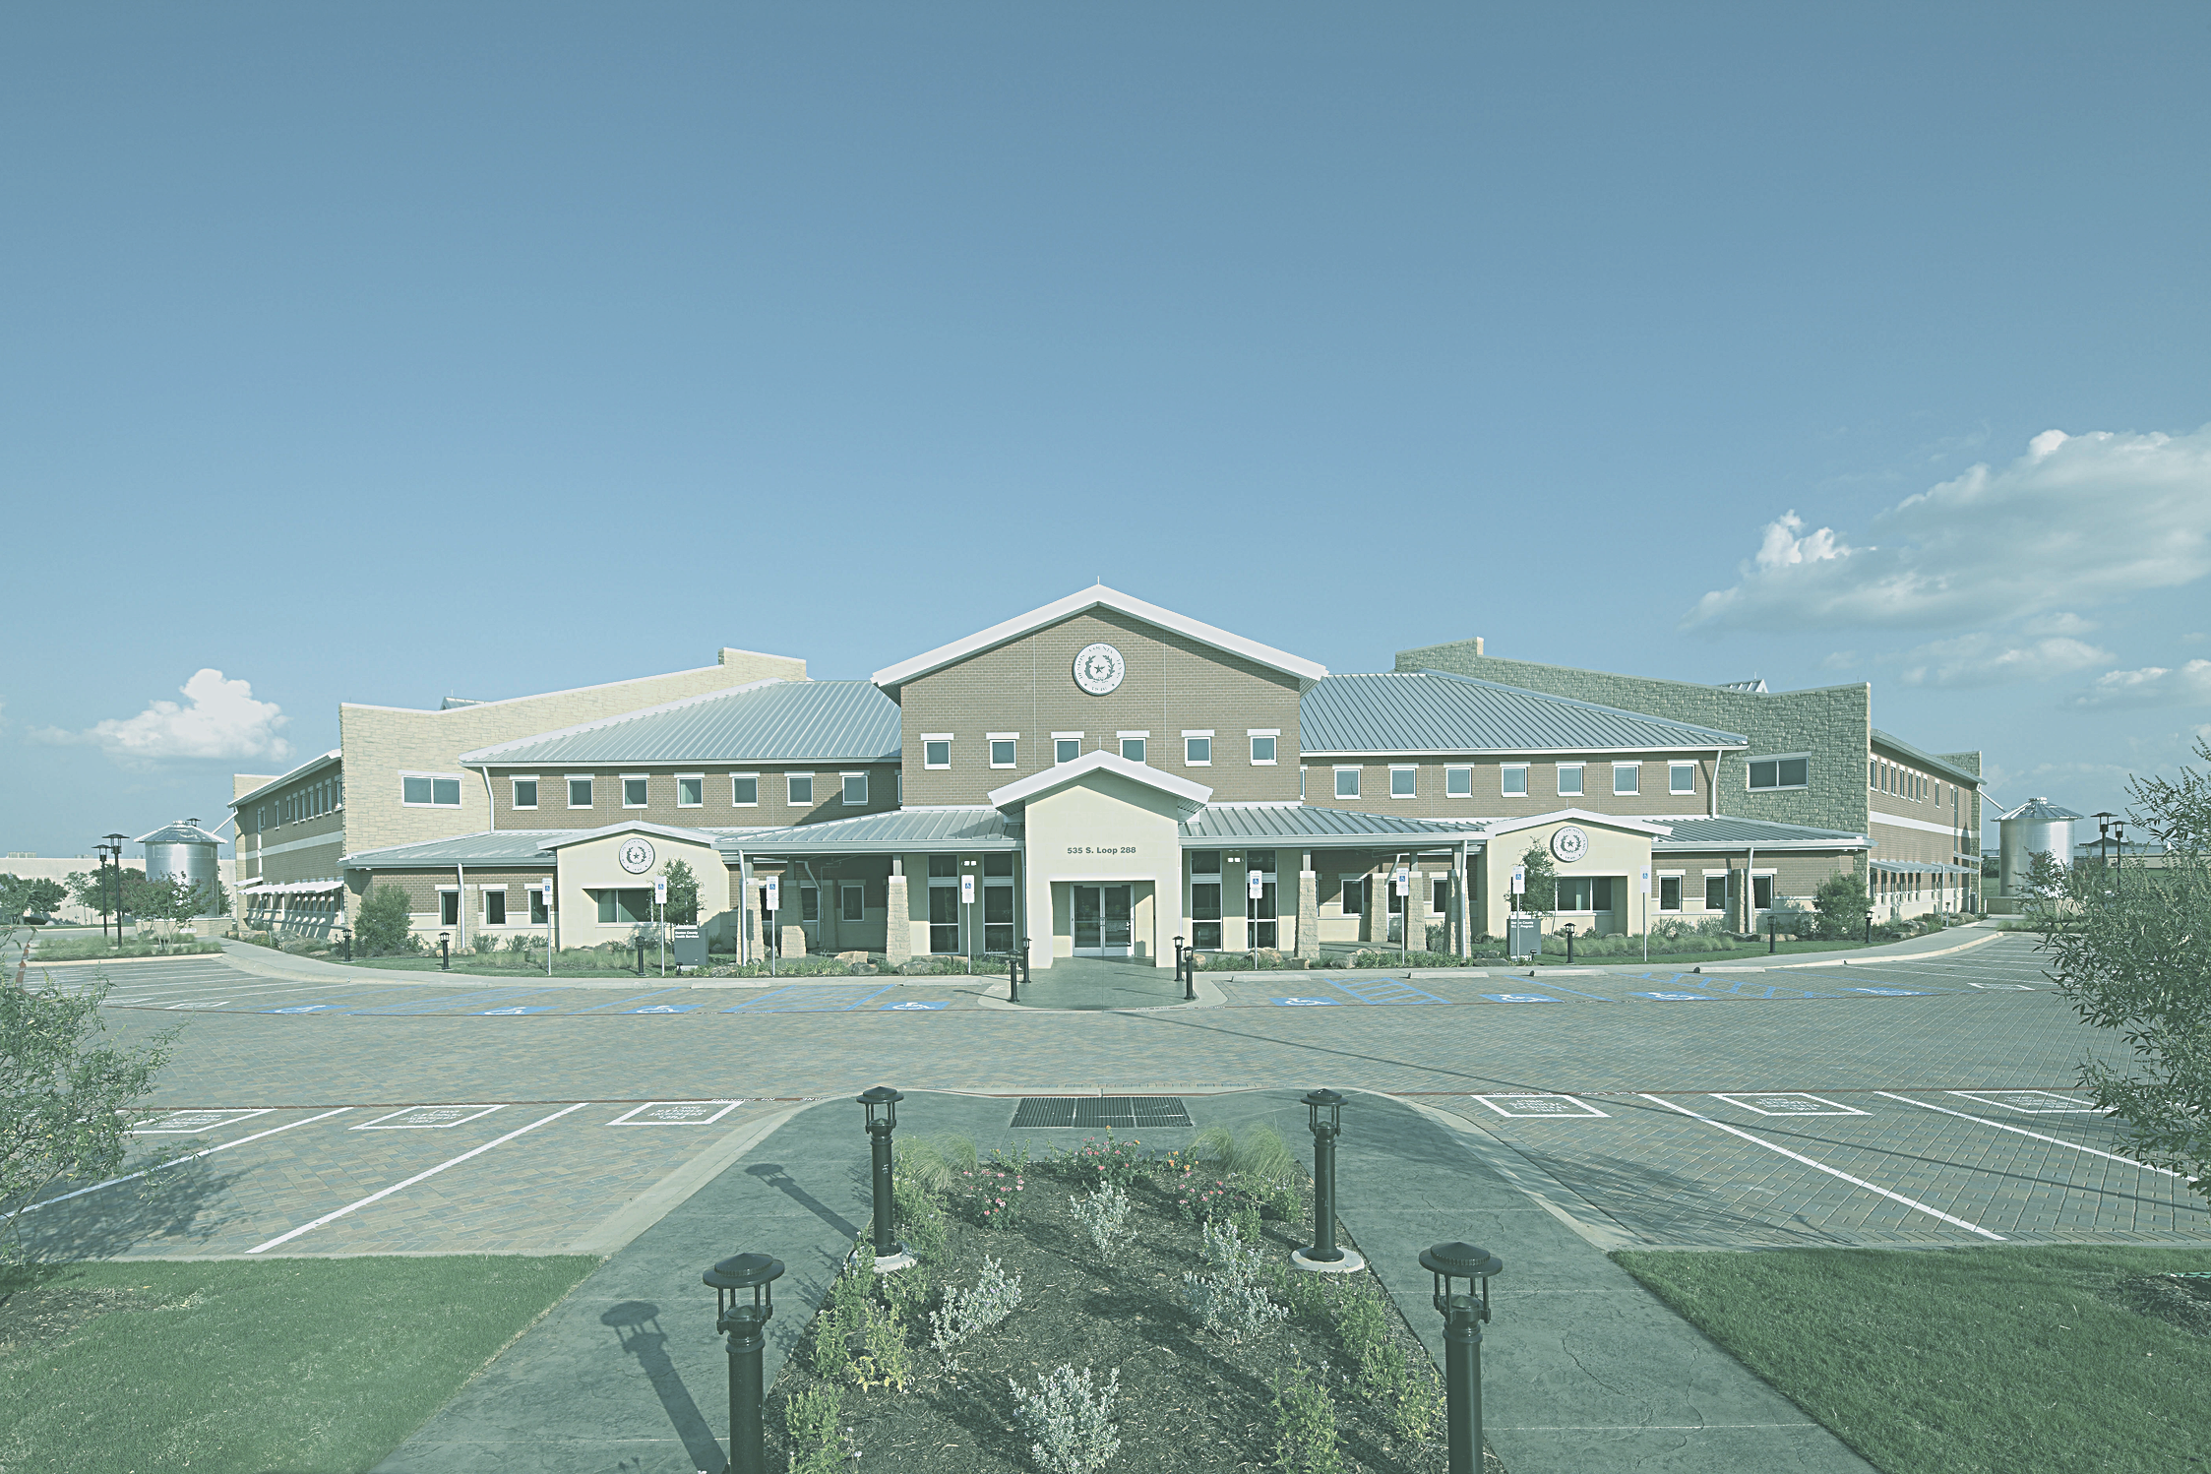

Connecting Communities to Care:
Public Health Tools for Mental Health Access
Presented By
Denton County Public Health
18 September, 2026

Slide 2
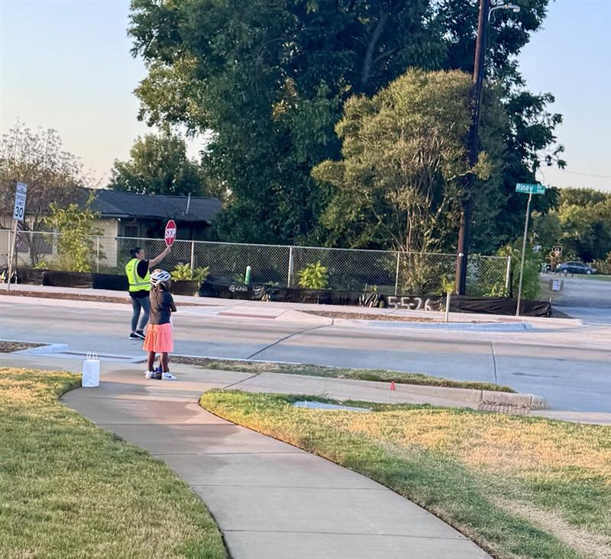
Meet the Reeves Elementary Crossing Guard

Slide 3
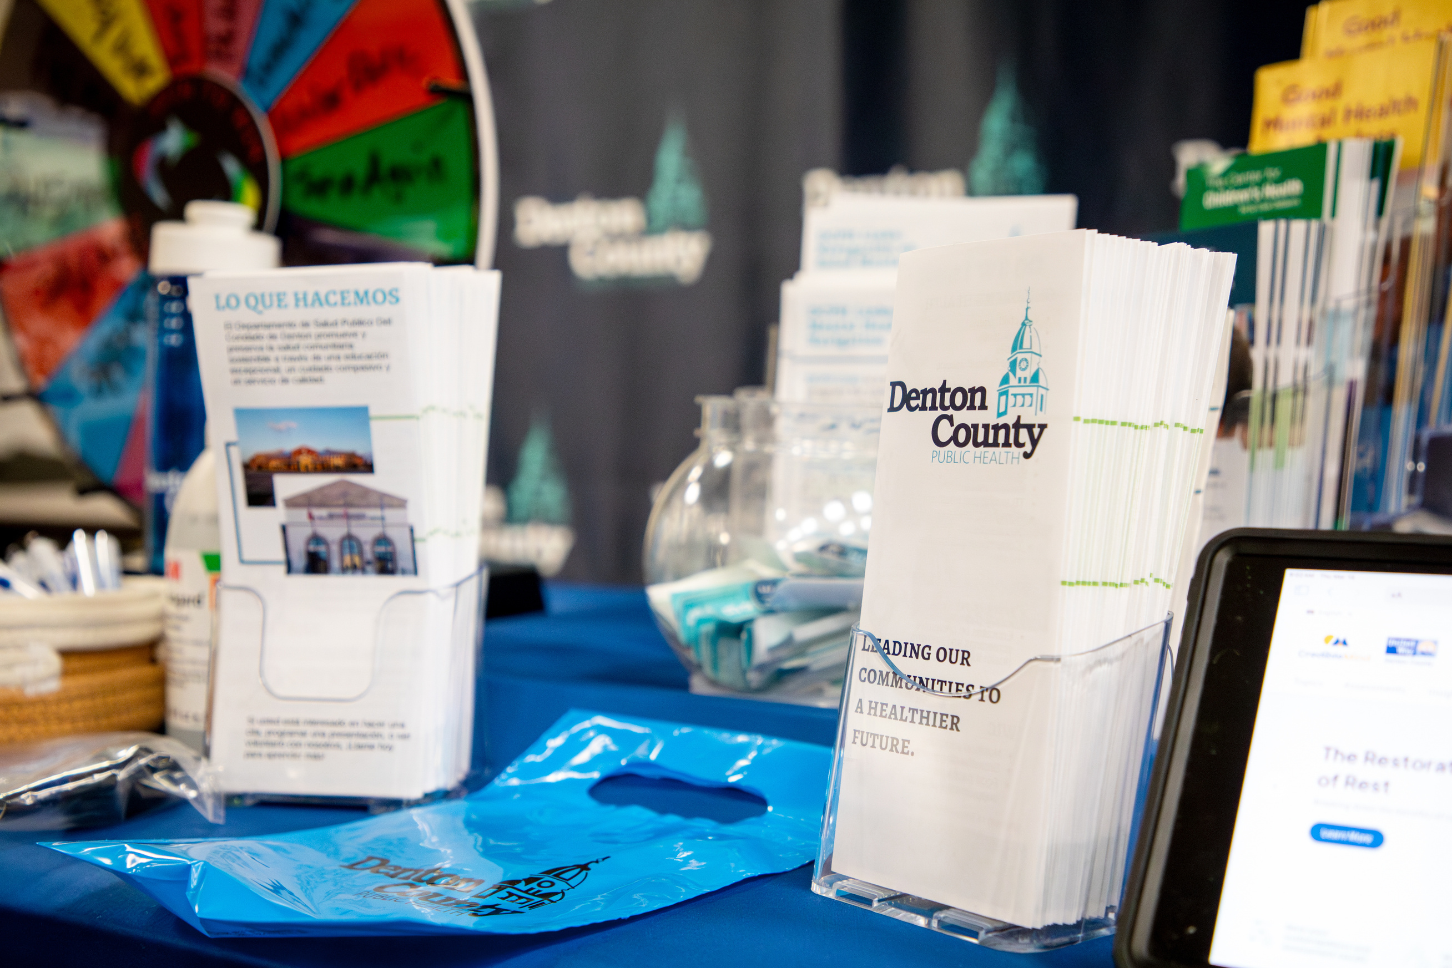
How can
we help?
Filling the Water Bottle
CredibleMind Platform
Carrying the Backpack
FindHelp Platform
Showing the Path
Mental Health Navigation Program

Slide 4
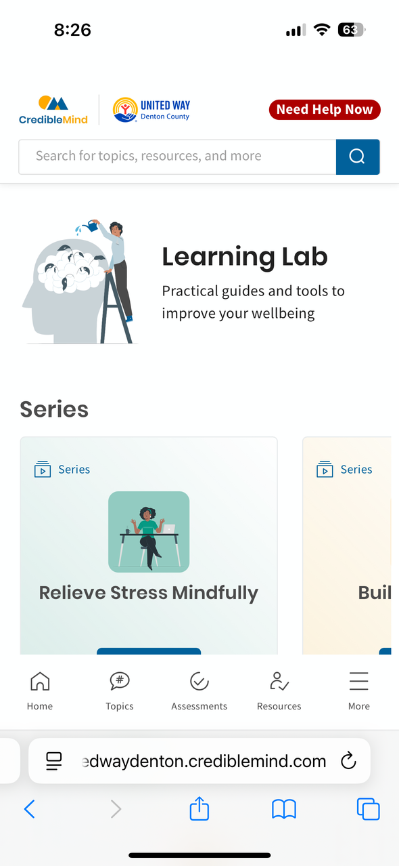
The Water Bottle
unitedwaydenton.crediblemind.com

Slide 5
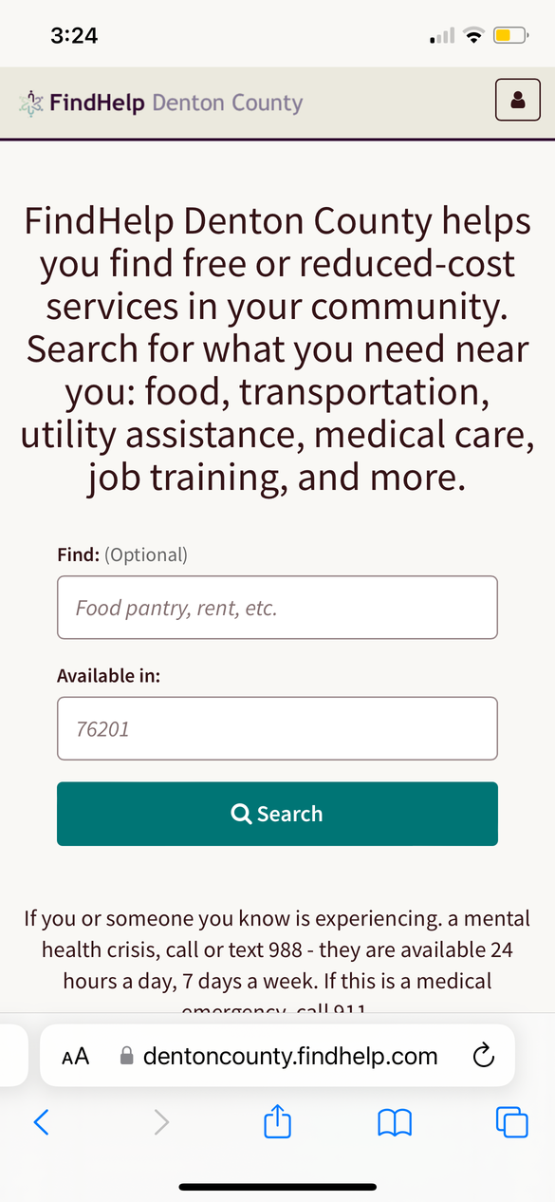

The Backpack
findhelp.dentoncounty.gov

Slide 6
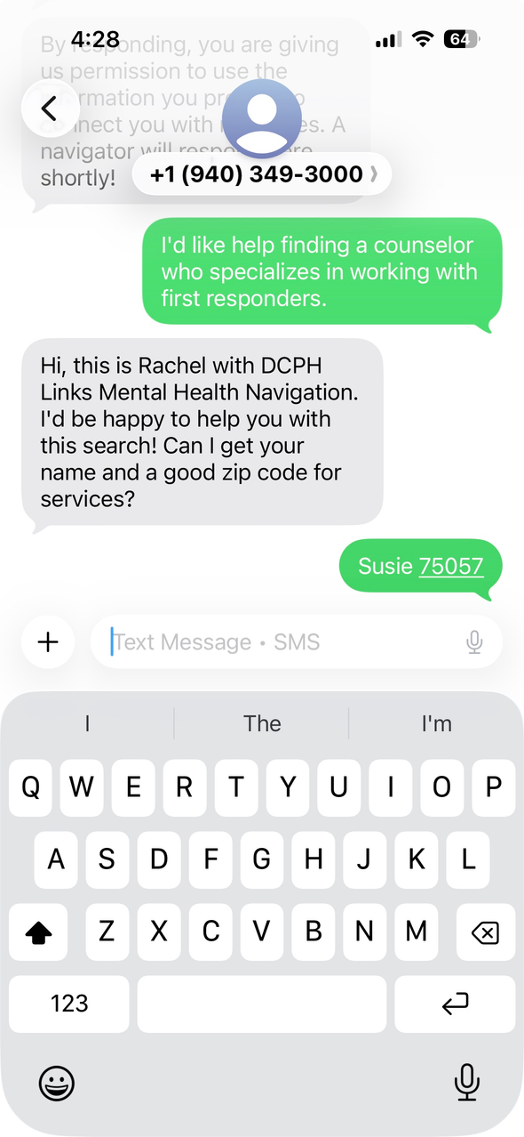

The Crosswalk

Slide 7
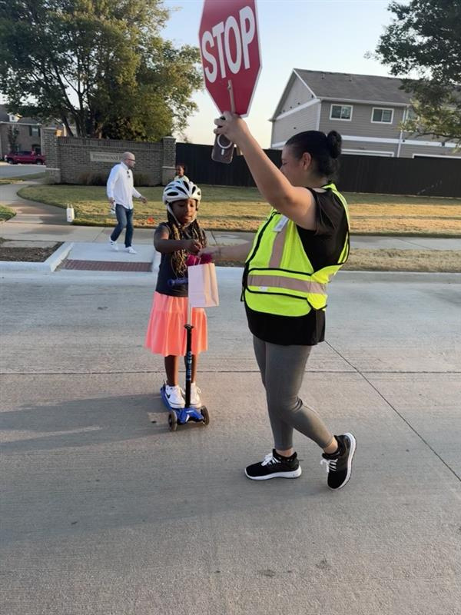
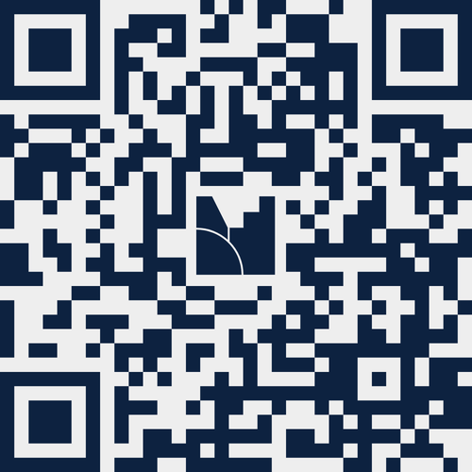
Thank you for all you do.
DCPHLinks@dentoncounty.gov
How can we make these tools more accessible to support your work?

