Slide 1
Overlooked Populations by the Numbers
Presented by:
Landon Dickeson, MS, LPC, C-DBT
Chief Operating Officer
Ranch Hands Rescue and Bob’s House of Hope

Slide 2
Foundational Definitions
Trauma: Any experience that overwhelms safety and coping
Post Traumatic Stress: Symptoms that occur in the aftermath of a traumatic experience
Complex Trauma: When traumatic experiences recur repeatedly over a period of time
  Complex trauma during key developmental periods disrupts the normal development of self-regulation, healthy communication, relationship formation, and self-concept
Complex PTSD: Chronic behavioral, emotional, cognitive, and interpersonal difficulties, as well as frequent somatic complaints, that significantly disrupt an individual’s ability to function across a range of domains

Slide 3
Foundational Definitions
Trauma-informed care seeks to:
  Realize the widespread impact of trauma and understand paths for recovery
  Recognize the signs and symptoms of trauma in patients, families, and staff
  Integrate knowledge about trauma into policies, procedures, and practices
  Actively avoid re-traumatization
Ethics: determining, systematizing, and recommending concepts of right and wrong behavior
  First, do no harm
Special Populations: refers to individuals who must overcome barriers that may require special consideration and attention to ensure equal opportunity for success in a treatment setting

Slide 4
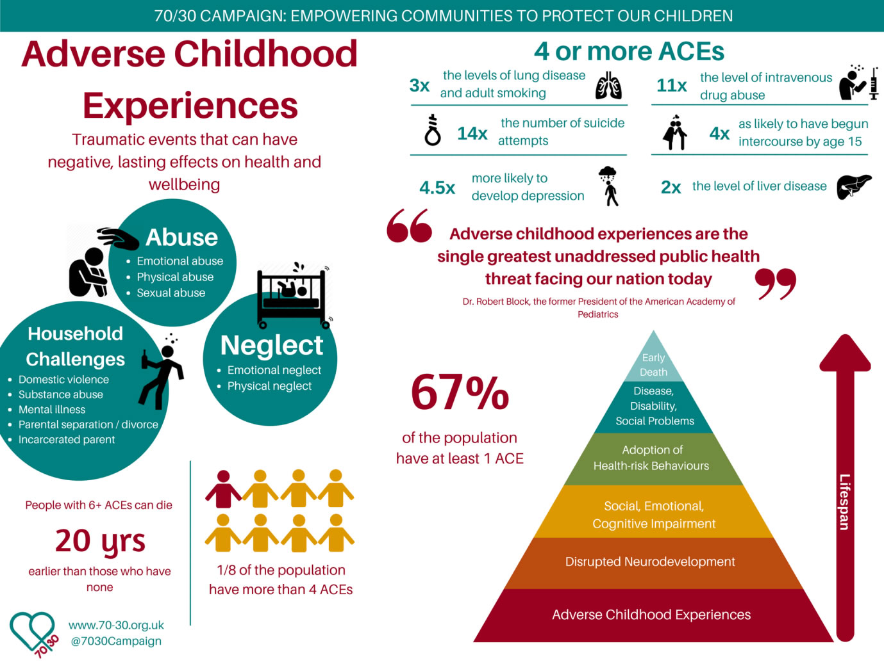
How Trauma Effects People
Anger, Irritability, Mood swings
Fear, Anxiety
Guilt, Shame, Blame
Isolation, Suicidal thoughts
Hopelessness, Depression
Disconnected, Numb, Dissociated
Intrusive thoughts, Nightmares, Flashbacks
Memory loss, Time loss
Disorientation, Confusion
Addiction, Self-harm

Slide 5
Assessing Trauma’s Impact
ACE Assessment
TSI
TSCC and TSCYC
MID
SASSI
C-SSRS
BDI
DES
GAD
TAA
CAPS
Biopsychosocial
Establishing a baseline
Assessing severity
Illuminating presenting concerns
  Destigmatize symptoms
Tracking progress
Evaluating treatment plateaus, emerging needs, and stuck points
Gauging readiness for graduation
Providing quantitative data to supplement qualitative reports

Slide 6
Ethical Treatment Decisions
Prioritize First, Do No Harm
Maintain holistic awareness
  Needs of the body, mind, and spirit
  Impact of all systems on the individual
Focus on individualized care
Access to research and evidenced based practices
Adherence to clear boundaries
Deference for individual autonomy
Protect confidentiality
Balance doing for and doing with
Follow all relevant laws and ethical guidelines

Slide 7
Overlooked Population:
Sex Trafficked Males
40%, or more, of CSEY victims are boys
  36% and underreported – DOJ
  38% and underreported – ECPAT
  40%+ from CSE-IT screenings in certain settings
70% of youth targeted for sexploitation are males
Average age of entry to CSE for boys is 15
  Often begins online, particularly via gaming platforms
51% of missing foster care youth are male
  Missing foster care youth are at the highest risk
Gay identifying youth are 3–7 times more likely to engage in survival sex, and they are 7 times more likely to experience acts of sexual violence than heterosexual peers

Slide 8
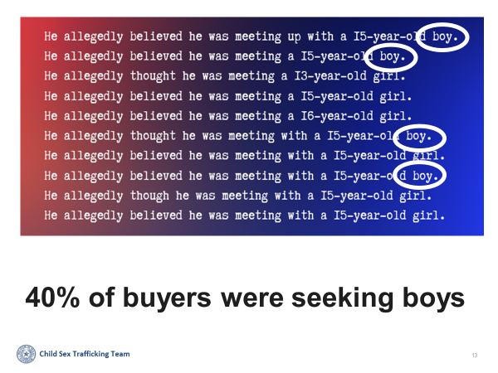
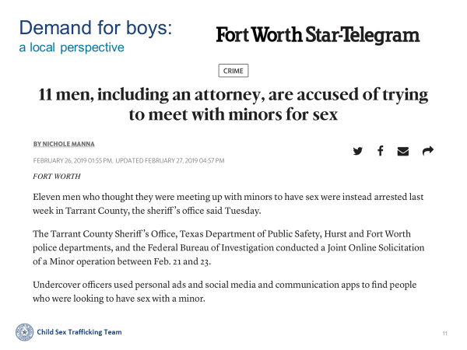
Overlooked Population:
Sex Trafficked Males

Slide 9
Overlooked Population:
Sex Trafficking Of Those With Disabilities
~6x more likely to be sex trafficked than those without
~4x more likely to be neglected and physically abused
Over 3x more likely to experience sexual abuse
Over 2x as likely to be victimized by violent crimes compared to children without disabilities
Physical impairment, ASD, IDD, and other functionally disabling disorders lead to increased risk for sexual exploitation
Extreme lack of research, assessment, and programming options for these populations

Slide 10
Overlooked Population:
Indigenous Youth
10% of the population (Indigenous Youth) represents up to 40% of trafficking victims in some areas of the country
25% of Native American teens have received offers involving sex trafficking via social media
25% of forced labor victims in the U.S. are Native American
  Cross-victimization and disproportionate representation
Man Camps

Slide 11
NCMEC Wake-Up Call Report (2025)
January to June 2025
Online Enticement: 518,720 (doubled from 2024)
Sadistic Online Enticement: 1,093 (doubled from 2024)
Financial Sextortion: 23,593 (doubled from 2024)
Generative Artificial Intelligence: 440,419 (up from 6,835 in 2024)
Child Sex Trafficking: 62,891 (up from 5,976 in 2024)

Slide 12
Challenges Unique to These Groups
Lack of resources
  Particularly demographically specific resources
Fear of law enforcement
  Bad experiences and fear indoctrination by abusers, family, and media
Cross- and Poly-victimization
  Victims often experience a combination of sex, drug, and/or labor trafficking
  Males are more likely to be identified with labor and drug trafficking statistics
Acculturation stress
Familial involvement in the abuse

Slide 13
Perception and Beliefs Among Male Victims
Stigma and shame (culture of silence): 84% of respondents
Beliefs related to masculinity (e.g., seeking help is a sign of 'weakness'): 71% of respondents
Fears about others' responses to disclosure (e.g., blaming, punishing, not believing, mocking): 79% of respondents
Reluctance to view themselves as victims (e.g., it only happens to girls): 79% of respondents
Negative attitudes, fears, or difficulties asking for help and support: 87% of respondents

Slide 14
Financial Impact
$236 Billion criminal industry
  Impacts at least 50 million people worldwide
  In 2023, traffickers profited more than the Fortune 500 businesses combined
Estimated worldwide cost of $39.3 trillion in lost productivity
~$1 billion annual cost for US anti-trafficking enforcement
84% of male survivors make less than $50,000 annually after exit from “the life”
Case example: $121k in failed treatment for one survivor over a 3-year period

Slide 15
Service Gaps
Lack of urgency in crisis response
  These populations tend to be highly transient, therefore “striking while the iron is hot” is paramount
Denial of services to high care needs
Limited access to long-term, wrap around care
Lack of clear systems navigation processes
Lack of knowledge of Complex PTSD among providers
Lack of resources for adults with severe comorbidities such as ASD, IDD, addiction, and PTSD

Slide 16
Questions And Recommendations
What are we missing?
How can we fill these identified gaps?
How do we improve access to services for victims/survivors?
We need more research on Complex PTSD AND the sex trafficking of males, GLBTQ, ethnic/racial minorities, and persons with disabilities
We need an official C-PTSD or Developmental PTSD diagnosis recognized in the DSM and by insurance providers
We need to develop treatment programs aimed specifically at addressing C-PTSD

Slide 17
References
Fischer, J (1999). The work of stabilization in trauma recovery. The Trauma Center Lecture Series.
Herman, J. L. (1997). Trauma and recovery. New York: BasicBooks.
Nichols, Andrea and Heil, Erin (2022) "Human Trafficking of People with a Disability: An Analysis of State and Federal Cases," Dignity: A Journal of Analysis of Exploitation and Violence: Vol. 7: Iss. 1, Article 1. DOI: 10.23860/dignity.2022.07.01.01
Van, . K. B. A. (2014). The body keeps the score: Brain, mind, and body in the healing of trauma.
https://polarisproject.org/2019-us-national-human-trafficking-hotline-statistics/
ECPAT-USA (2016). And boys too. New York.
Davis, J., & Filoteo, M. (2024). "And Minnesota Boys, Too": Meeting the Needs of Sexually Exploited Boys and Young Men in Minnesota. PACT
https://www.dhs.gov/science-and-technology/news/2020/03/18/snapshot-combatting-human-trafficking-analytics
https://www.usatoday.com/story/news/investigations/2019/07/29/12-trafficking-statistics-enormity-global-sex-trade/1755192001/
https://www.cdc.gov/violenceprevention/aces/index.html
Spike in online crimes against children a “wake-up call”

